Slide 1
Portfolio Performance Evaluation
18
Bodie, Kane, and Marcus
Essentials of Investments, 9th Edition

Slide 2
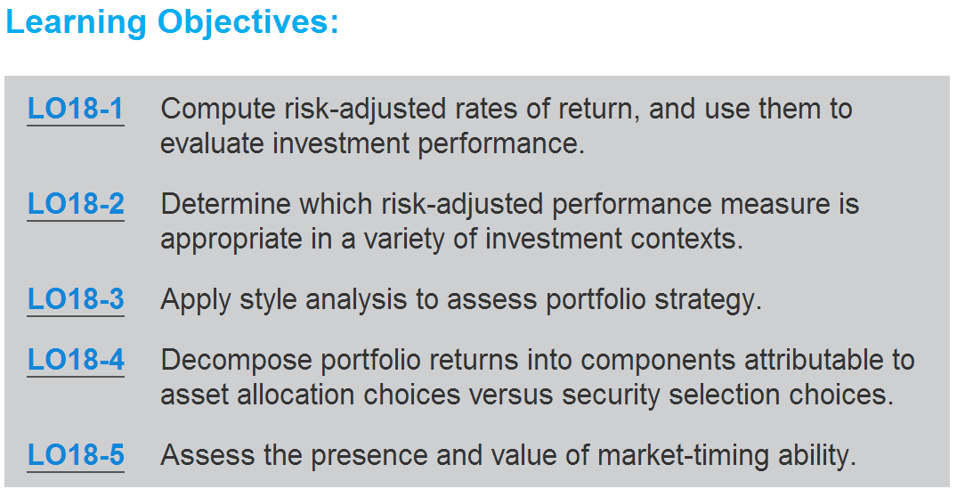

Slide 3
KEY TERMS
active management, 597
alpha capture, 604
alpha transfer or alpha transport, 604
bogey, 612
cash, 597
comparison universe, 598
fund of funds, 601
information ratio, 602
Jensen measure, 603
M-square (M²), 600
market timing, 617
passive management, 597
Sharpe ratio, 599
survivorship bias, 611
Treynor measure, 602

Slide 4
18.1 Investment Clients, Service Providers, Objectives of Performance Evaluation
Passive Management
  Diversified portfolio with no security mispricing identification
Cash
  Virtually risk-free money market securities
Active Management
  Forecasting broad markets and/or identifying mispriced securities to achieve higher returns
Market Timing
  Relative performance drives fund movement between risky portfolio and cash

Slide 5
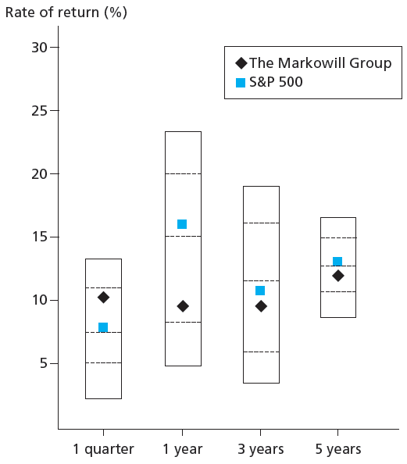
Figure 18.1 Universe Comparison

Slide 6
18.1 Investment Clients, Service Providers, Objectives of Performance Evaluation
Comparison Universe
  Set of portfolio managers with similar investment styles used to assess relative performance

Slide 7
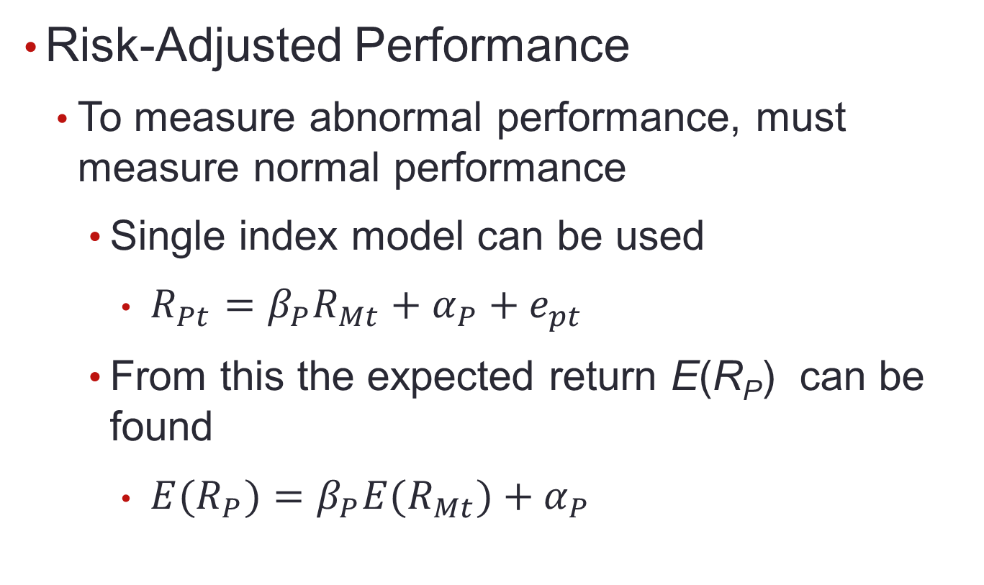
18.1 Investment Clients, Service Providers, Objectives of Performance Evaluation

Slide 8
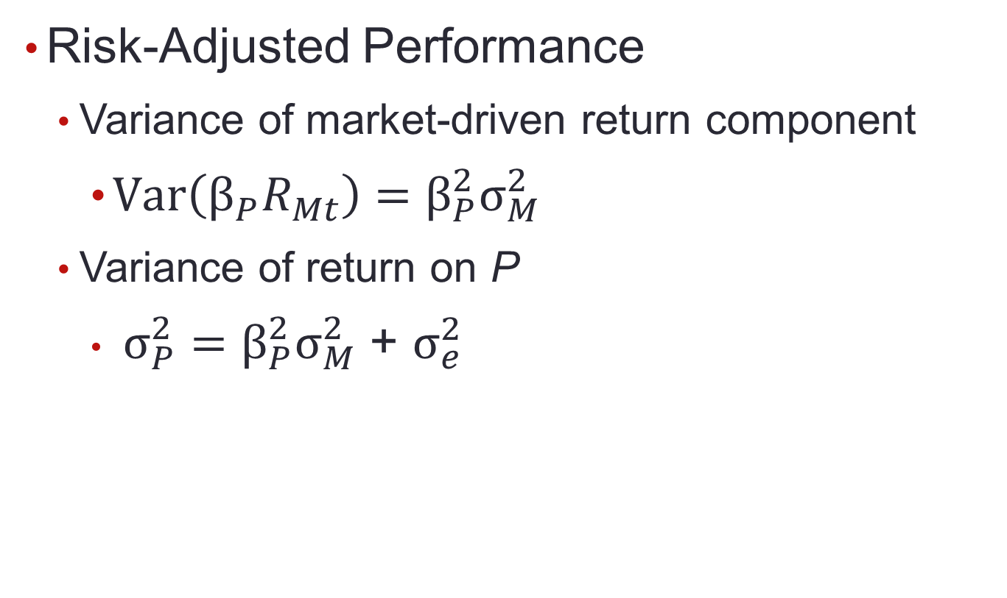
18.1 Investment Clients, Service Providers, Objectives of Performance Evaluation

Slide 9
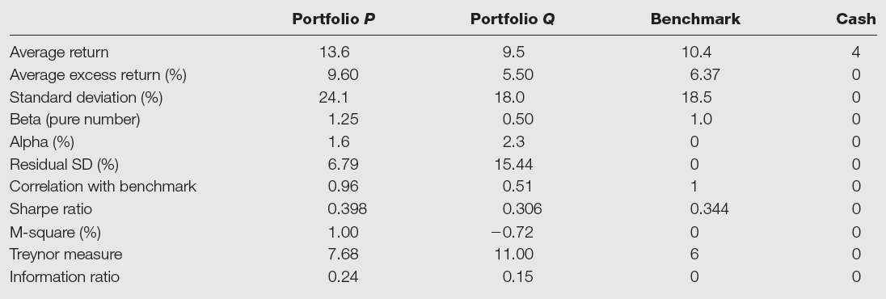
Table 18.1 Performance of Two Managed Portfolios

Slide 10
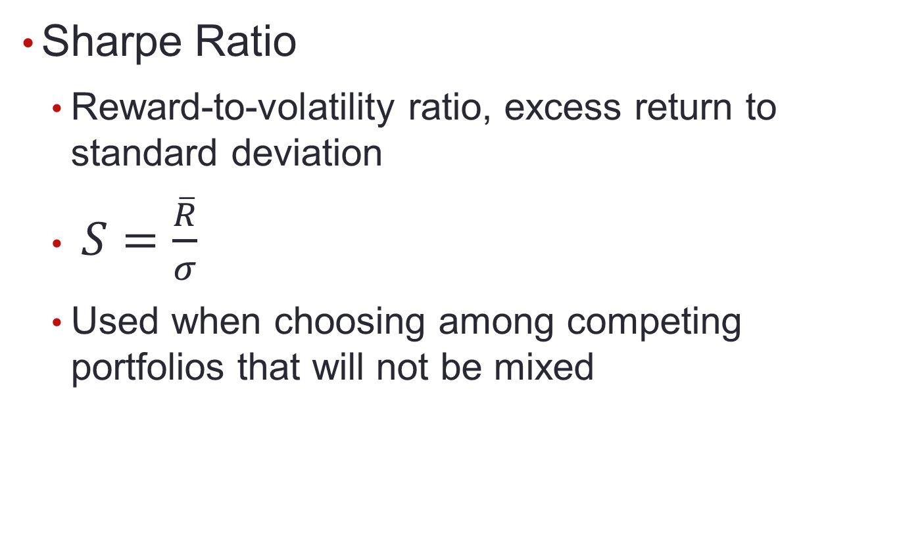
18.1 Investment Clients, Service Providers, Objectives of Performance Evaluation

Slide 11
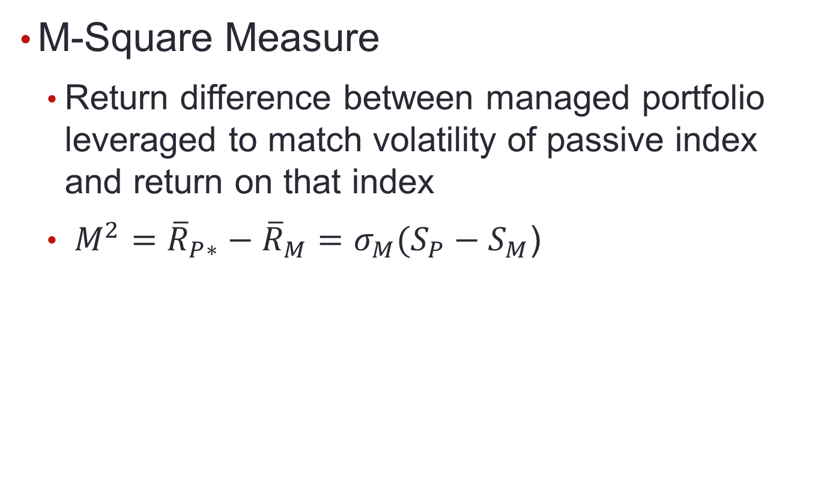
18.1 Investment Clients, Service Providers, Objectives of Performance Evaluation

Slide 12
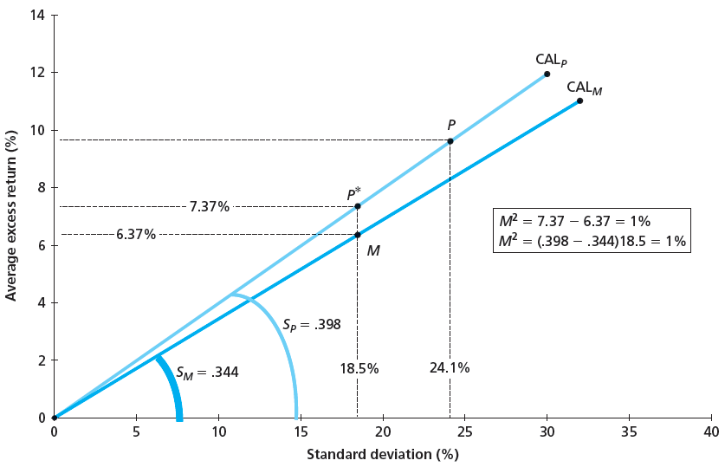
Figure 18.2 M² of Portfolio

Slide 13
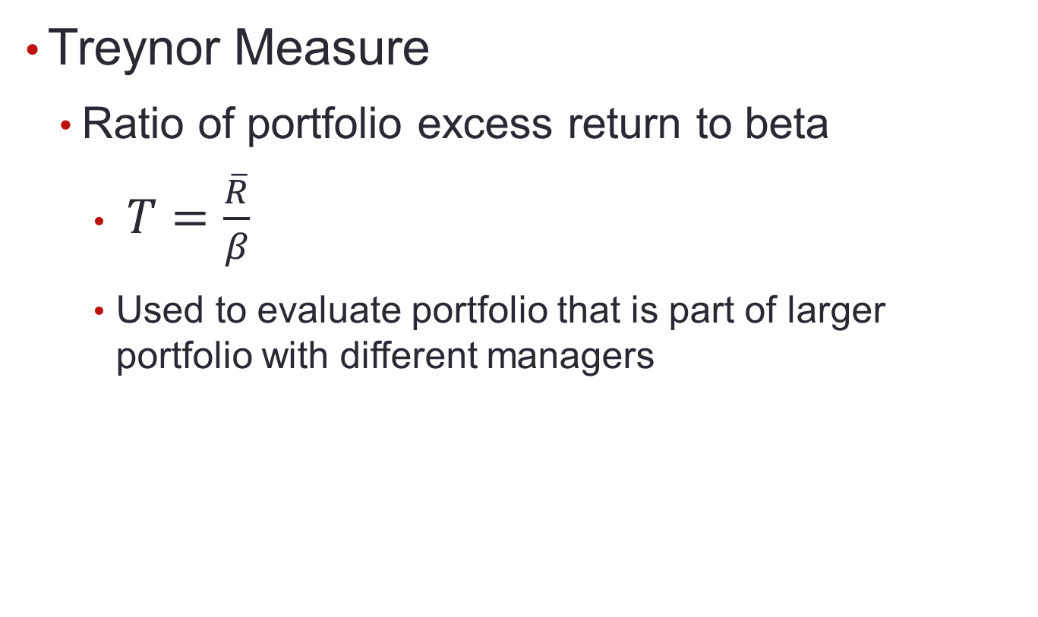
18.1 Investment Clients, Service Providers, Objectives of Performance Evaluation

Slide 14
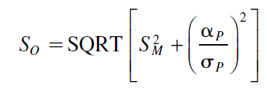
18.1 Investment Clients, Service Providers, Objectives of Performance Evaluation
Information Ratio
  Ratio of alpha to standard deviation of diversifiable risk

Slide 15
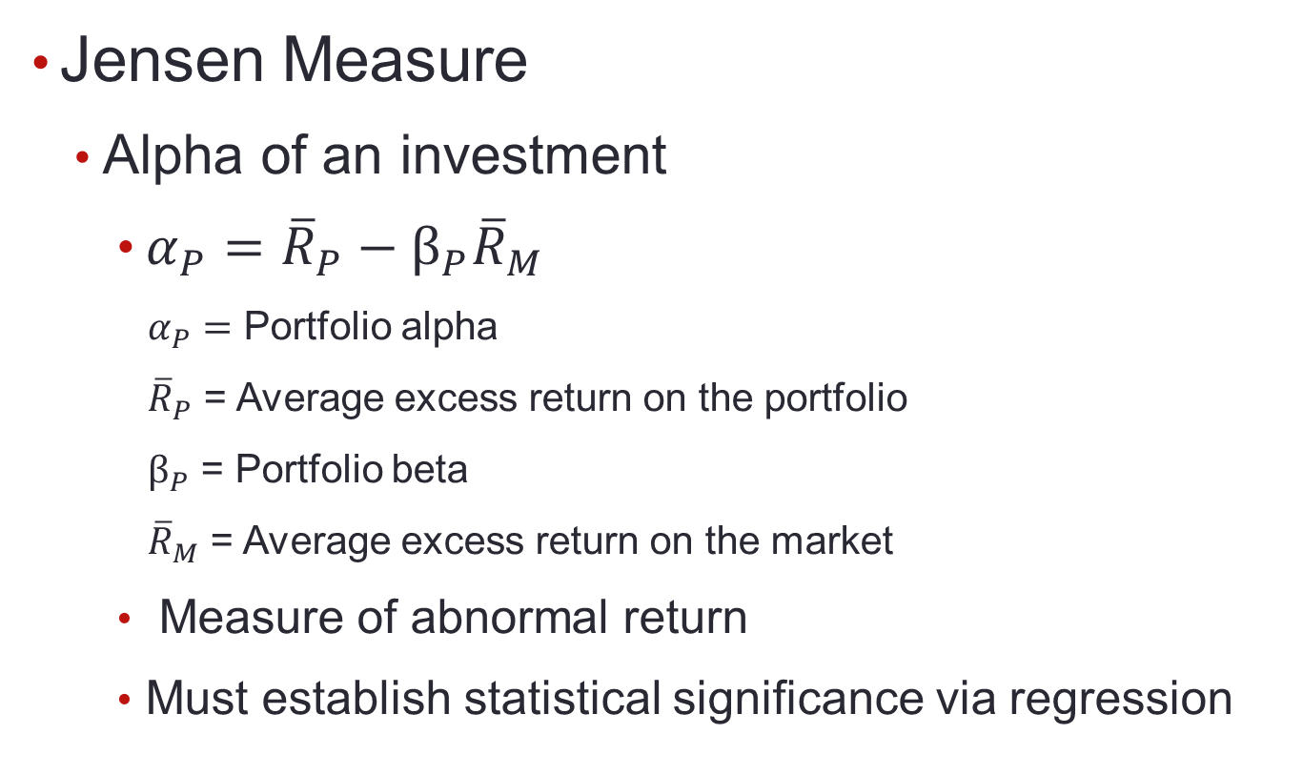
18.1 Investment Clients, Service Providers, Objectives of Performance Evaluation

Slide 16
18.1 Investment Clients, Service Providers, Objectives of Performance Evaluation
Alpha Capture and Transport
  Alpha transport
    Establishing alpha while using index products to both hedge market exposure and establish exposure to desired sectors
  Alpha capture
    Construction of positive-alpha portfolio with systematic risk hedged away

Slide 17
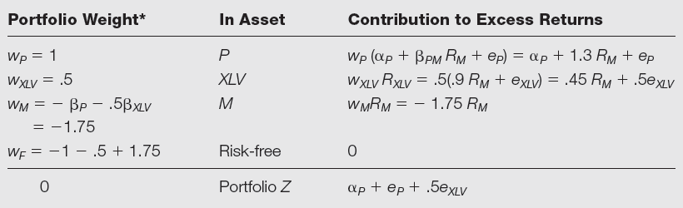
Table 18.2 Alpha Capture/Transfer, Healthcare Sector
*If P ’s alpha is negative, then reverse the sign of w_{P} and adjust the signs of w_{M} and w_{F}.

Slide 18
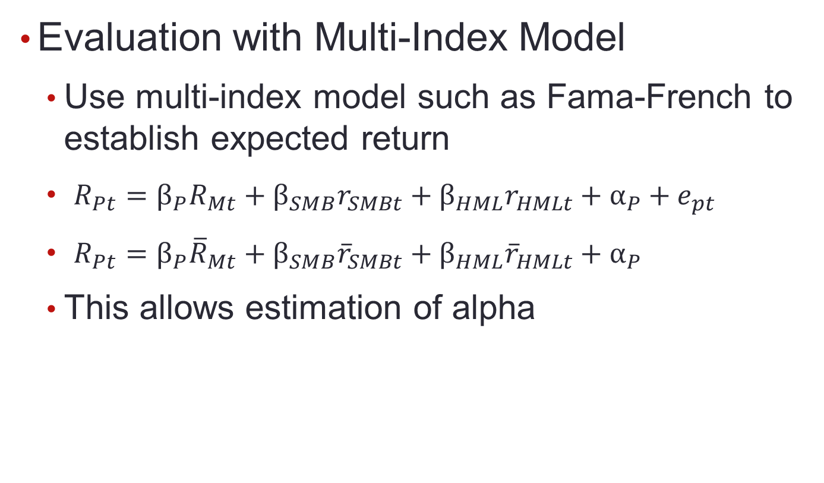
18.1 Investment Clients, Service Providers, Objectives of Performance Evaluation

Slide 19
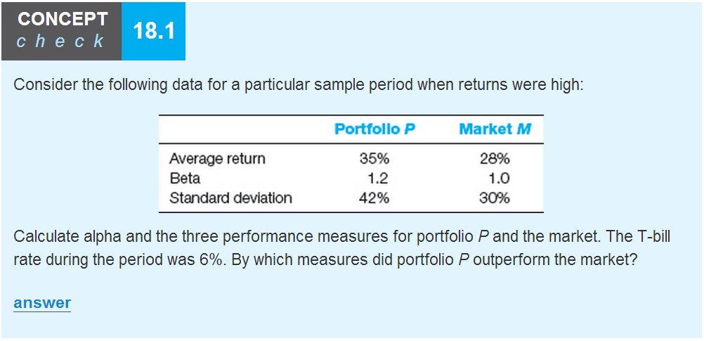

Slide 20
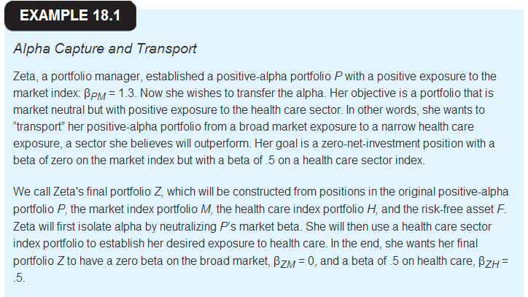

Slide 21
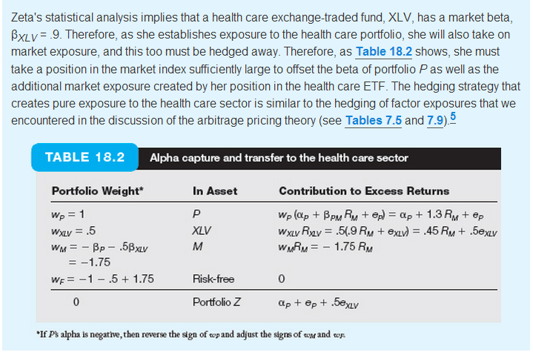

Slide 22
18.2 Style Analysis
Complex method of performance evaluation introduced by William Sharpe
Recent studies of mutual fund performance show > 90% of return variation can be explained by funds’ allocations to T-bills, stocks, and bonds

Slide 23
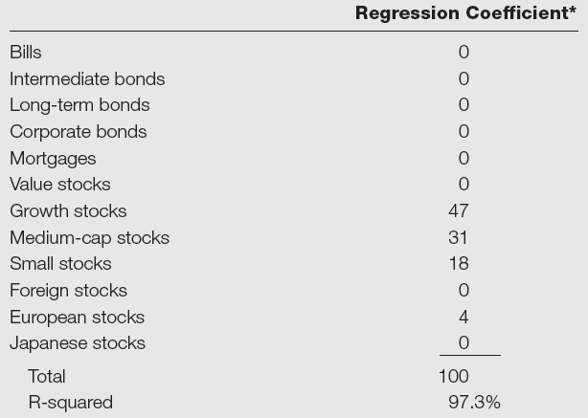
Table 18.3 Sharpe’s Style Portfolios for Magellan Fund
*Regressions are constrained to have nonnegative coefficients and to have coefficients that sum to 100%.

Slide 24
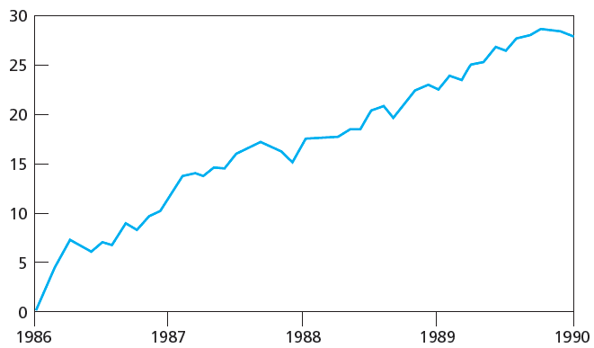
Figure 18.3 Fidelity Magellan Fund Cumulative Return Difference versus Style Benchmark

Slide 25
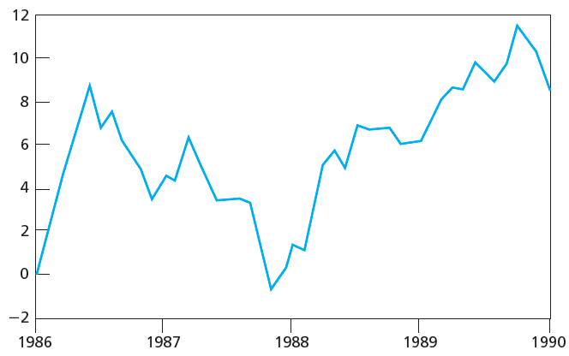
Figure 18.4 Fidelity Magellan Fund Cumulative Return Difference versus S&P 500

Slide 26
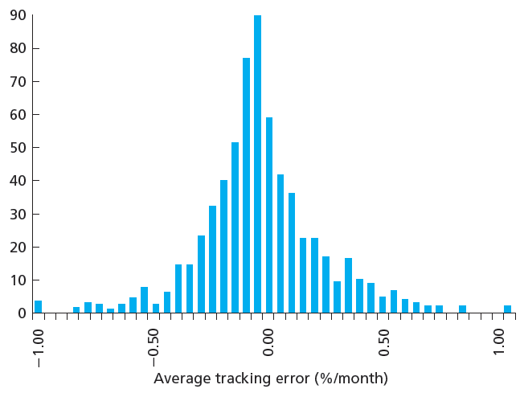
Figure 18.5 Average Tracking Error, 636 Mutual Funds, 85-89

Slide 27
18.3 Morningstar’s Risk-Adjusted Rating
Company peer groups established based on Morningstar style definitions
Risk-adjusted performance ranked; then stars assigned according to table
Percentile | Stars
0-10 | 1
10-32.5 | 2
32.5-67.5 | 3
67.5-90 | 4
90-100 | 5

Slide 28
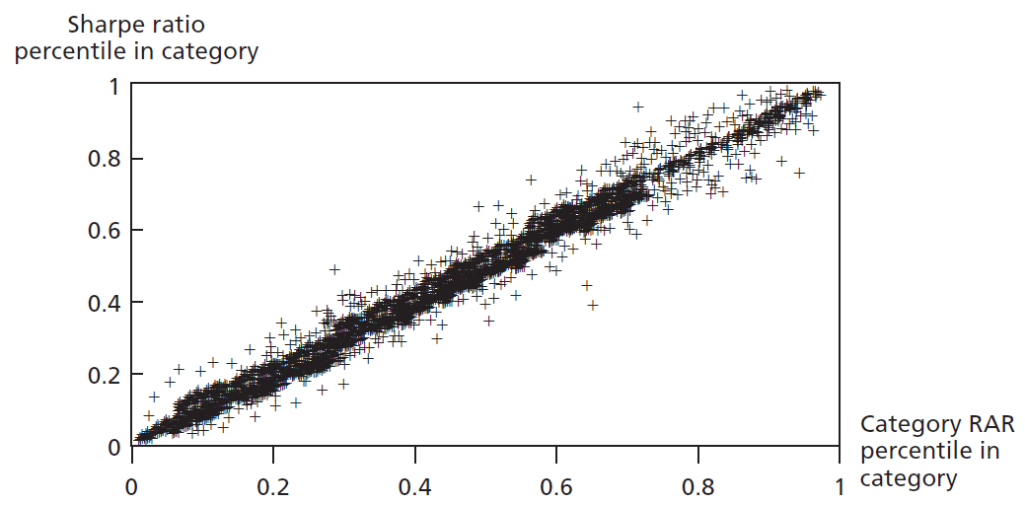
Figure 18.6 Rankings Based on Morningstar’s Category RARs and Excess Return Sharpe Ratios

Slide 29
18.4 Risk Adjustments with Changing Portfolio Composition
Problems with Performance Measures
  Assume fund maintains constant level of risk
    Particularly problematic for funds engaging in active asset allocation
  In large universe of funds, some will have abnormal performance each period by chance
  Survivorship bias
    Upward bias in average fund performance due to failure to account for failed funds over sample period

Slide 30
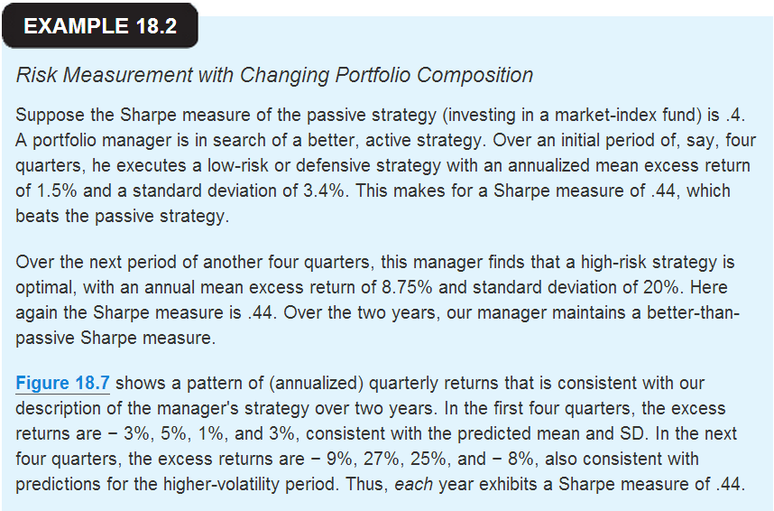

Slide 31
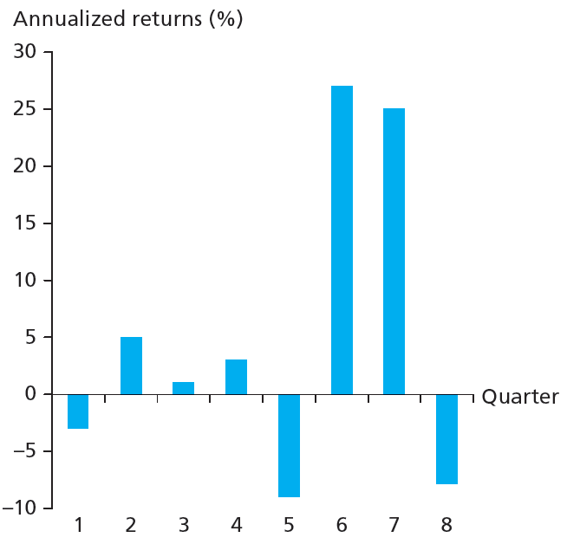
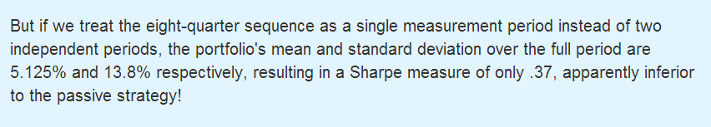
Figure 18.7 Portfolio Returns

Slide 32
18.5 Performance Attribution Procedures
Decomposing overall performance into components
  Determined by specific portfolio choices
    Broad asset allocation among types of securities
    Industry weighting in equity portfolio
    Security choice
    Timing

Slide 33
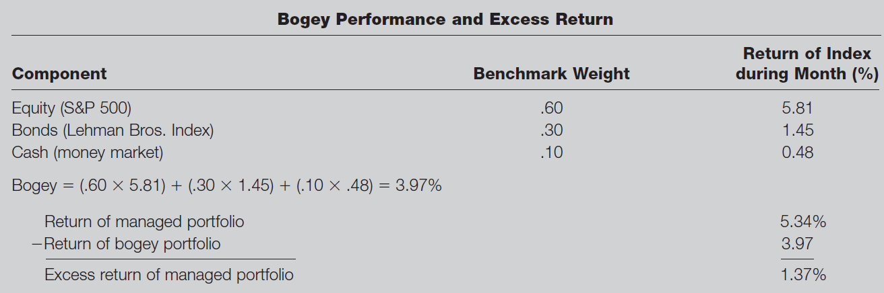
Table 18.4 Performance of Managed Portfolio
Bogey
  Benchmark portfolio comprised of three indexes with given weights
    Bogey return represents return on unmanaged portfolio
    Weights represent standard portfolio for typical risk tolerance of given type of client or typical fund in category

Slide 34
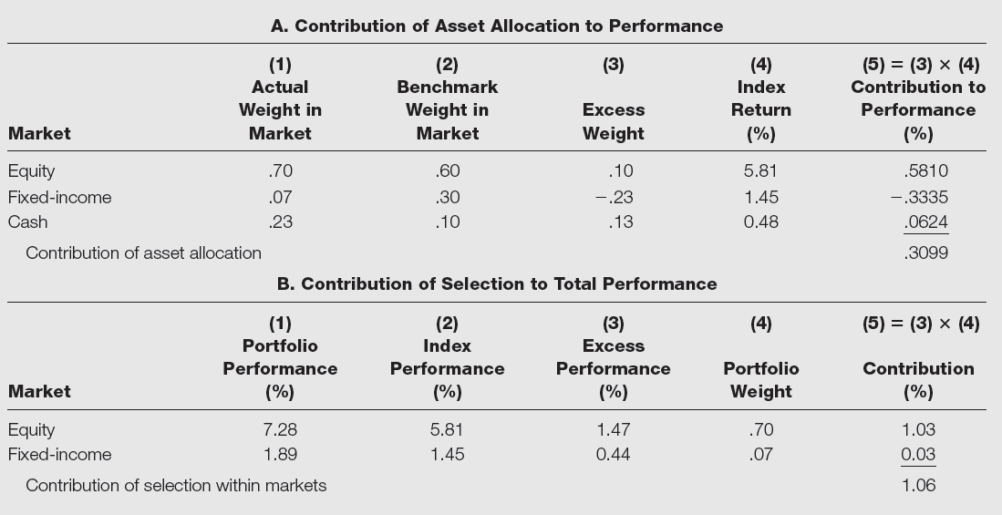
Table 18.5 Performance Attribution

Slide 35
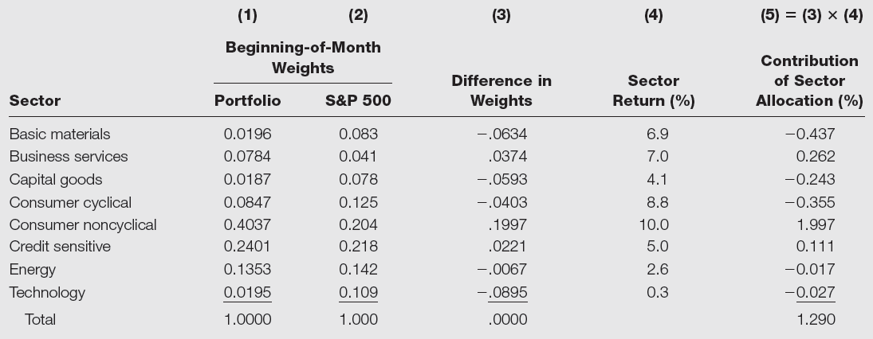
Table 18.6 Sector Allocation within Equity Market

Slide 36
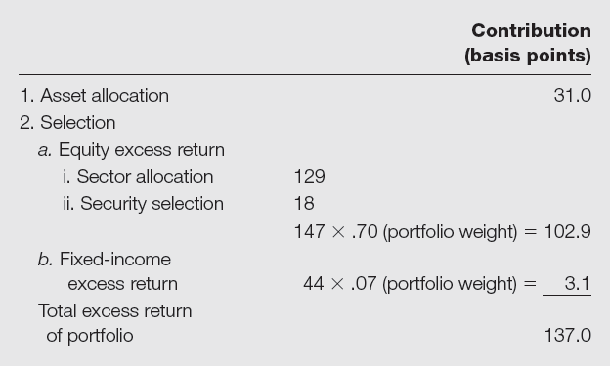
Table 18.7 Portfolio Attribution: Summary

Slide 37
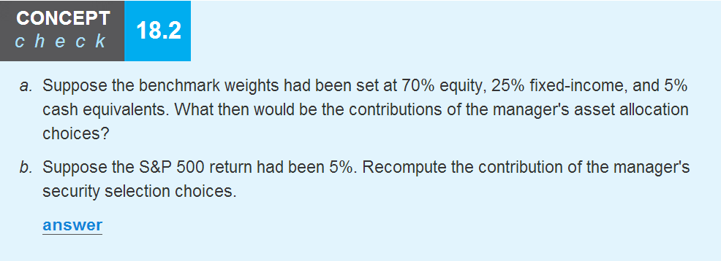

Slide 38
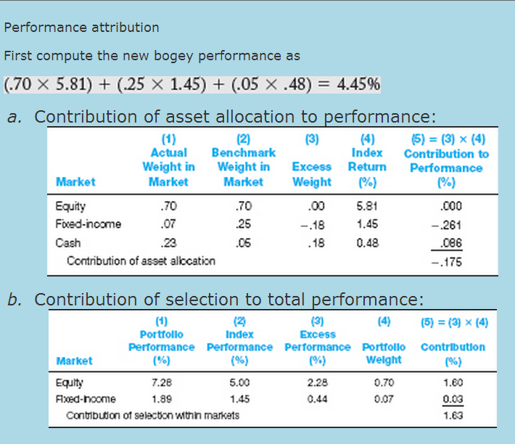

Slide 39
18.6 Market Timing
Adjust asset allocation for movements in market
  Shift between stocks and money market instruments or bonds
  Behaves like an option if one has perfect ability to forecast
  Little evidence of market-timing ability

Slide 40
Market Timing
With Imperfect Ability to Forecast
  Takes long time horizon to judge ability
  Judge proportions of correct calls
    Bull market and bear market calls

Slide 41
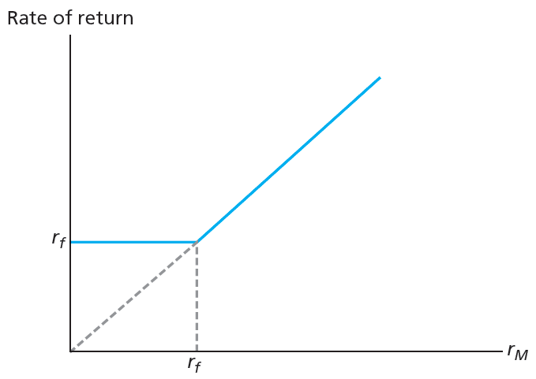
Figure 18.8 RoR of Perfect Market Timer

Slide 42
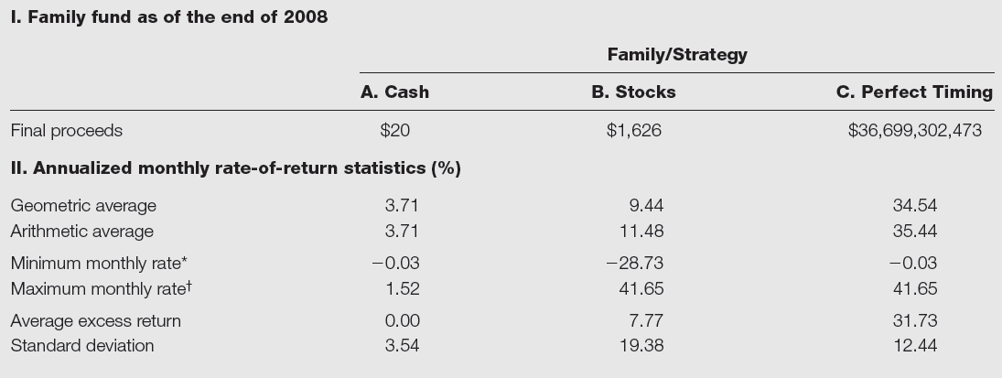
Table 18.8 Performance of Cash, Stocks, and Perfect Timing Strategies

Slide 43
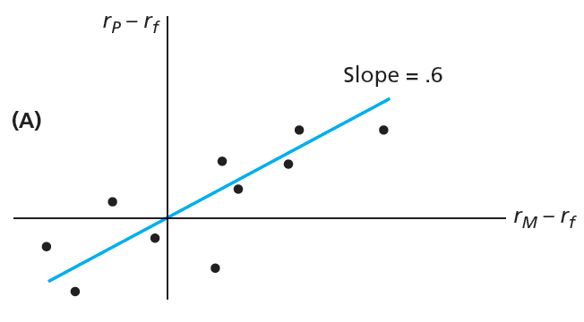
Figure 18.9A Characteristic Lines

Slide 44
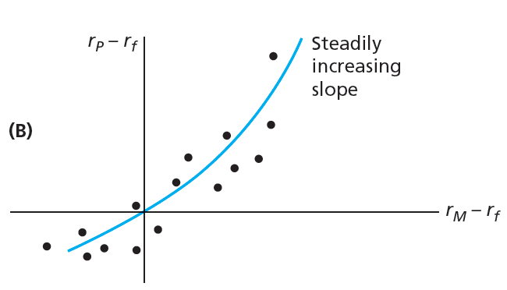
Figure 18.9B Characteristic Lines

Slide 45
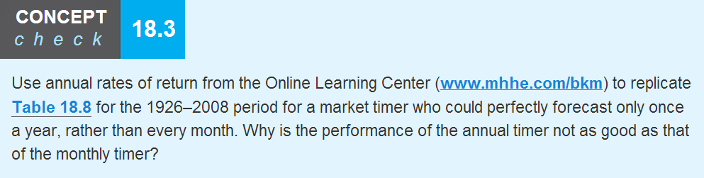
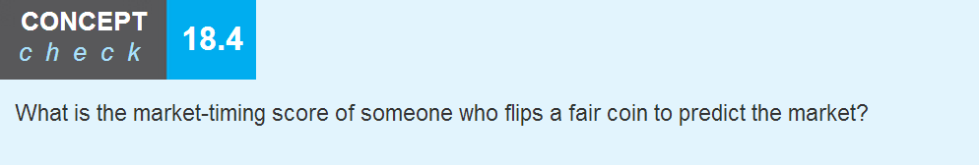

Slide 46
