Slide 1
Hedge Funds
20
Bodie, Kane, and Marcus
Essentials of Investments, 9th Edition

Slide 2

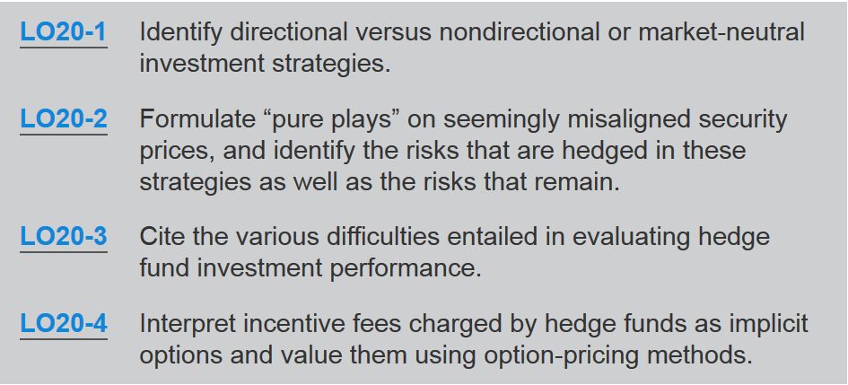

Slide 3
20.1 Hedge Funds versus Mutual Funds
 | Mutual Funds | Hedge Funds
Transparency | Public info on portfolio composition | Info provided only to investors
Investors | Unlimited | < 100, high dollar minimums
Strategies | Must adhere to prospectus, limited short selling & leverage, limited derivatives usage | No limitations

Slide 4
20.1 Hedge Funds versus Mutual Funds
 | Mutual Funds | Hedge Funds
Liquidity | Redeem shares on demand | Multiple year lock-up periods typical
Fees | Fixed percentage of assets; typically .5% to 2% | Fixed percentage of assets; typically 1% to 2% plus incentive fee = 20% of gains above threshold return

Slide 5
20.2 Hedge Fund Strategies
Directional and Nondirectional Strategies
  Directional strategy
    Speculation that one market sector will outperform others
  Nondirectional strategy
    Designed to exploit temporary misalignments in relative pricing; typically involves long position in one security hedged with short position in related security

Slide 6
20.2 Hedge Fund Strategies
Directional and Nondirectional Strategies
  Market neutral
    Designed to exploit relative mispricing within market; hedged to avoid taking stance on direction on broad market
  Pure plays
    Bets on particular mispricing across two or more securities; extraneous sources of risk hedged away

Slide 7
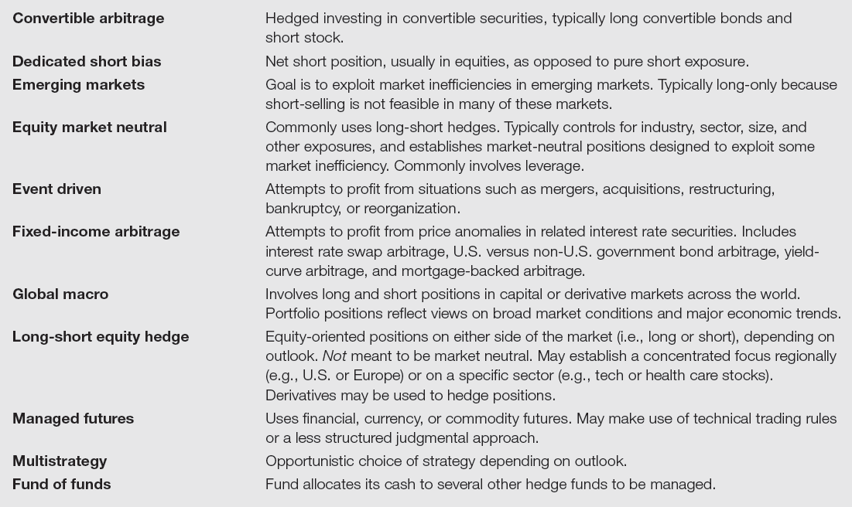
Table 20.1 Hedge Fund Styles

Slide 8
20.2 Hedge Fund Strategies
Statistical Arbitrage
  Use of quantitative system to uncover perceived misalignments in relative pricing and ensure profit by averaging over these bets
  Pairs trading
    Pairing of stocks based on similarities; long-short positions established to exploit mispricing between each
  Data mining
    Sorting through large amounts of historical data to uncover patterns to exploit

Slide 9
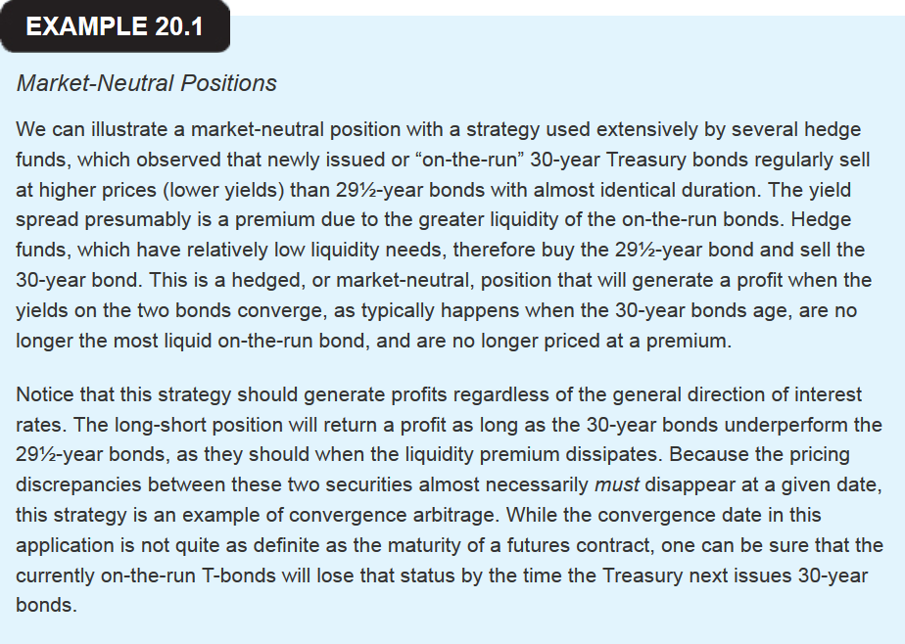

Slide 10
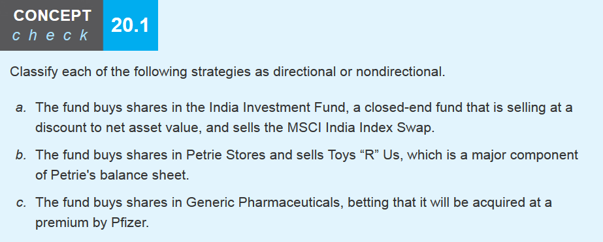

Slide 11
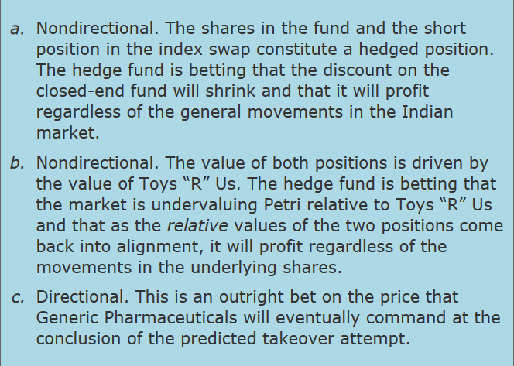

Slide 12
20.3 Portable Alpha
Alpha Transfer
  Invest in positive-alpha positions, hedge systematic risk of investment, and establish market exposure where desired using passive indexes

Slide 13
20.3 Portable Alpha
Pure Play Example
  Find a portfolio with α_{P} > 0, but r_{M} < 0
  We wish to hedge by selling stock-index futures. How many contracts should we sell if we have a $1,500,000 portfolio?
  β = 1.20 α = .02 rf = .01
  S&P 500 Index = 1,200 Futures multiplier = 250

Slide 14
20.3 Portable Alpha
Pure Play Example
  Futures position value = 6 × 250 × (F₀ − F₁)
  F₀ = 1.01S₀ from spot futures parity model
  F₁ = S₁ because of convergence of spot and futures prices at contract maturity, substituting into the future’s position value formula:
  6 x 250 × (1.01S₀ – S₁)
  S₁ = S₀(1 + r_{M}); The market moves by r_{M} so we now have:
    6 x 250 × (1.01S₀ – S₀(1 + r_{M}))
    1,500 × (800(.01 – r_{M})) = $18,000 – $1,800,000r_{M}

Slide 15
20.3 Portable Alpha
Pure Play Example
  Spot futures position combined
  = 1,500 × (S₀(.01 – r_{M}))
  recall S₀ = 1,200 so

Slide 16
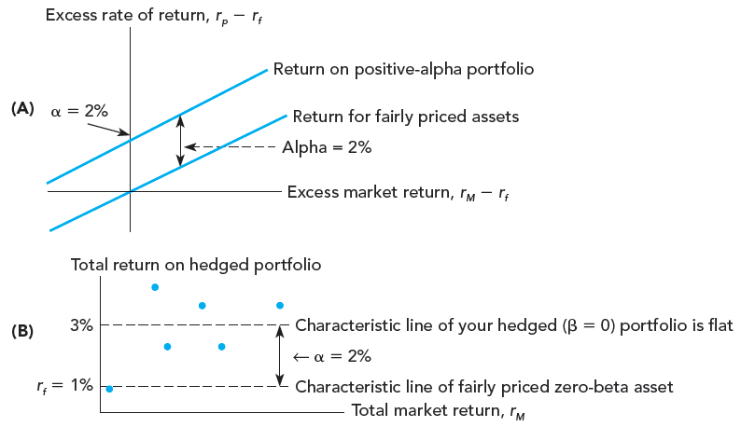
Figure 20.1 Pure Play

Slide 17
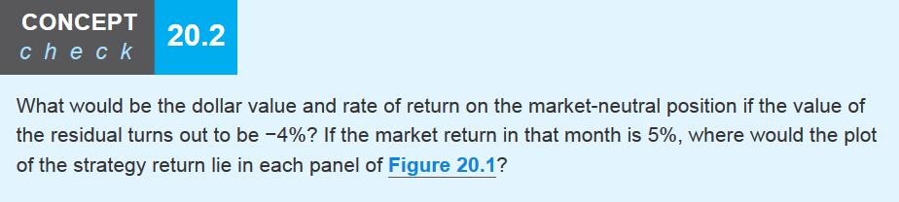
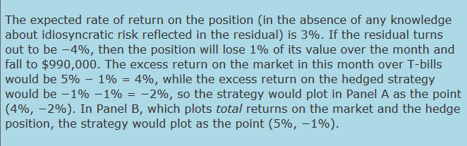

Slide 18
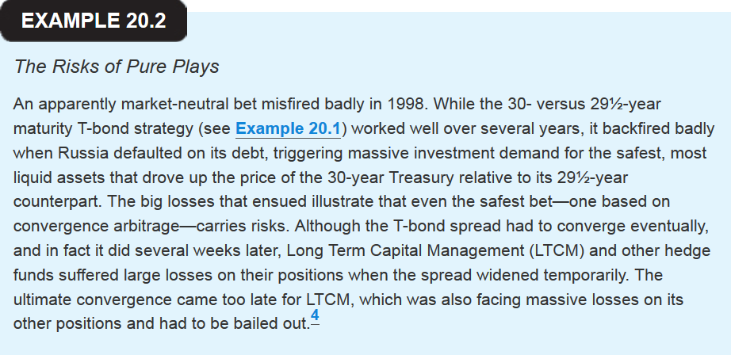

Slide 19
20.4 Style Analysis for Hedge Funds
Style and Factor Loadings
  Many fund strategies are directional bets and may be evaluated with style analysis
  Directional investments will have nonzero betas called “factor loadings”
  Typical factors include exposure to stock markets, interest rates, credit conditions, and foreign exchange

Slide 20
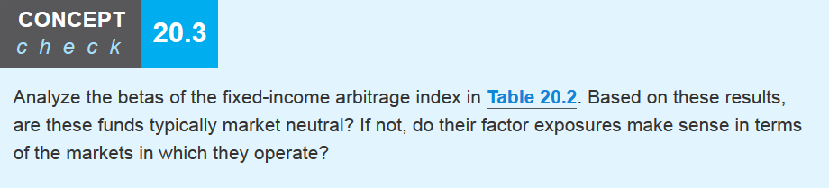
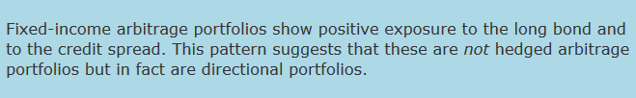

Slide 21
20.5 Performance Management for Hedge Funds
Liquidity and Hedge Fund Performance
  Prices in illiquid markets tend to exhibit serial correlation
    Funds estimate values of investments to calculate fund’s share values and rates of return
      Funds estimate prices optimistically
      Funds mark to market slowly instead of all at once
      Serial correlation strongly related to fund’s Sharpe ratios; higher Sharpe ratios are compensation for illiquidity

Slide 22
20.5 Performance Management for Hedge Funds
Fund Performance and Survivorship Bias
  Backfill bias
    Induced by including past returns on funds that entered sample because they were successful
  Survivorship bias
    Induced by excluding past returns on funds removed from sample because they were unsuccessful

Slide 23
20.5 Performance Management for Hedge Funds
Fund Performance and Factor Loadings
  Many performance measures assume constant risk levels; many hedge funds have variable risk levels
    Implies positive alphas may be measurement error
  Many funds hold options or perform like options
    Options result in nonlinear performance, but most performance measures assume or fit straight line to return data

Slide 24
20.5 Performance Management for Hedge Funds
Tail Events and Performance
  Many hedge funds employ mathematical models that rely on near-term historical price data
  Strategies’ performance in form of a written put option
    Way to capture the put premium, appropriate in low-volatility markets
    Face large losses in high-volatility markets: Out of pocket if markets fall, large opportunity costs if markets rise
  When tail events occur, hedge fund performance may suffer large losses

Slide 25
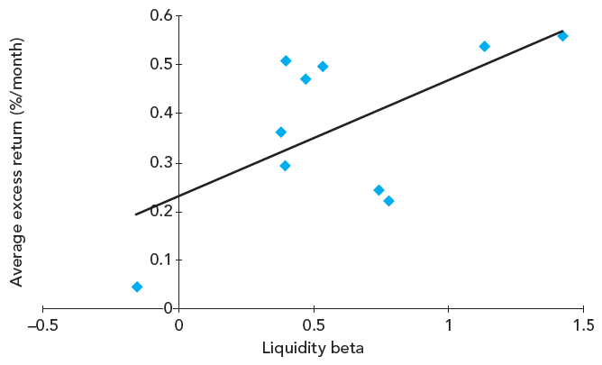
Figure 20.2 Average Hedge Fund Returns as Function of Liquidity Risk

Slide 26
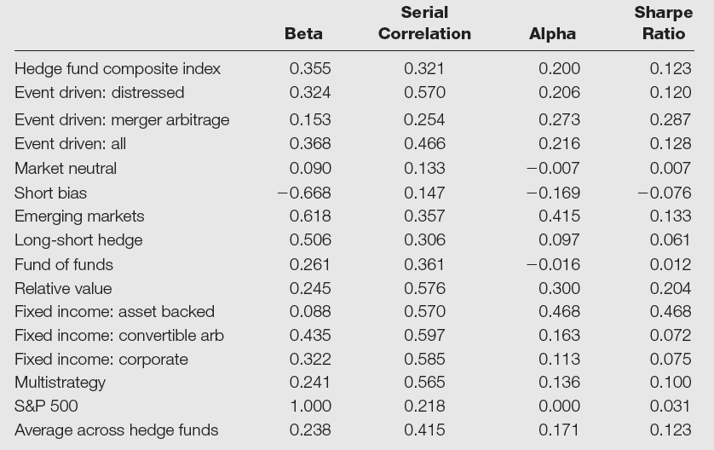
Table 20.3 Index Model Regressions for Hedge Fund Indexes

Slide 27
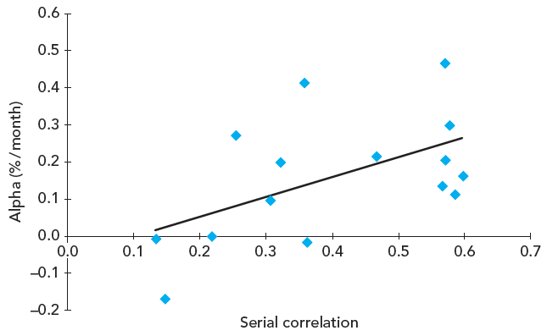
Figure 20.3A Hedge Funds with Higher Serial Correlation in Returns

Slide 28
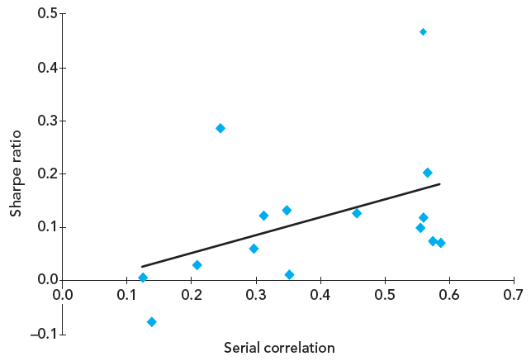
Figure 20.3B Hedge Funds with Higher Serial Correlation in Returns

Slide 29
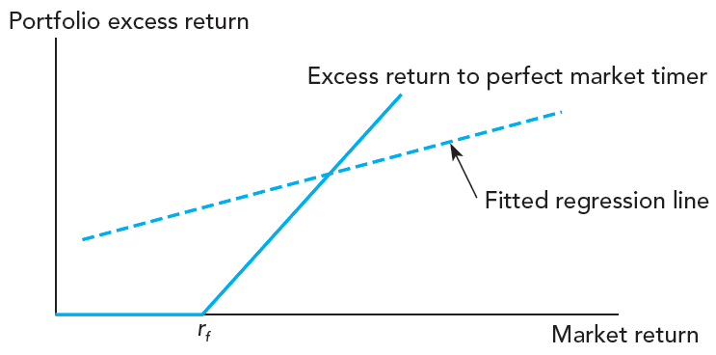
Figure 20.4 Characteristic Line of Perfect Market Timer

Slide 30
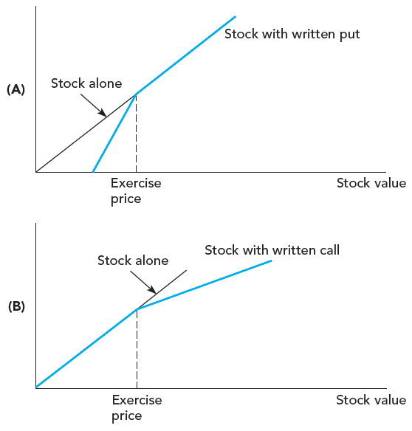
Figure 20.5 Characteristic Line of Stock Portfolio with Written Options

Slide 31
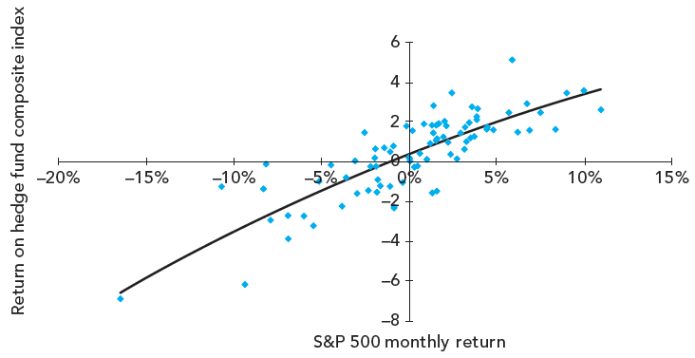
Figure 20.6A Monthly Returns on Hedge Fund Indexes versus Return on S&P 500, 1/2005-11/2011

Slide 32
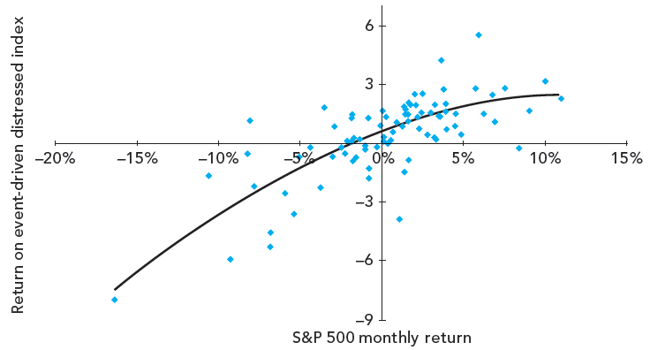
Figure 20.6B Monthly Returns on Hedge Fund Indexes versus Return on S&P 500, 1/2005-11/2011

Slide 33
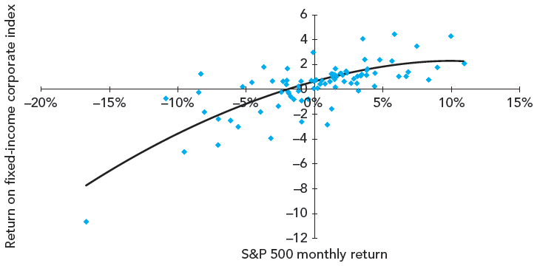
Figure 20.6C Monthly Returns on Hedge Fund Indexes versus Return on S&P 500, 1/2005-11/2011

Slide 34

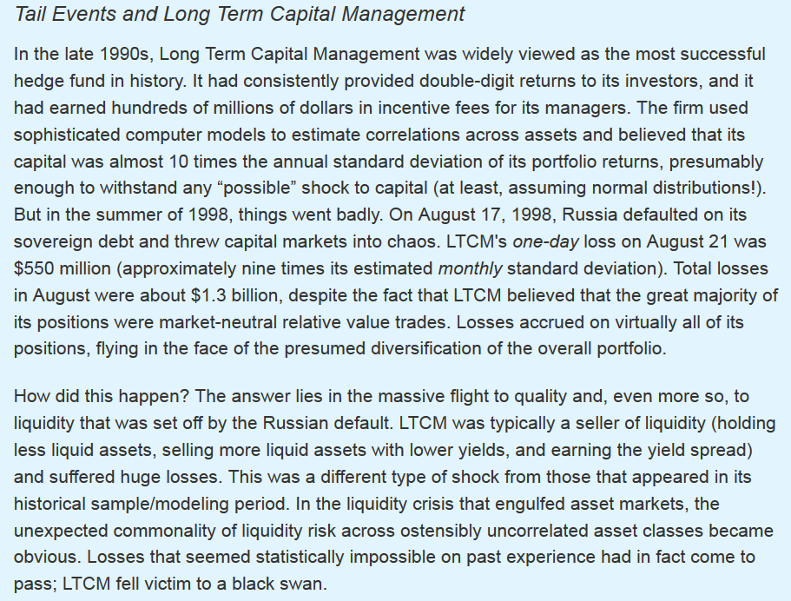

Slide 35
20.6 Fee Structure in Hedge Funds
Incentive Fee
  Equal to share of any investment returns beyond stipulated benchmark performance
High Water Mark
  Previous portfolio value; must be reattained before hedge fund can charge incentive fees
Fund of Funds
  Hedge funds investing in other hedge funds

Slide 36
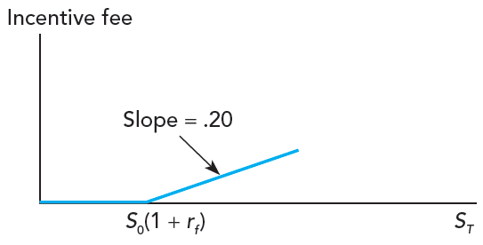
Figure 20.7 Incentive Fees as Call Option

Slide 37
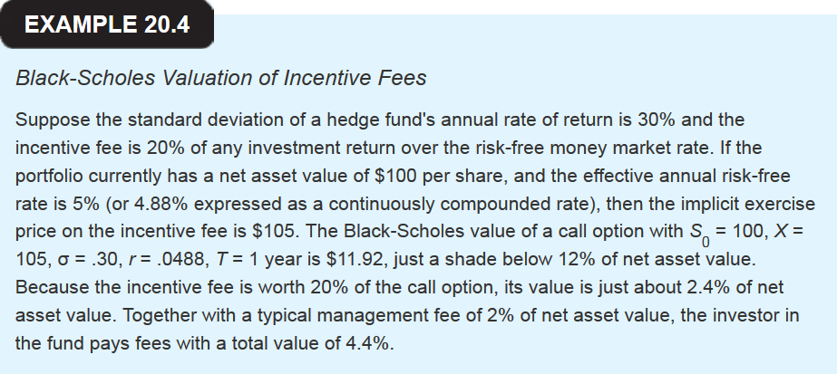

Slide 38

