Slide 1

FinTech: Blockchain Technologies
FNAN472 / SYST448 / GBUS696
Fall 2025
Jiasun Li
https://sites.google.com/view/jiasunli
https://scholar.google.com/citations?user=LXZUjssAAAAJ&hl=en
Twitter: @mysteryfigure

Slide 2
What is this course about?
An in-depth introduction to the exciting world of blockchain!
How does Bitcoin work? How are they created?
Can I mine my own? Am I anonymous when I pay with Bitcoin?
What is a Smart Contract? What can it do?
What creative business applications has blockchain enabled?
What challenges blockchains face and how to overcome them?
What knowledge/skills do I need to follow the space?
What new world learning blockchain can bring me to?
A lot… (cryptography, economics, game theory, legal, etc.)

Slide 3
Some history

Slide 4
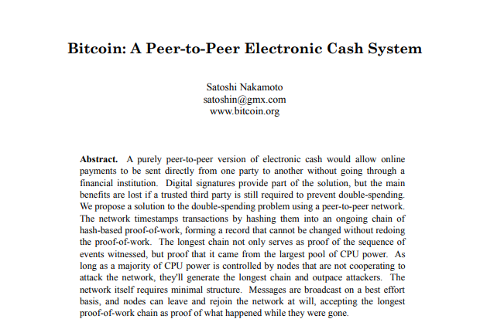

Genesis
?

Slide 5
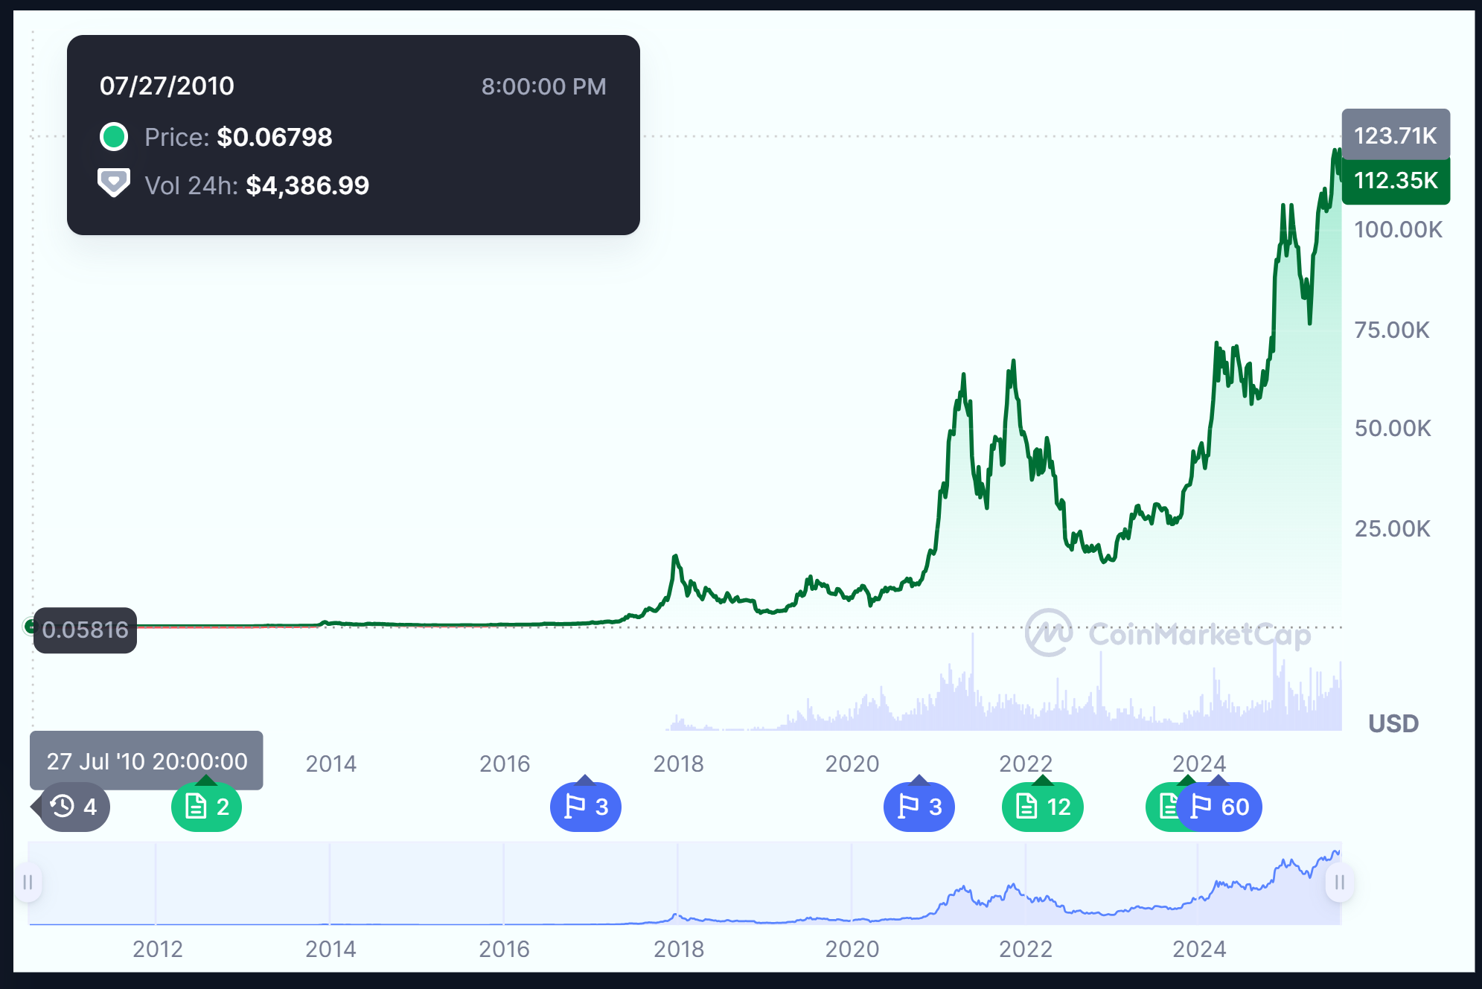
Source: CoinMarketCap
https://coinmarketcap.com/currencies/bitcoin/

Slide 6
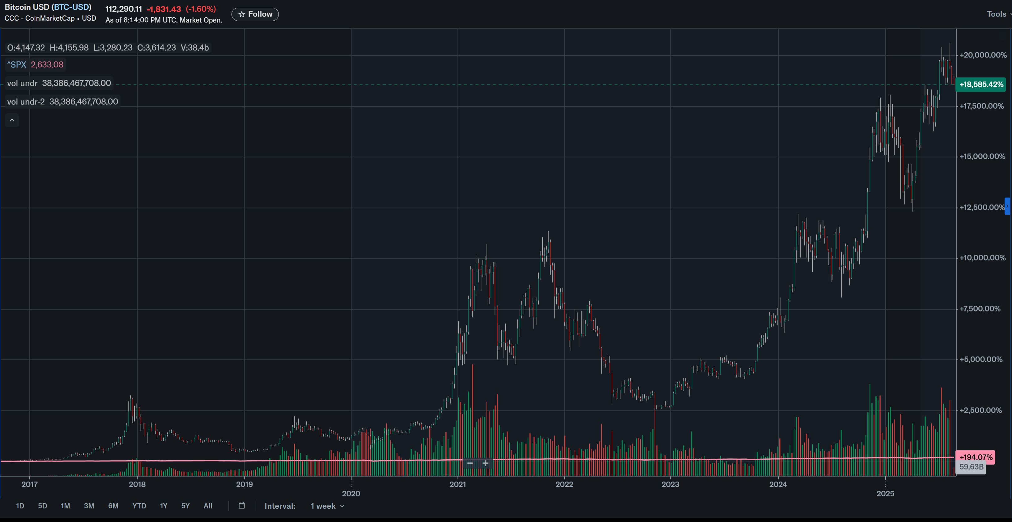

Slide 7
First-wave of mainstream attention

Slide 8
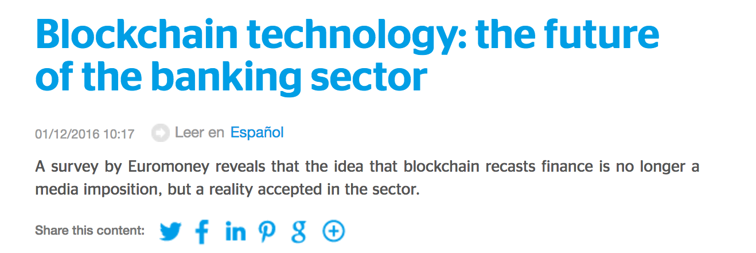
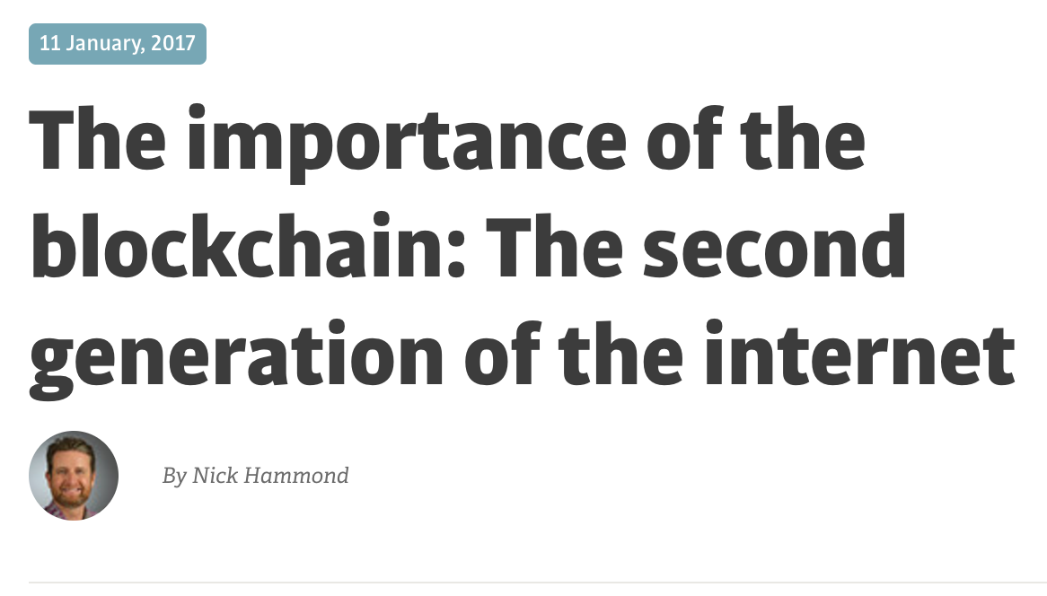
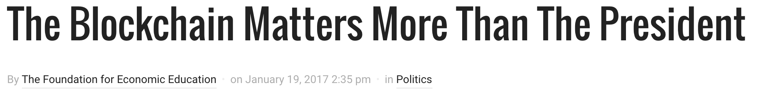
Why blockchain Technologies?

Slide 9
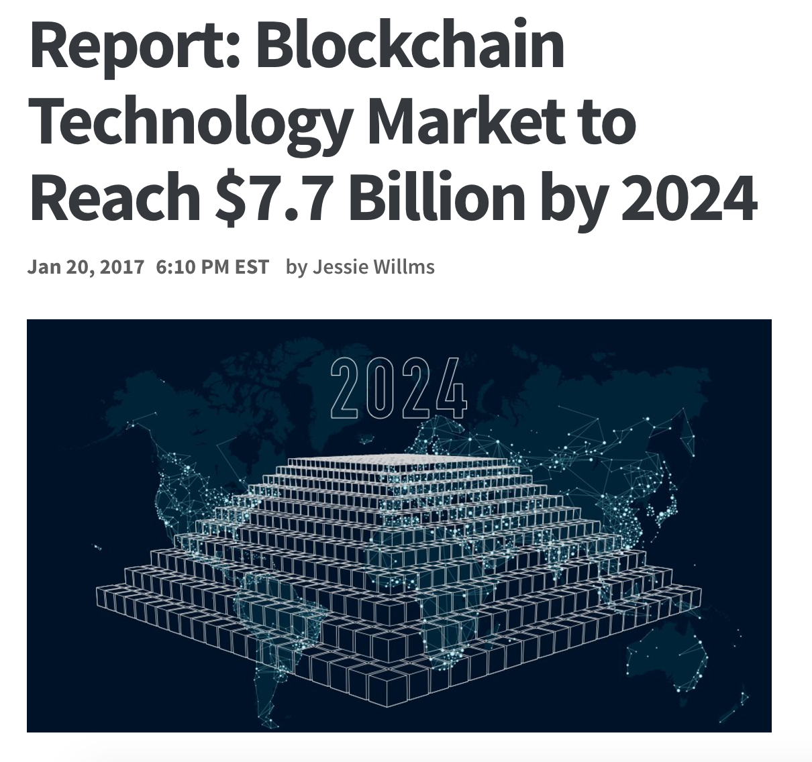
Why blockchain Technologies?

Slide 10
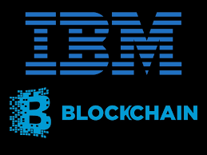
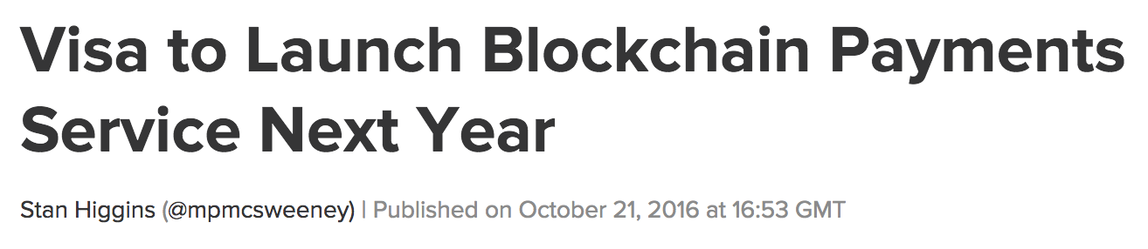
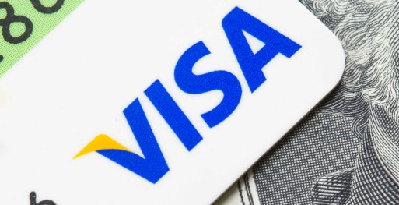
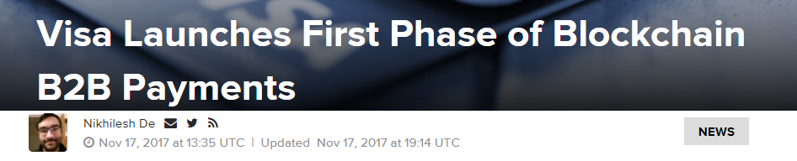

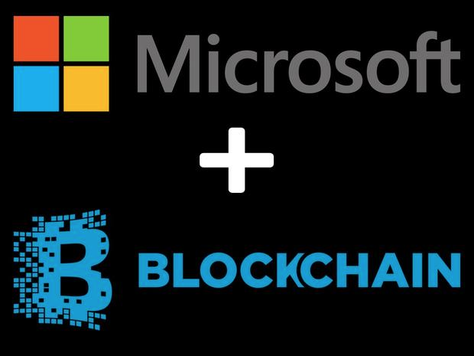
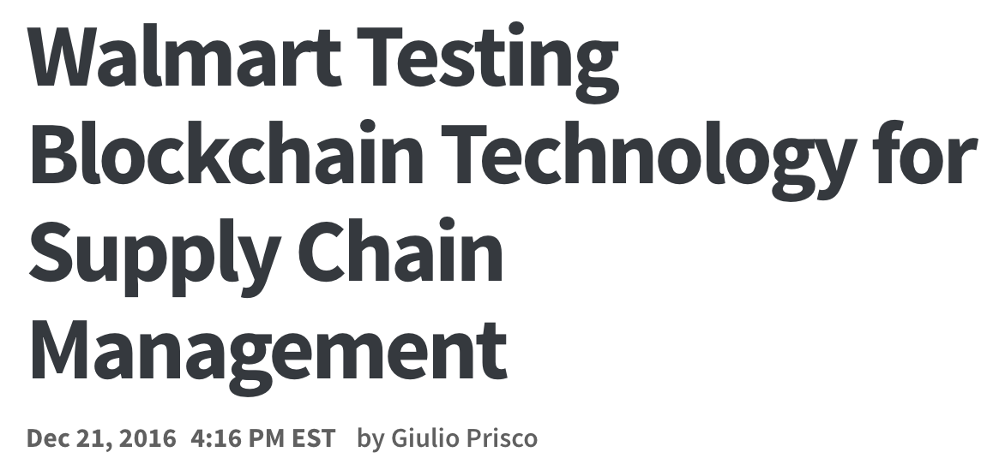
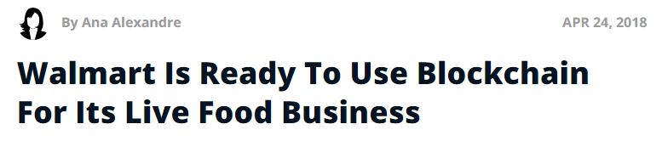

Jump to action
https://aws.amazon.com/partners/blockchain/

Slide 11
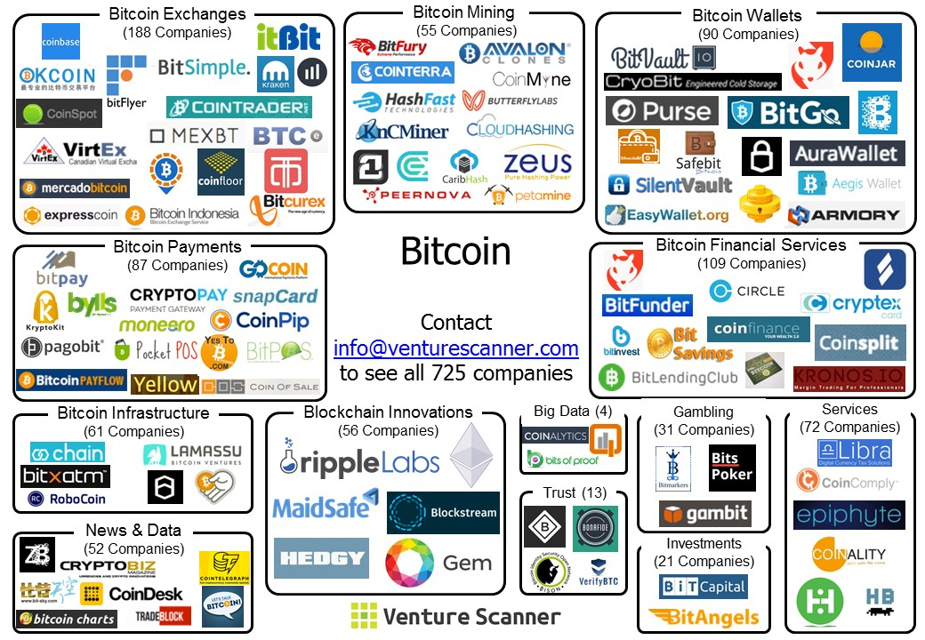
Emerging ecosystem
circa 2017Q1

Slide 12
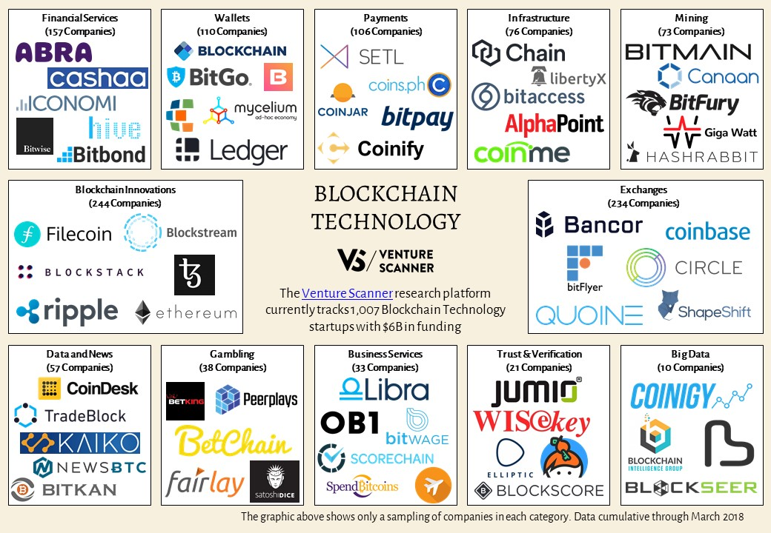
Emerging ecosystem
https://www.venturescanner.com

Slide 13
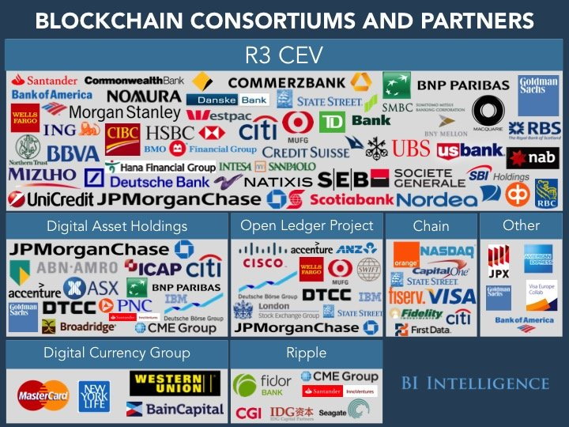
Responses from tradFi
http://www.eurasianews.it/2018/03/04/future-of-the-banking-industry-not-without-blockchain/

Slide 14
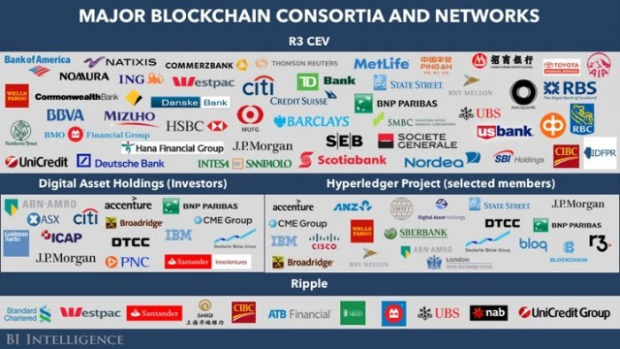
US regulator joined the R3 consortium (Illinois Department of Financial and Professional Regulation (IDFPR))
https://www.businessinsider.com/one-us-regulator-has-joined-the-r3-blockchain-consortium-2017-3

Slide 15
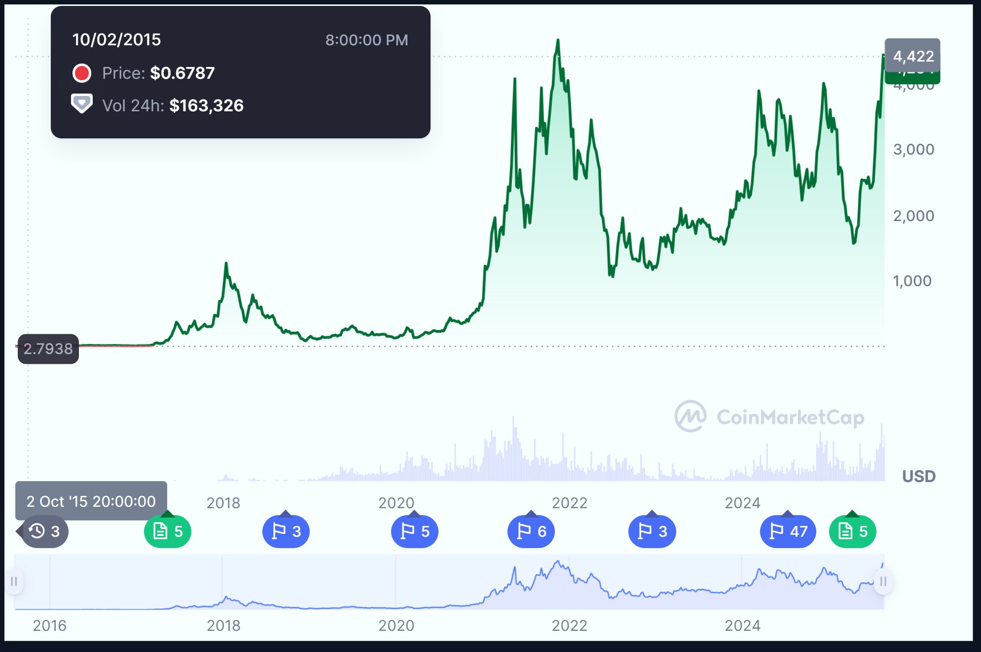
Rise of Ethereum https://coinmarketcap.com/currencies/ethereum/

Slide 16
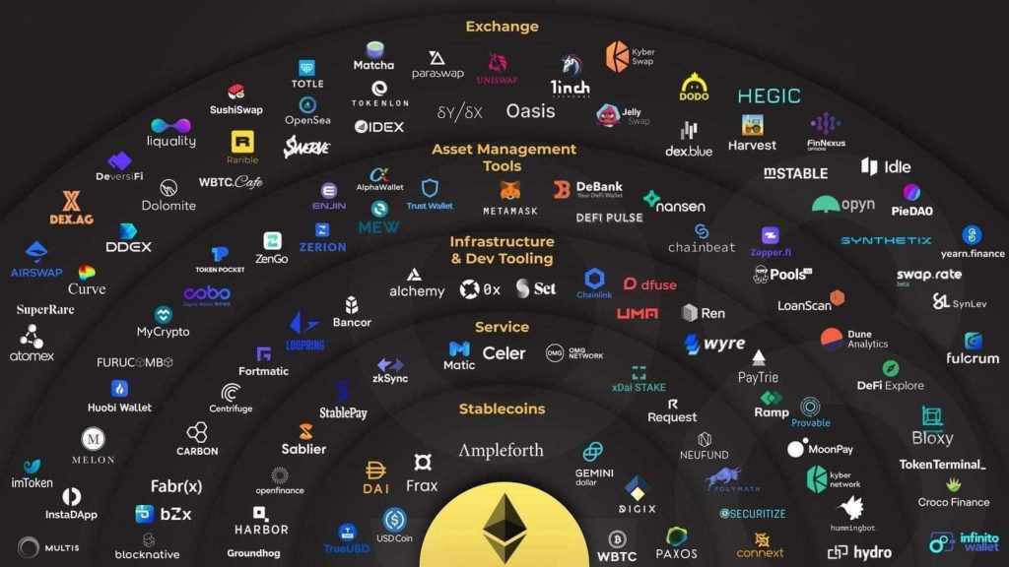

Slide 17
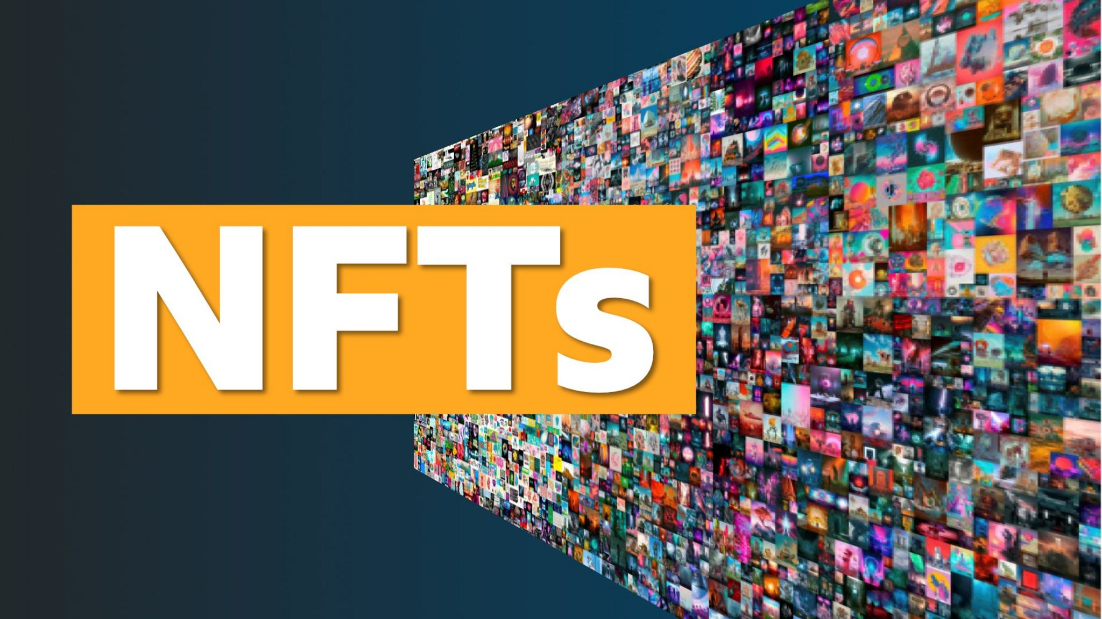

Slide 18
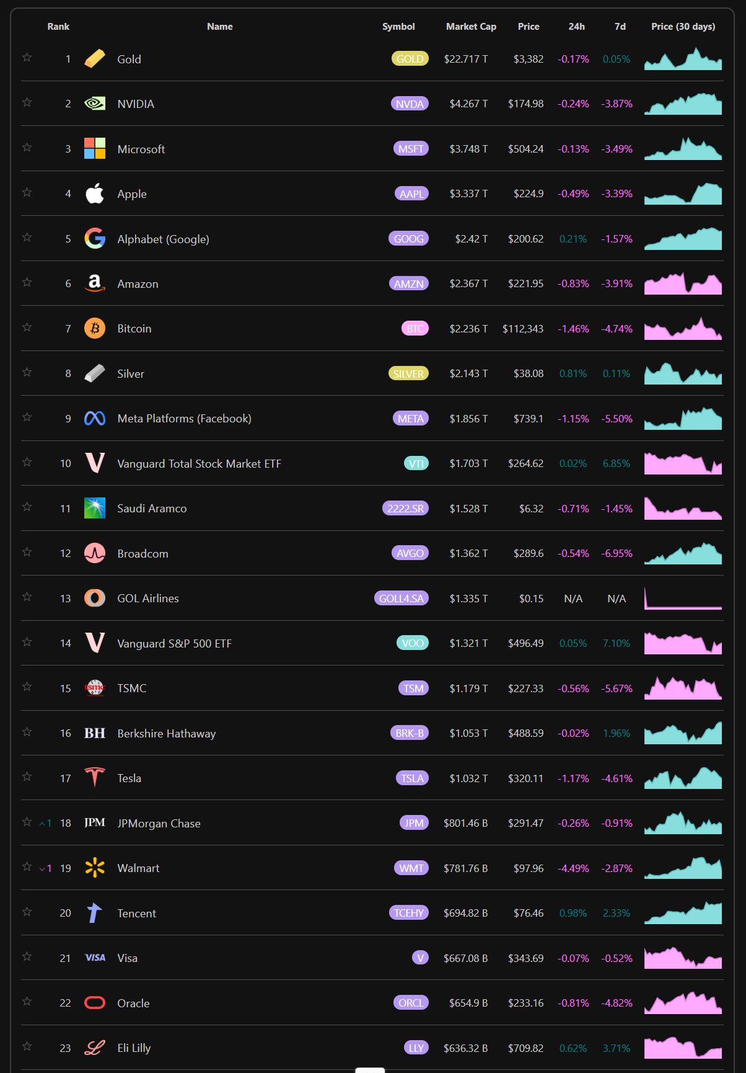
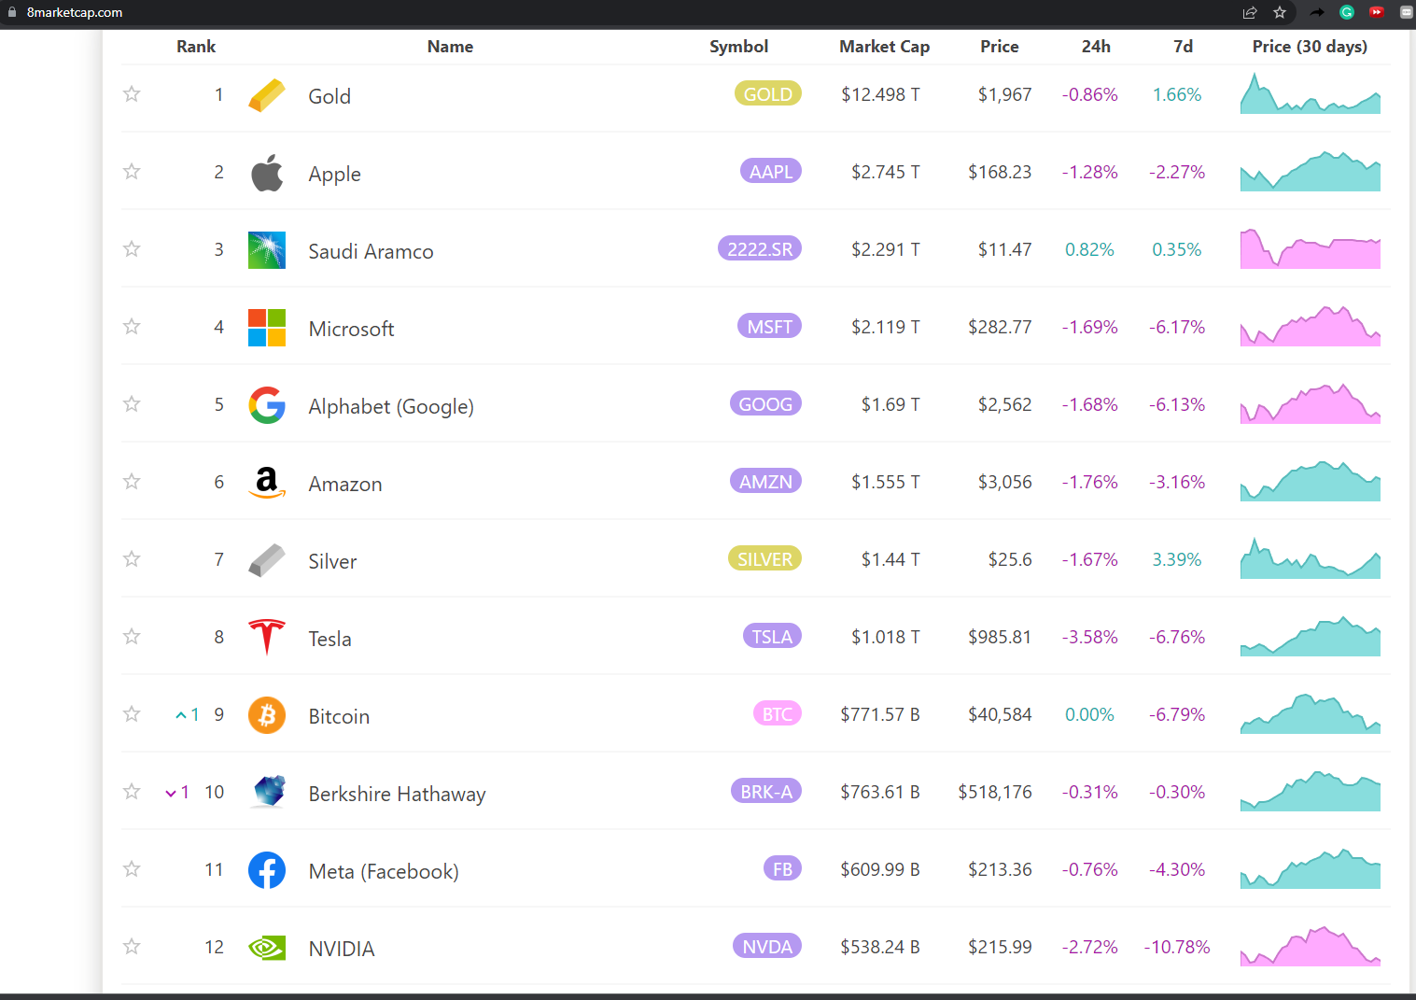
https://8marketcap.com/

Slide 19
The Craze of 2021

Slide 20
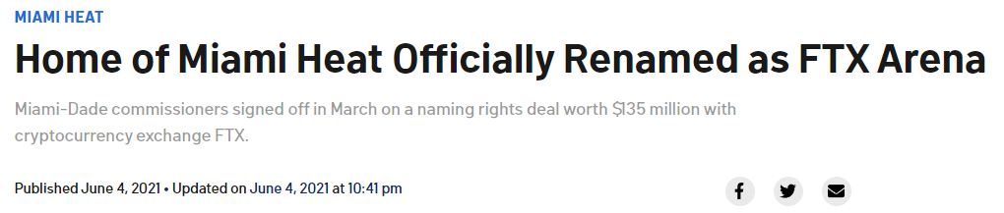
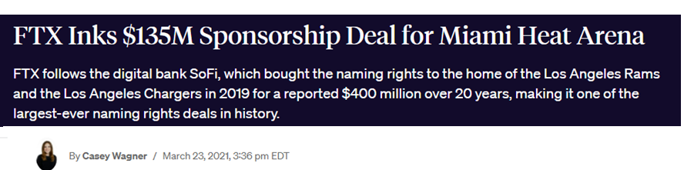
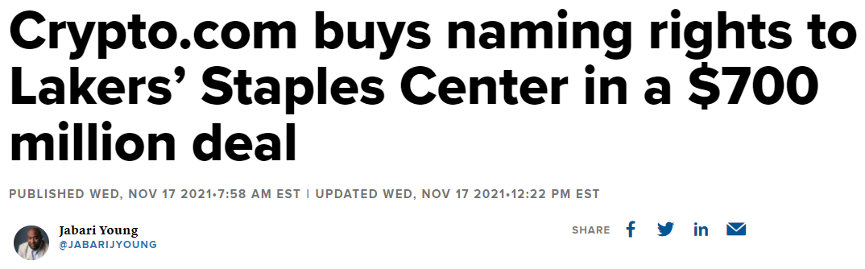
NBC
Blockworks.co
cnbc

Slide 21
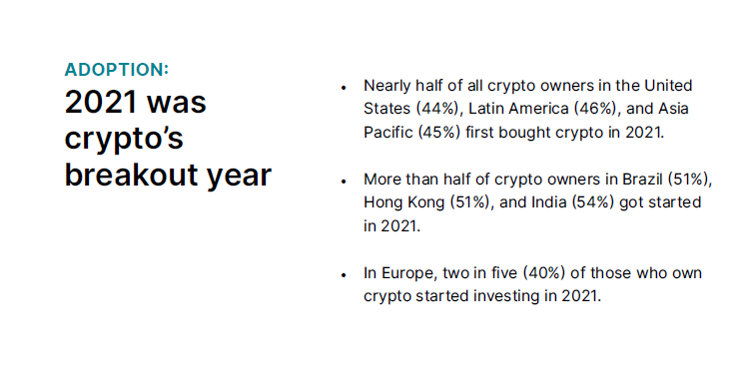
Where’s the money coming from?
Impact of COVID-19 Stimulus Checks:
https://pubsonline.informs.org/doi/full/10.1287/mnsc.2023.4790
Gemini: Global state of crypto report

Slide 22
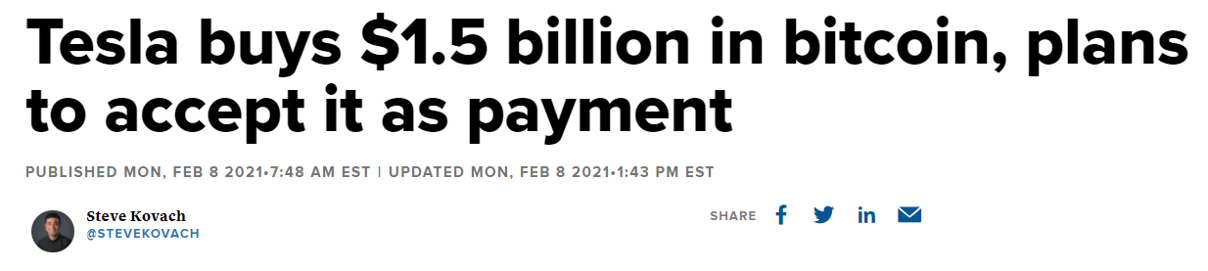
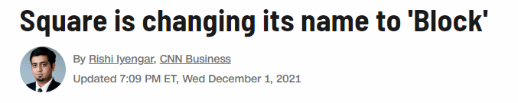
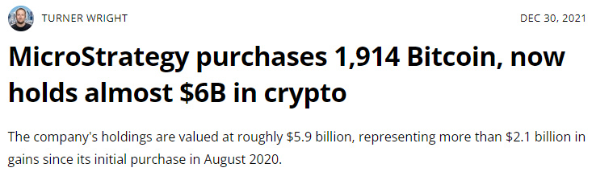
CNBC

Slide 23
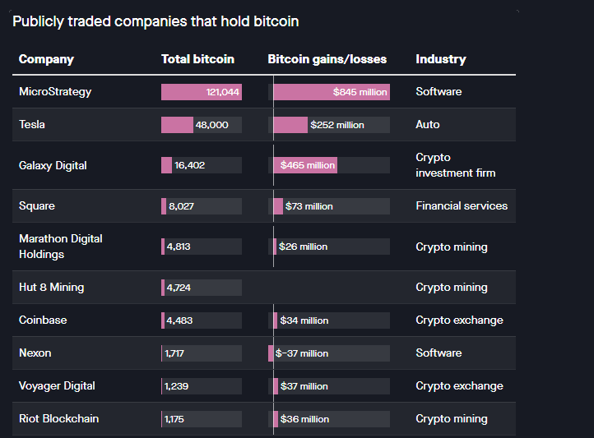
Quartz (July 20, 2022): https://qz.com/2118492/the-biggest-corporate-holder-of-bitcoin-is-not-square-or-tesla
Fast forward to today: https://bitcointreasuries.net/

Slide 24
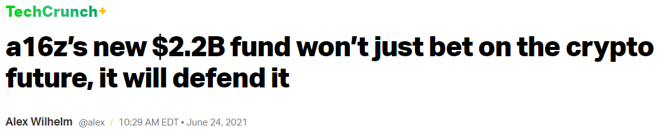
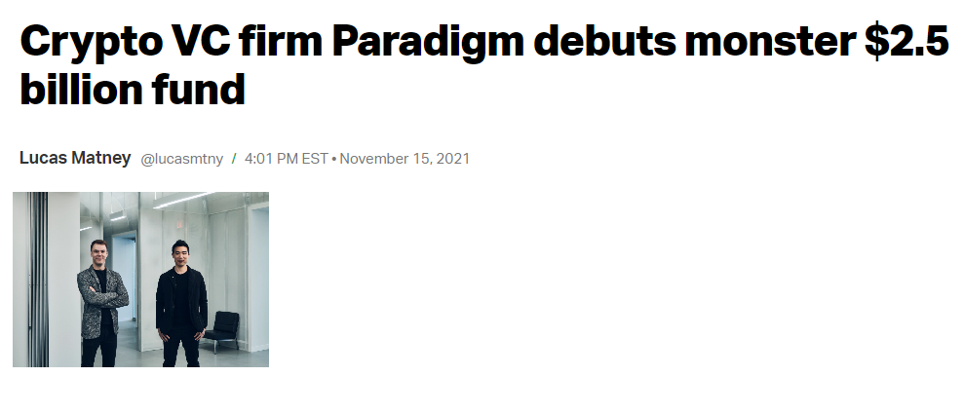
Techcrunch

Slide 25
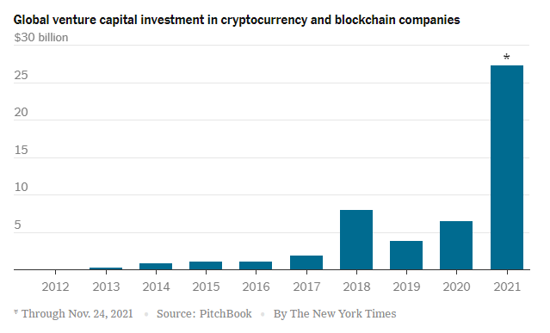

Slide 26
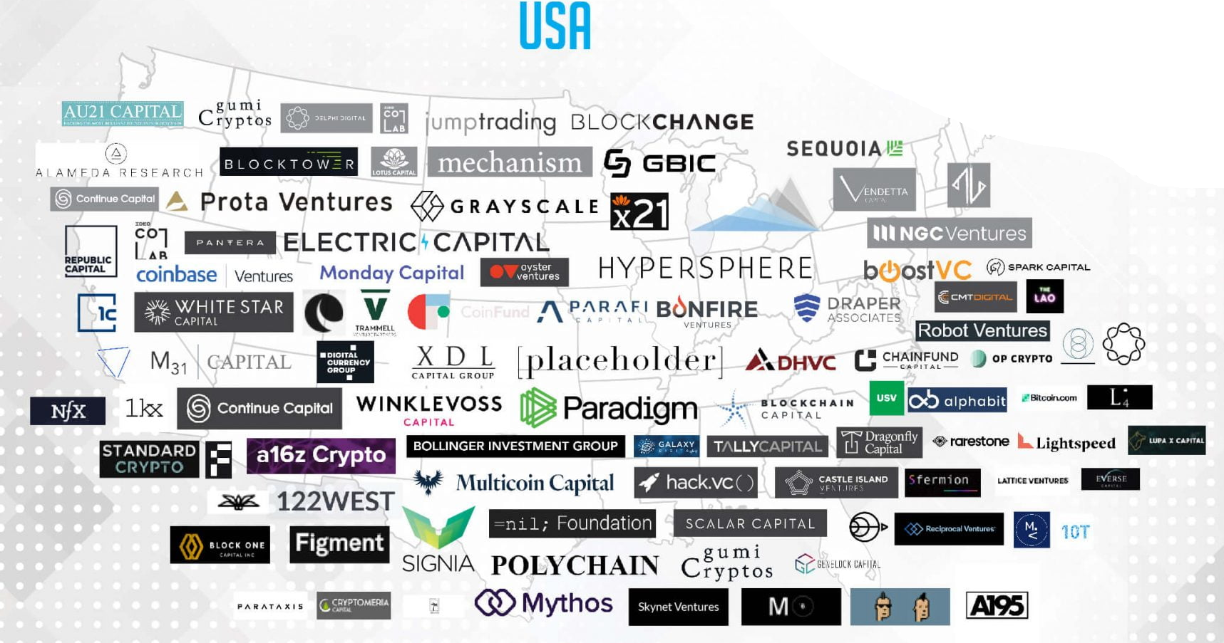
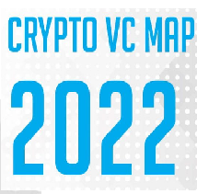


Slide 27
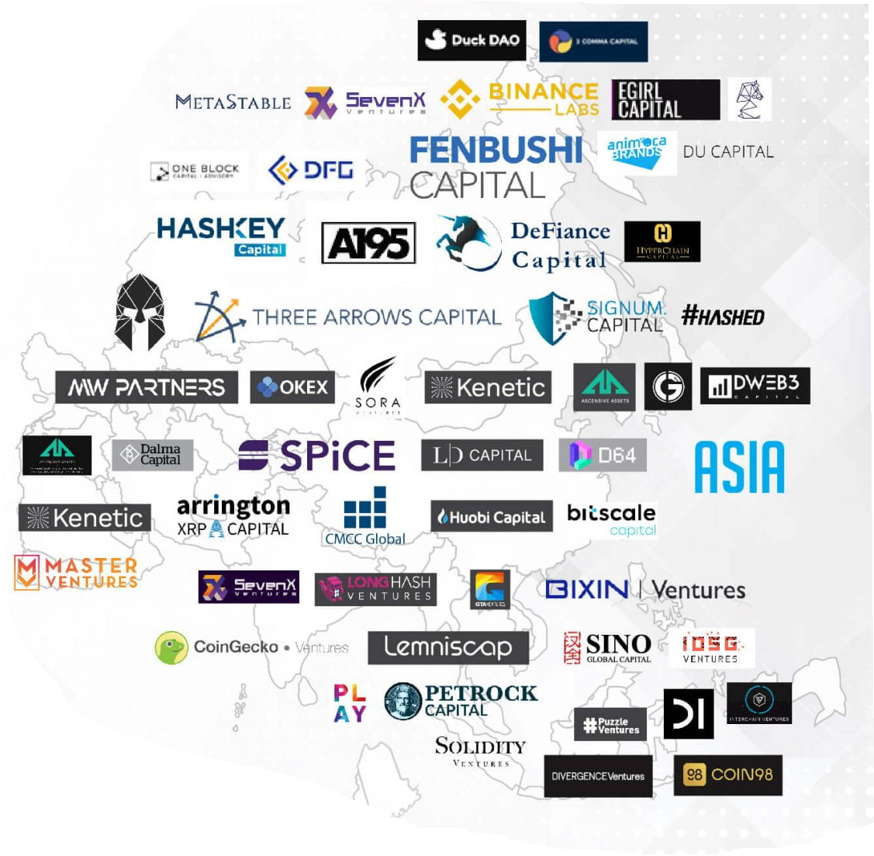

Slide 28
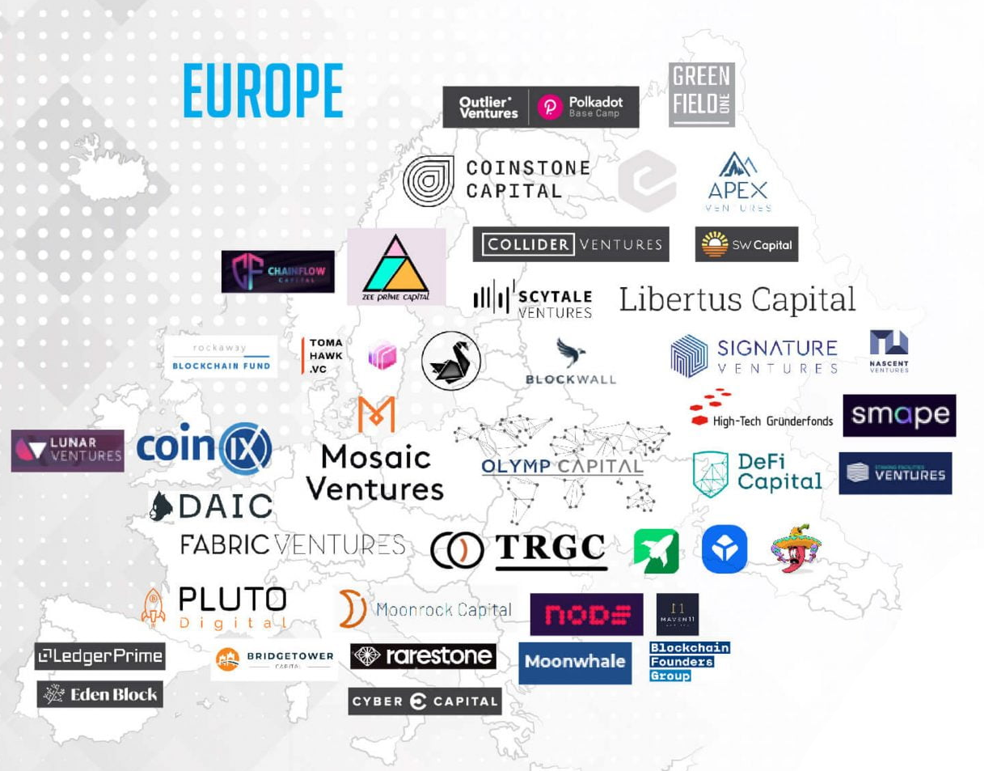

Slide 29
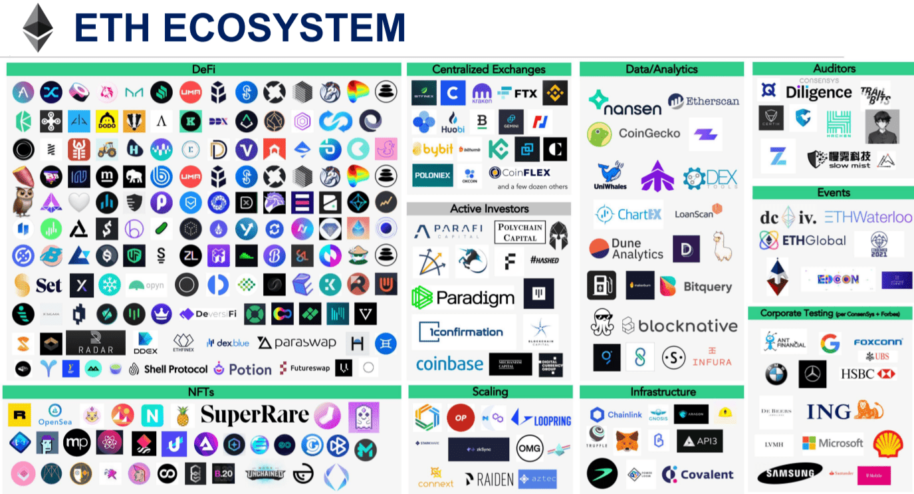
SeekingAlpha Ethereum 2022 Outlook

Slide 30
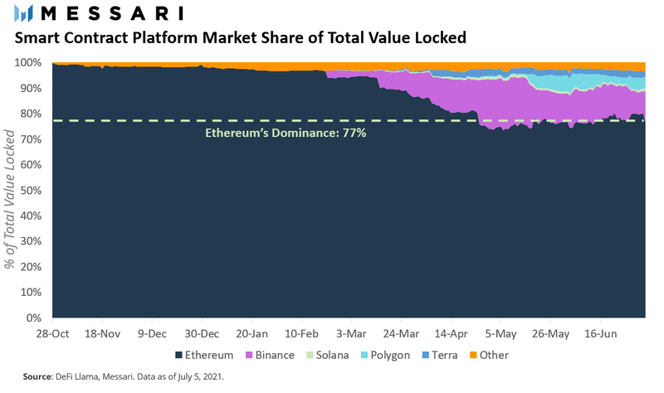

Slide 31
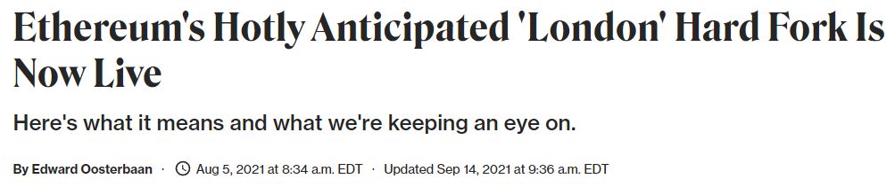
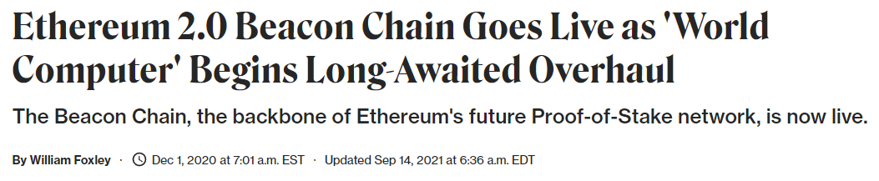
Coindesk

Slide 32
Regulatory, academic, and educational responses

Slide 33
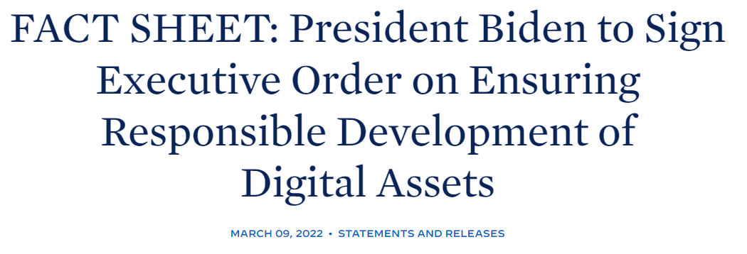

Slide 34
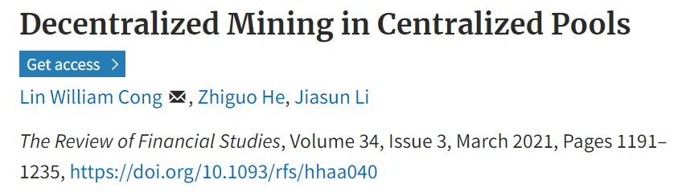
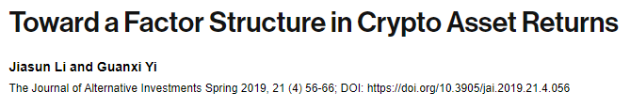
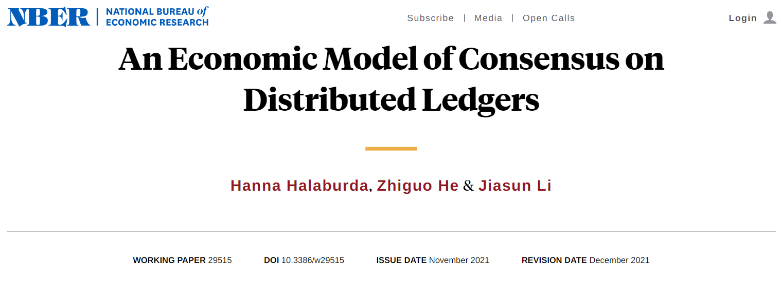

Slide 35
The Crash of 2022

Slide 36

Summer 2022
Things begin to turn ugly
Terra collapse
Celsius liquidity trouble
Three-Arrow bankrupt
BlockFi bailed out by FTX
FTX collapsed …

Slide 37
Recovery: Late 2023 – late 2024

Slide 38
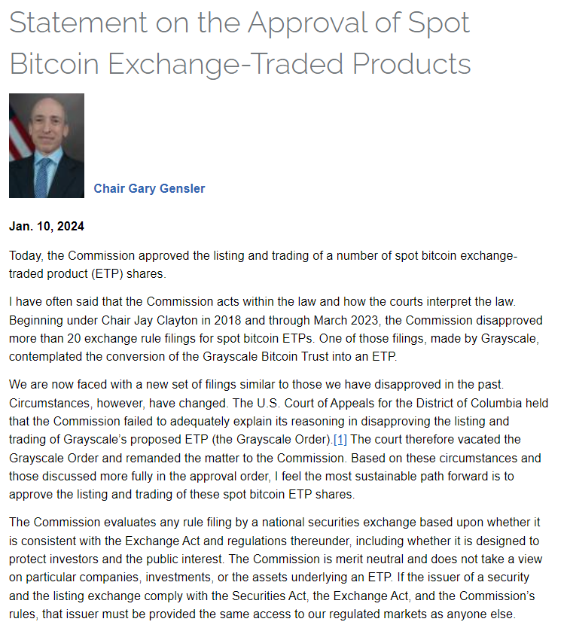
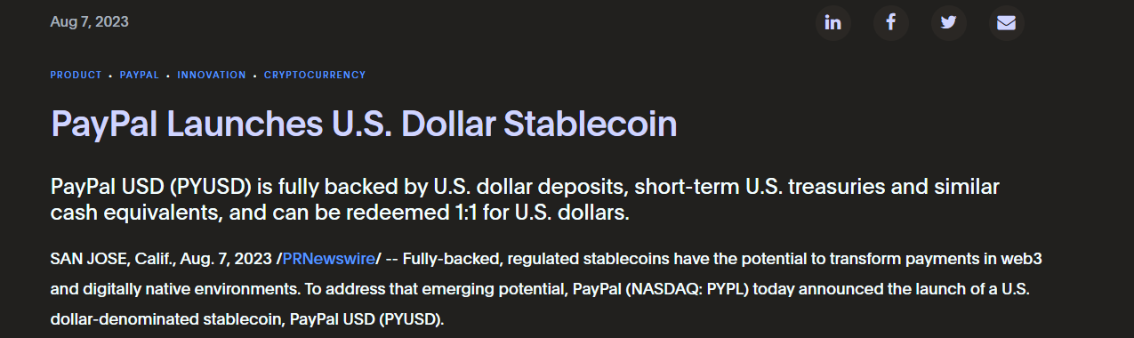
Operations Chokepoint 2.0?

Slide 39
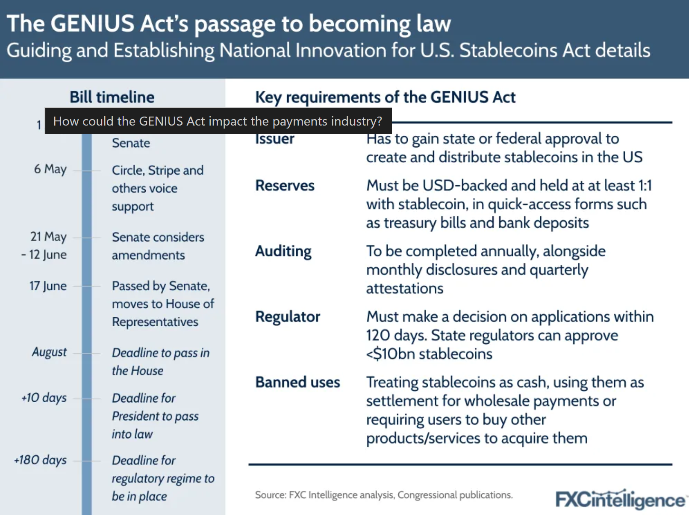
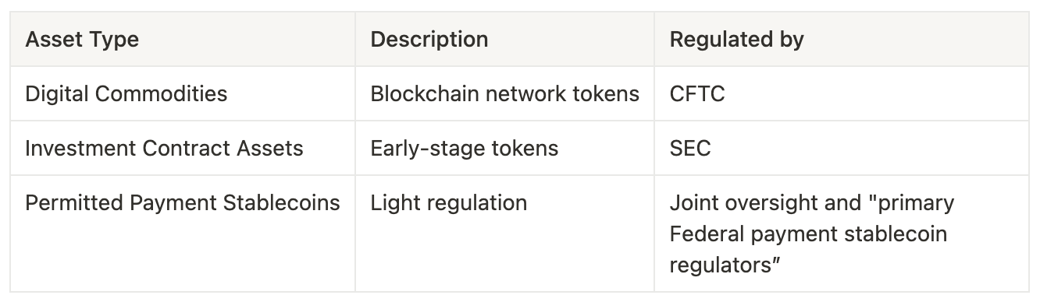

Late 2024-present: the Crypto president
Clarity Act of 2025
https://www.fxcintel.com/research/analysis/genius-act-payments-industry-impact

Slide 40

Why blockchain Technologies?
Single point of failure:
https://www.ftc.gov/equifax-data-breach
Censorship resistance: https://etherscan.io/tx/0x2d6a7b0f6adeff38423d4c62cd8b6ccb708ddad85da5d3d06756ad4d8a04a6a2
How the ethereum blockchain saved this China #MeToo letter from censorship
Why bitcoin/cryptocurrencies?
Inflation protection? Transaction in the Bitcoin Genesis Block
Inflation Expectation and Cryptocurrency Investment
Arbitrary money cancellation: Rupee note cancellation plunges India into panic (censorship of value?)
What’s more?

Slide 41
Two pillars of blockchains
Cryptography:
Hash functions
Digital signatures
(Zero-knowledge proofs, multiparty computations, trusted execution)
…
Economics:
Game theory
Monetary economics
…
A new mindset: embracing an (increasingly) uncertain future

Slide 42

Contact Info
Office Hours
You are always welcome
jli29@gmu.edu
Q&A every week after class
Class website
http://somfin.gmu.edu/courses/fnan472/

Slide 43

Lectures material
We will use a combination of slides and whiteboard/weblinks/actual papers
You may want to take notes from time to time!
Some slides may be updated on the class web-site after class
Extra reading materials may also be posted on the website
I will often post advanced stuff; don’t be intimitated if you find them difficult
skim to get as much as you can; I will help you reading advanced stuff in class
get used to be overwelmed as we face information explosion!
I’ll let you know in advance of any required reading before class

Slide 44

Textbook
This is a seminar-style class but we will follow a textbook for the early parts of the class.
“Bitcoin and Cryptocurrency Technologies: A Comprehensive Introduction”
Available freely here (pre-publication draft)

Slide 45

Evaluation
Exams | 48%
Team Project | 50%
Class Participation | 2%
Occasional bonus points
class schedule (subject to change): http://somfin.gmu.edu/courses/fnan472/#schedule

Slide 46
Class participation
Ask questions and give comments
Slow me down whenever confused (don’t be shy)
Bonus:
ask relevant questions that pushes us to look for answers
Identify typos or mistakes in slides
A Venn diagram of our knowledge overlaps

Slide 47

Final Project
A research project - offering new knowledge to the blockchain/cryptocurrency community.
Encouraged to work in teams (3-5 teammates, or seek approval otherwise).
Goal is for publishable work in conference/workshop/medium.
I may assign topics around the midde of the semester; or you may select your own topic and obtain my approval, after which I’ll give you further guidance
Write a report and present on the last week of class.
Presentation/report will be graded on: 1) do we learn anything new from your work? 2) how well do you address my earlier comments
Welcome to seek help from me, your classmates, or outside sources
Topic ideas (not limited)
Fully explain one specific blockchain project.
Provide a research report of a specific industry in the blockchain universe
Identify a business application of blockchain technology and write a white paper.
Survey and describe in detail a few commonly observed smart contracts.
Survey a specific issue and provide a solution (e.g., scaling, stable coin, token design, etc.)
SoK of a particular area (ask me for references to start with)

Slide 48
My goal with this course
Some of you will keep working on blockchain technologies after the course.

Slide 49
Done with logistics!
Questions?

Slide 50
Lecture 1
Intro to Crypto and Cryptocurrencies

Slide 51
This lecture
Crypto background
hash functions
digital signatures
… and applications
Intro to cryptocurrencies
basic digital cash

Slide 52
Lecture 1.1:
Cryptographic Hash Functions

Slide 53
Hash function:
takes any string as input
fixed-size output (we’ll use 256 bits)
efficiently computable
Security properties:
collision-free
hiding
puzzle-friendly
Demo

Slide 54
Hash property 1: Collision-free
Nobody can find x and y such that
x != y and H(x)=H(y)
x
H(x) = H(y)
y

Slide 55
Collisions do exist ...
possible outputs
possible inputs
… but can anyone find them?

Slide 56
How to find a collision
try 2¹³⁰ randomly chosen inputs
99.8% chance that two of them will collide
This works no matter what H is …
… but it takes too long to matter

Slide 57
Is there a faster way to find collisions?
For some possible H’s, yes.
For others, we don’t know of one.
No H has been proven collision-free.

Slide 58

Existing Schemes
Best-known cryptographic hash functions: MD5 (128 bits), SHA-1 (160 bits), SHA-256/384/512 (256/384/512 bits)
https://md5calc.com/hash
Security:
MD5: A 2013 attack by Xie Tao, Fanbao Liu, and Dengguo Feng breaks MD5 collision resistance in 2¹⁸ time. This attack runs in less than a second on a desktop computer.
SHA-1: Some theoretical attacks - not yet collisions
Suggested to use SHA-2 (256 or 512) or SHA-3/Keccak

Slide 59
Application: Hash as message digest
If we know H(x) = H(y), it’s safe to assume that x = y.
To recognize a file that we saw before,
just remember its hash.
Useful because a hash is small.
Checksum, Password mgmt, decentralized internet,
InterPlanetary File System (IPFS), Filecoin – Protocol Labs

Slide 60

Hash property 2: Hiding
We want something like this:
Given H(x), it is infeasible to find x.
H(“heads”)
easy to find x!
H(“tails”)

Slide 61
Application: Commitment
Want to “seal a value in an envelope”, and
“open the envelope” later.
Commit to a value, reveal it later.
E.g. how to store user passwords?

Slide 62

Hash property 3: Puzzle-friendly
Puzzle-friendly:
For every possible output value y,
if k is chosen from a distribution with high min-entropy,
then it is infeasible to find x such that H(k | x) = y.
$$H\left(k | x\right)∈Y={\left\{0,1\right\}}^{256}$$
$$H\left(k | x\right)∈Y=\{y_{1}\}$$
$$H\left(k | x\right)∈Y=\{y_{1},y_{2},y_{3}\}$$

Slide 63
Hash function review
https://md5calc.com/hash
Bitcoin address: https://en.bitcoin.it/wiki/Technical_background_of_version_1_Bitcoin_addresses

Slide 64
Application: Search puzzle
Given a “puzzle ID” id (from high min-entropy distrib.),
and a target set Y:
Try to find a “solution” x such that
H(id | x) ∈ Y.
Puzzle-friendly property implies that no solving strategy is much better than trying random values of x.

Slide 65
Hashcash
It is a proof-of-work algorithm, which has been used as a denial-of-service counter-measure technique in a number of systems.
A hashcash stamp constitutes a proof-of-work which takes a parameterizable amount of work to compute for the sender. The recipient (and indeed anyone as it is publicly auditable) can verify received hashcash stamps efficiently.
Hashcash was invented by Adam Back in 1997
It is most widely used as the bitcoin mining function

Slide 66





Reducing Spam
“If I don’t know you and you want to send me a message, then you must prove that you spent, say, ten seconds of CPU time, just for me and just for this message” [DN92]
email Server
I am an approved contact
Alice
Verifier
Bob
Approved contacts:
Alice
...

Slide 67

The Bitcoin hash function

Slide 68
SHA-256 hash function
Padding (10* | length)
512 bits
Message
(block 1)
Message
(block 2)
Message
(block n)
256 bits
256 bits
c
c
c
IV
Hash
Theorem: If c is collision-free, then SHA-256 is collision-free.

Slide 69
References to SHA256 standard
https://csrc.nist.gov/glossary/term/secure_hash_algorithm_256
https://nvlpubs.nist.gov/nistpubs/fips/nist.fips.180-4.pdf
https://infosecwriteups.com/breaking-down-sha-256-algorithm-2ce61d86f7a3

Slide 70
Lecture 1.2:
Hash Pointers and Data Structures

Slide 71
hash pointer is:
* pointer to where some info is stored, and
* (cryptographic) hash of the info
if we have a hash pointer, we can
* ask to get the info back, and
* verify that it hasn’t changed

Slide 72
H( )
(data)
will draw hash pointers like this

Slide 73
key idea:
build data structures with hash pointers

Slide 74
linked list with hash pointers = “block chain”
H( )
prev: H( )
prev: H( )
prev: H( )
data
data
data
use case: tamper-evident log

Slide 75
detecting tampering
H( )
prev: H( )
prev: H( )
prev: H( )
data
data
data
use case: tamper-evident log

Slide 76
Tamper-evident log
The World’s Oldest Blockchain Has Been Hiding in the New York Times Since 1995
http://www.surety.com/

