Slide 1
From last lecture:
build data structures with hash pointers

Slide 2
linked list with hash pointers = “block chain”
H( )
prev: H( )
prev: H( )
prev: H( )
data
data
data
use case: tamper-evident log

Slide 3
detecting tampering
H( )
prev: H( )
prev: H( )
prev: H( )
data
data
data
use case: tamper-evident log

Slide 4
Tamper-evident log
The World’s Oldest Blockchain Has Been Hiding in the New York Times Since 1995
Haber and Stornetta
http://www.surety.com/

Slide 5
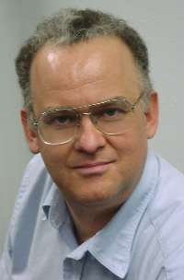
Merkle tree
Ralph C. Merkle https://ralphmerkle.com/

Slide 6
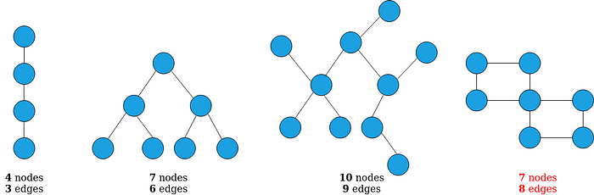
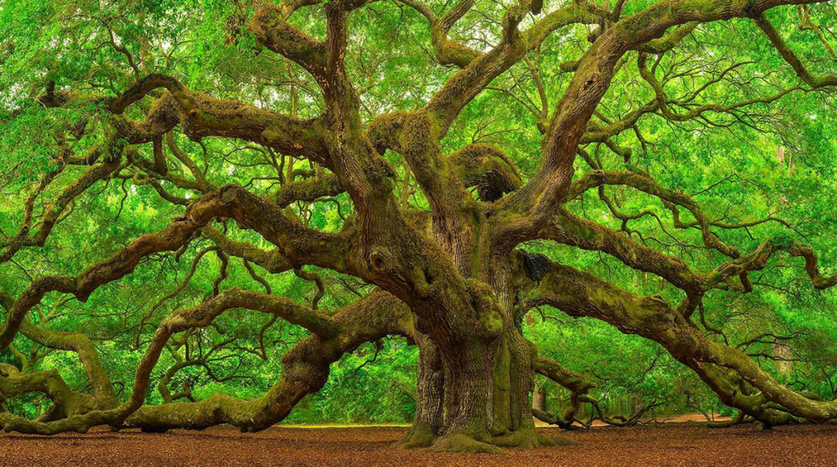
Tree
https://treenewal.com/complete-all-in-one-tree-care-guide-for-oak-trees/
https://towardsdatascience.com/graph-theory-introduction-to-trees-a34ab267fc28

Slide 7
binary tree with hash pointers = “Merkle tree”
H( ) H( )
H( ) H( )
H( ) H( )
H( ) H( )
H( ) H( )
H( ) H( )
H( ) H( )
(data)
(data)
(data)
(data)
(data)
(data)
(data)
(data)

Slide 8
proving membership in a Merkle tree
show O(log n) items
H( ) H( )
H( ) H( )
H( ) H( )
(data)

Slide 9
Advantages of Merkle trees
Tree holds many items
but just need to remember the root hash
Can verify membership in O(log n) time/space
Variant: sorted Merkle tree
can verify non-membership in O(log n)
(show items before, after the missing one)

Slide 10
Application of Merkle trees
Proof of reserve (exchanges)
Exchange Graveyard: https://www.cryptowisser.com/exchange-graveyard/

Slide 11
More generally ...
can use hash pointers in any pointer-based
data structure that has no cycles
e.g. Directed acyclic graph (DAG; used in GHOST, IOTA, etc.)

Slide 12
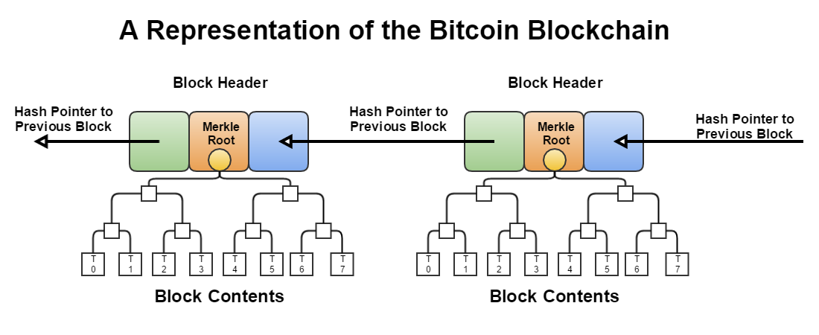

Slide 13
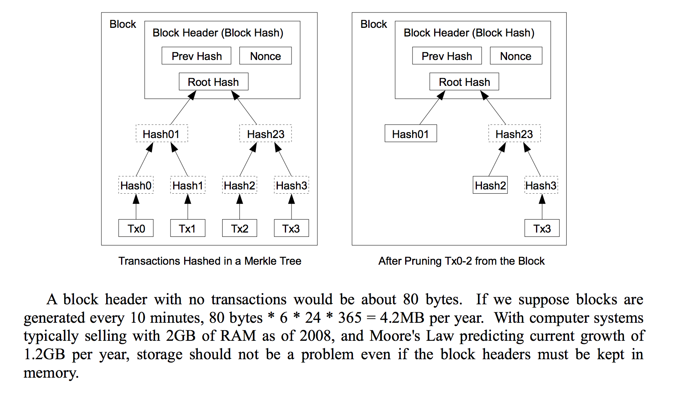
Reclaiming Space (Satoshi white paper)
1MB block size in practice (until 2017-ish https://bitcoinmagazine.com/guides/what-is-the-bitcoin-block-size-limit
https://blockchain.info/charts/blocks-size?timespan=all

Slide 14
Lecture 1.3:
Digital Signatures

Slide 15
What we want from signatures
Recall what a check/contract looks like
Only you can sign, but anyone can verify
Signature is tied to a particular document
can’t be cut-and-pasted to another doc

Slide 16
API for digital signatures
(sk, pk) := generateKeys(keysize)
sk: secret signing key
pk: public verification key
sig := sign(sk, message)
isValid := verify(pk, message, sig)
can be
randomized
algorithms

Slide 17
Requirements for signatures
“valid signatures verify”
verify(pk, message, sign(sk, message)) == true
“can’t forge signatures”
adversary who:
knows pk
gets to see signatures on messages of his choice
can’t produce a verifiable signature on another message
Illustration: https://www.bitaddress.org/bitaddress.org-v3.3.0-SHA256-dec17c07685e1870960903d8f58090475b25af946fe95a734f88408cef4aa194.html

Slide 18
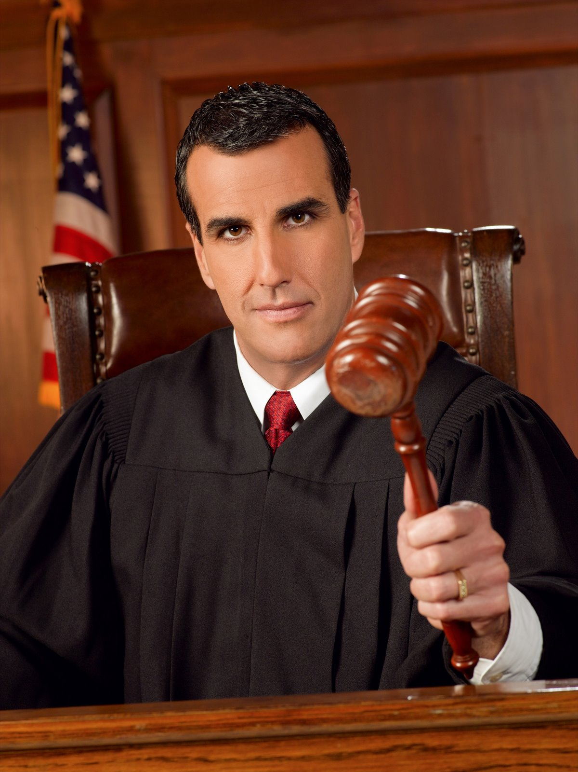
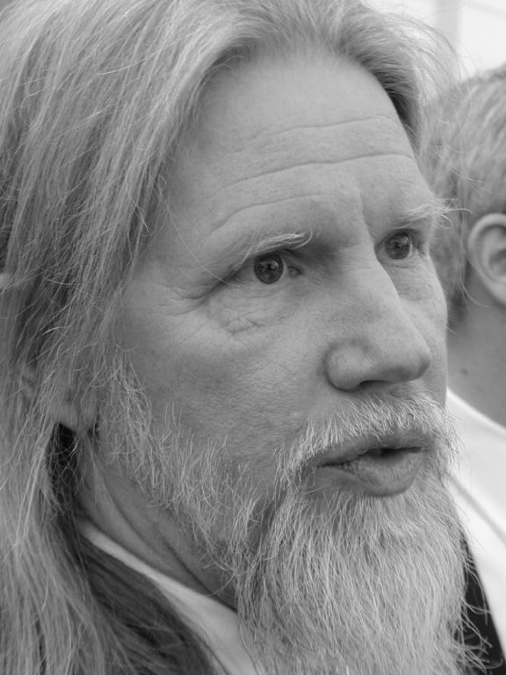
(sk, pk)
challenger
attacker
m₀
sign(sk, m₀)
m₁
sign(sk, m₁)
. . .
M, sig
M not in { m₀, m₁, … }
verify(pk, M, sig)
if true, attacker wins

Slide 19
Practical stuff...
algorithms are randomized
need good source of randomness
limit on message size
fix: use Hash(message) rather than message
fun trick: sign a hash pointer
signature “covers” the whole structure

Slide 20

Bitcoin uses ECDSA standard
Elliptic Curve Digital Signature Algorithm
relies on hairy math
will give a brief overview in later slides
good randomness is essential
foul this up in generateKeys() or sign() ?
probably leaked your private key

Slide 21
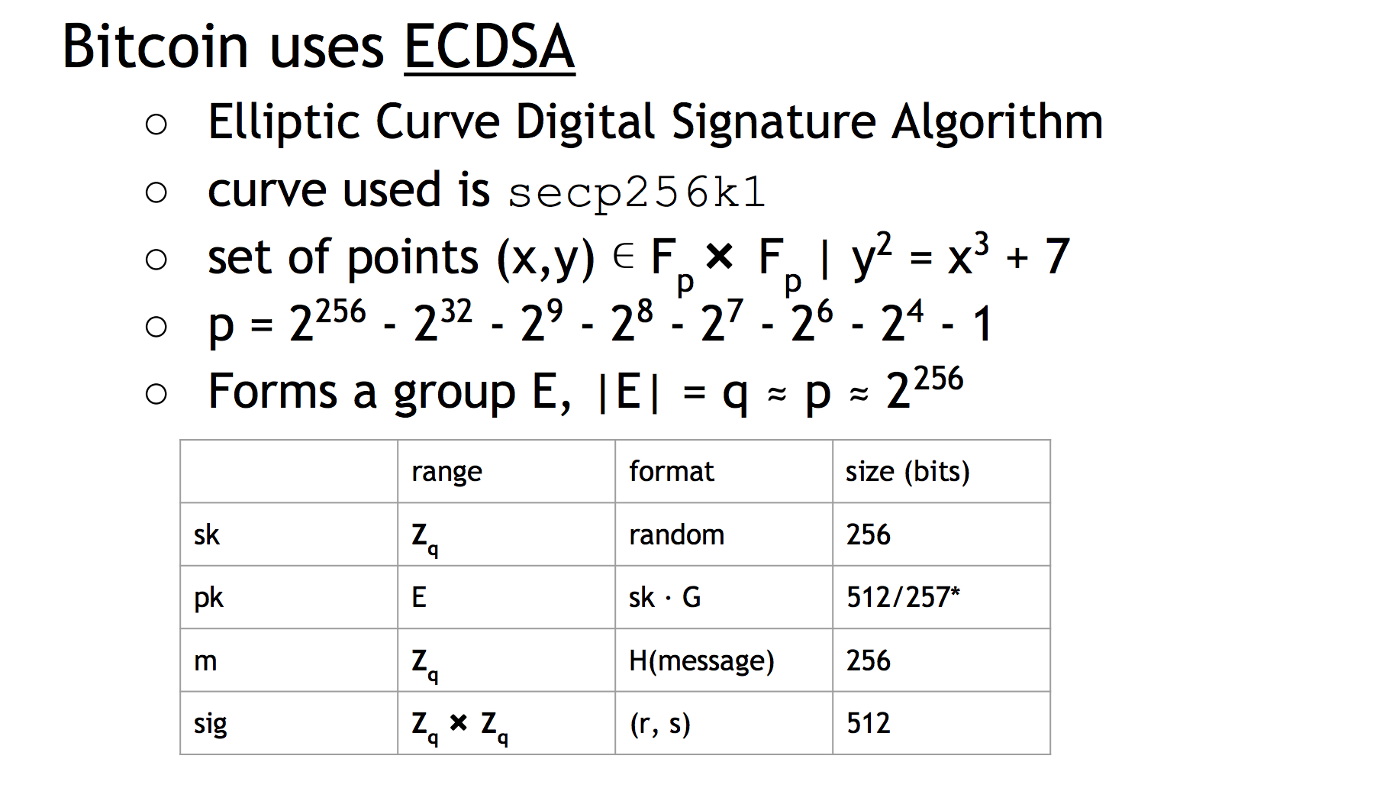
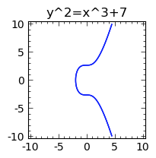
https://perso.univ-rennes1.fr/sylvain.duquesne/master/standards/sec2_final.pdf
http://www.coindesk.com/math-behind-bitcoin/
https://www.coindesk.com/markets/2014/10/19/the-math-behind-the-bitcoin-protocol
more background: https://www.youtube.com/watch?v=4M8_Oo7lpiA
Notes:
http://www.coindesk.com/math-behind-bitcoin/

Slide 22
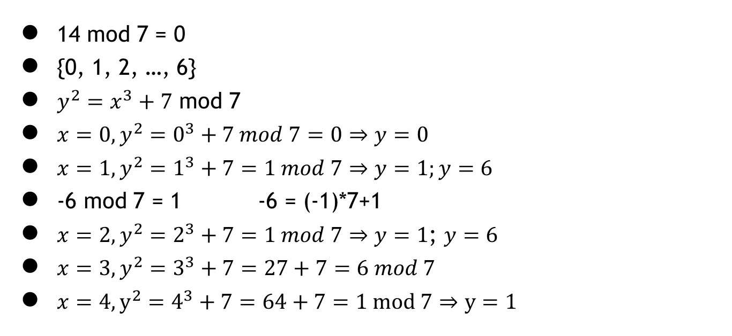
Modulo
14 mod 7 = 0
{0, 1, 2, …, 6}
$y^{2}=x^{3}+7$ mod 7
$x=0, y^{2}=0^{3}+7 mod 7=0⇒y=0$
$x=1, y^{2}=1^{3}+7=1 mod 7⇒y=1;y=6$
-6 mod 7 = 1 -6 = (-1)*7+1
$x=2, y^{2}=2^{3}+7=1 mod 7⇒y=1$; $y=6$
$x=3, y^{2}=3^{3}+7=27+7=6 mod 7$
$x=4, y^{2}=4^{3}+7=64+7=1 mod 7⇒y=1$

Slide 23
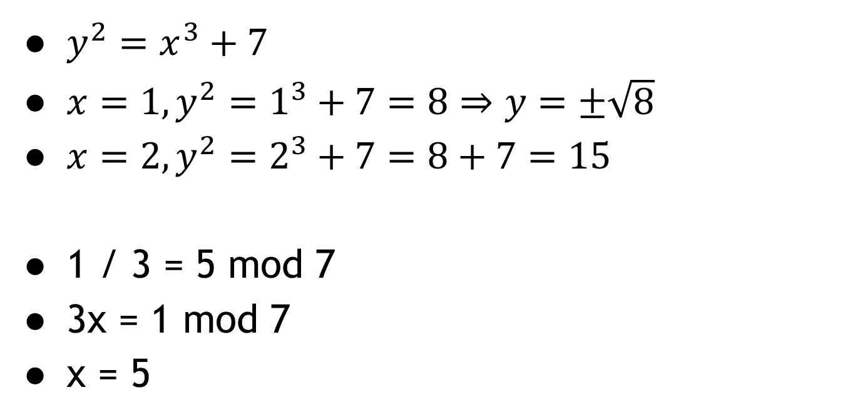
$y^{2}=x^{3}+7$
$x=1, y^{2}=1^{3}+7=8⇒y=±\sqrt{8}$
$x=2, y^{2}=2^{3}+7=8+7=15$
1 / 3 = 5 mod 7
3x = 1 mod 7
x = 5

Slide 24
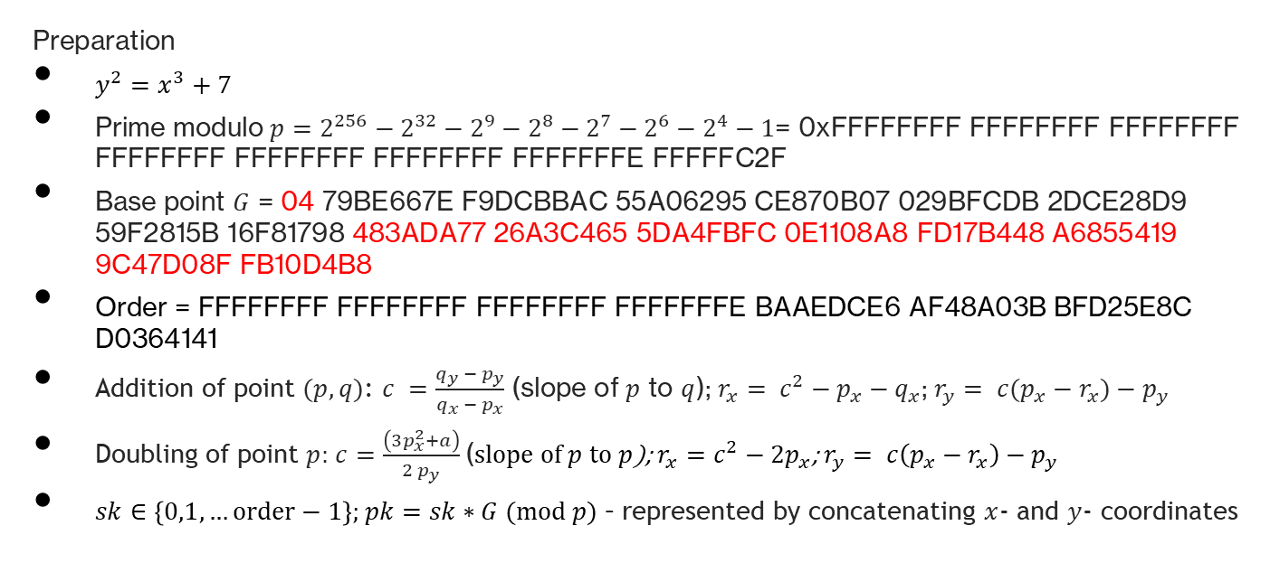
Summary of Bitcoin’s ECDSA (I)
Preparation
$y^{2}=x^{3}+7$
Prime modulo $p=2^{256}−2^{32}−2^{9}−2^{8}−2^{7}−2^{6}−2^{4}−1$= 0xFFFFFFFF FFFFFFFF FFFFFFFF FFFFFFFF FFFFFFFF FFFFFFFF FFFFFFFE FFFFFC2F
Base point $G$ = 04 79BE667E F9DCBBAC 55A06295 CE870B07 029BFCDB 2DCE28D9 59F2815B 16F81798 483ADA77 26A3C465 5DA4FBFC 0E1108A8 FD17B448 A6855419 9C47D08F FB10D4B8
Order = FFFFFFFF FFFFFFFF FFFFFFFF FFFFFFFE BAAEDCE6 AF48A03B BFD25E8C D0364141
Addition of point $(p,q)$: $c =\frac{q_{y} − p_{y}}{q_{x} − p_{x}}$ (slope of $p$ to $q$); $r_{x}= c^{2}−p_{x}−q_{x}$; $r_{y}= c(p_{x}−r_{x})−p_{y}$
Doubling of point $p$: $c=\frac{\left(3p_{x}^{2}+a\right)}{2 p_{y}}$ (slope of $p$ to $p$); $r_{x}=c^{2}−2p_{x}$; $r_{y}= c\left(p_{x}−r_{x}\right)−p_{y}$
$sk∈\left\{0,1,…order−1\right\}$; $pk=sk∗G (mod p)$ – represented by concatenating $x$- and $y$- coordinates

Slide 25
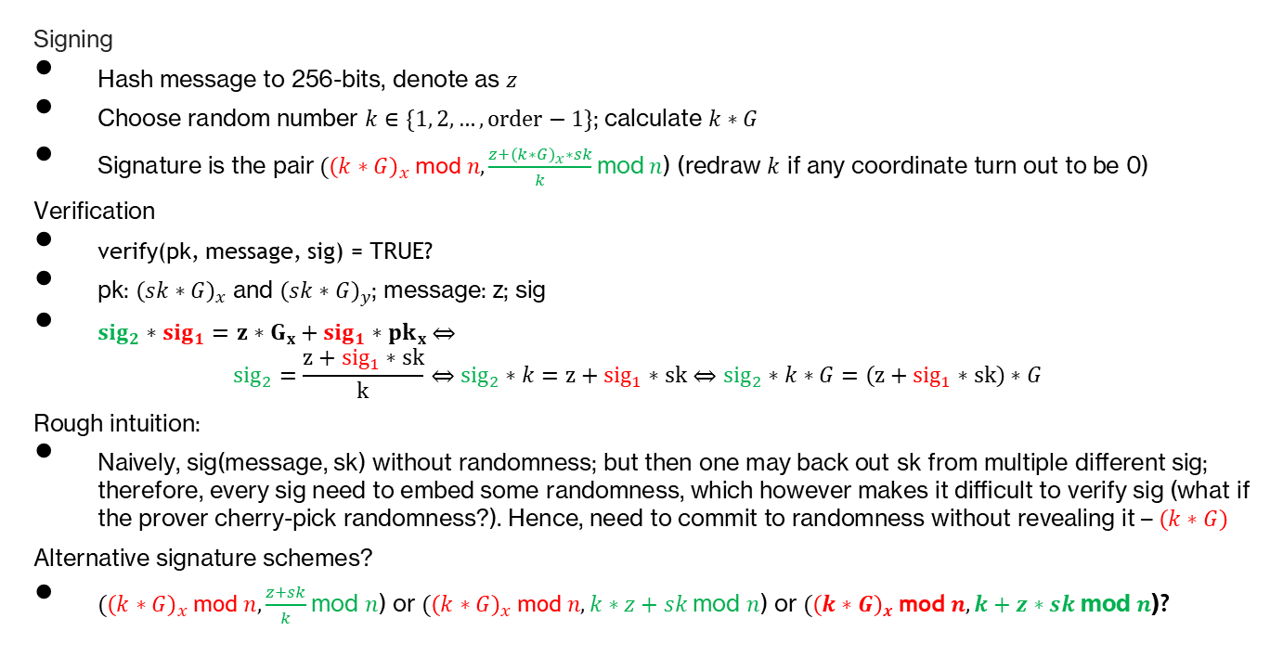
Summary of Bitcoin’s ECDSA (II)
Signing
Hash message to 256-bits, denote as $z$
Choose random number $k∈\{1, 2, …, order−1\}$; calculate $k∗G$
Signature is the pair $({\left(k∗G\right)}_{x}$mod$n, \frac{z+{\left(k∗G\right)}_{x}∗sk}{k}$mod $n$) (redraw $k$ if any coordinate turn out to be 0)
Verification
verify(pk, message, sig) = TRUE?
pk: ${\left(sk∗G\right)}_{x}$ and ${\left(sk∗G\right)}_{y}$; message: z; sig
${sig}_{2}∗{sig}_{1}=$ $z∗G_{x}+{sig}_{1}∗{pk}_{x}$ $⇔$
$${sig}_{2}=\frac{z+{sig}_{1}∗sk}{k}⇔{sig}_{2}∗k=z+{sig}_{1}∗sk⇔{sig}_{2}∗k∗G=\left(z+{sig}_{1}∗sk\right)∗G$$
Rough intuition:
Naively, sig(message, sk) without randomness; but then one may back out sk from multiple different sig; therefore, every sig need to embed some randomness, which however makes it difficult to verify sig (what if the prover cherry-pick randomness?). Hence, need to commit to randomness without revealing it – $\left(k∗G\right)$
Alternative signature schemes?
$({\left(k∗G\right)}_{x}$mod$n, \frac{z+sk}{k}$mod $n$) or $({\left(k∗G\right)}_{x}$mod$n, k∗z+sk$mod $n$) or $({\left(k∗G\right)}_{x}$mod$n, k+z∗sk$mod $n$)?

Slide 26
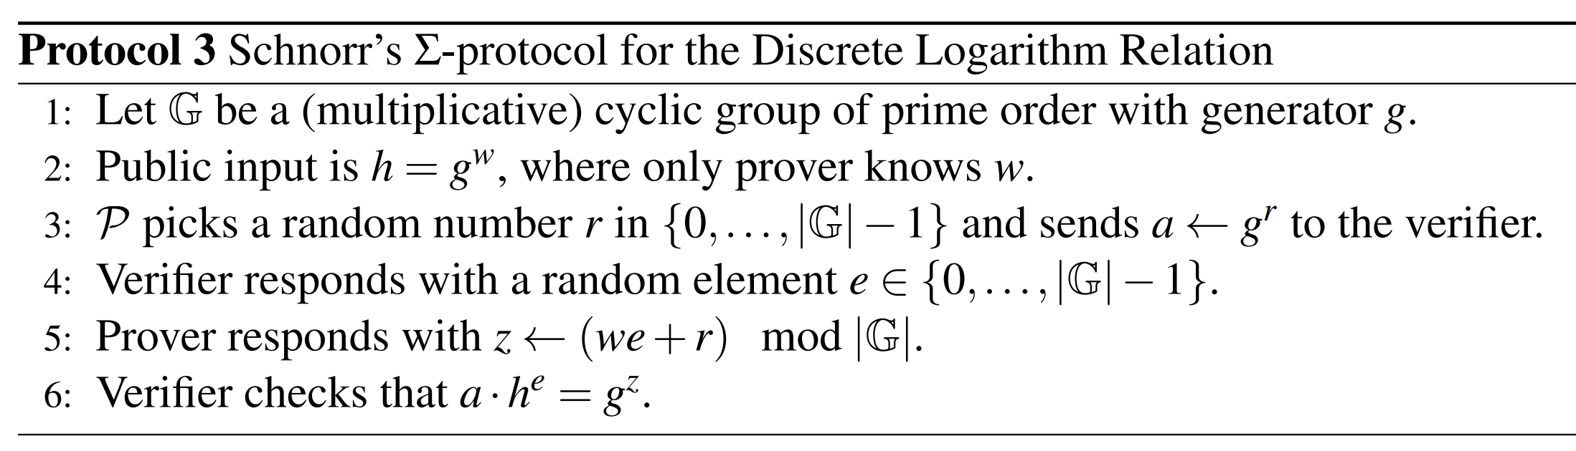


Relation to other cryptography fields
The last proposal: $({\left(k∗G\right)}_{x}$mod$n, k+z∗sk$mod $n$)?
Source: Thaler (2022) Chapter 12
A mapping from Schnorr’s $Σ$-protocol to our alternative ECDSA scheme
$g→G$, $w→sk$, $h→pk$, $r→k$, $a→sig_{1}$, $e→z$, $z→sk∗z+k$

Slide 27
Lecture 1.4:
Public Keys as Identities

Slide 28
Useful trick: public key == an identity
if you see sig such that verify(pk, msg, sig)==true,
think of it as
pk says, “[msg]”.
to “speak for” pk, you must know matching secret key sk

Slide 29
How to make a new identity
create a new, random key-pair (sk, pk)
pk is the public “name” you can use
[usually better to use Hash(pk)]
sk lets you “speak for” the identity
you control the identity, because only you know sk
if pk “looks random”, nobody needs to know who you are

Slide 30
Commercial services to de-anonymize bitcoin/crypto
Chainalysis
Sarah Meikeljohn (UCL) et al: A fistful of Bitcoins: characterizing payments among men with no names https://dl.acm.org/doi/10.1145/2896384
Blockchain intelligence group
Nansen
Foley, Karlsen, Putniņš (2019) RFS (first in finance)
https://academic.oup.com/rfs/article/32/5/1798/5427781
Measuring illicit activity in defi: The case of ethereum
https://link.springer.com/chapter/10.1007/978-3-662-63958-0_18 (similar methods to Foley, Karlsen, Putniņš (2019) but on Ethereum, also newer data and quite different findings).

Slide 31
Decentralized identity management
anybody can make a new identity at any time
make as many as you want!
no central point of coordination
These identities are called “addresses” in Bitcoin.

Slide 32
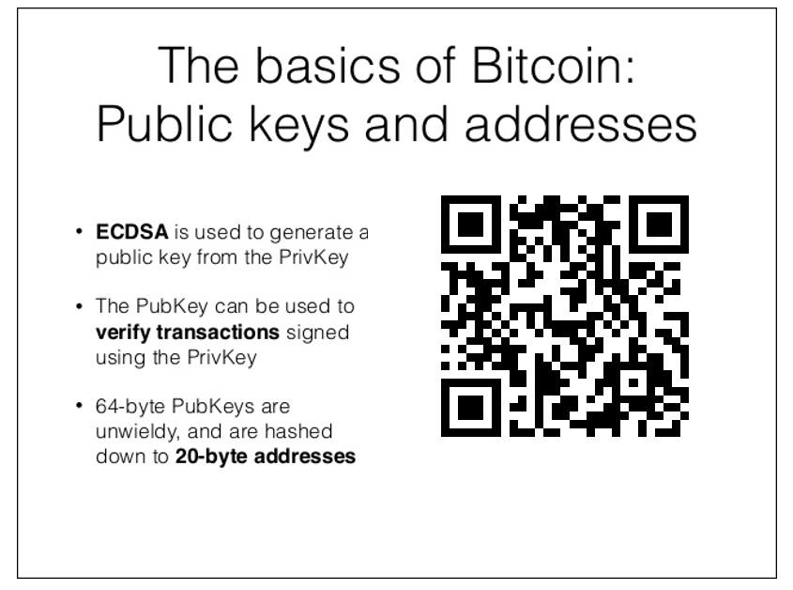
1KxRrFXyLo2d4P1toMizuP4g1HriieZjMM

Slide 33
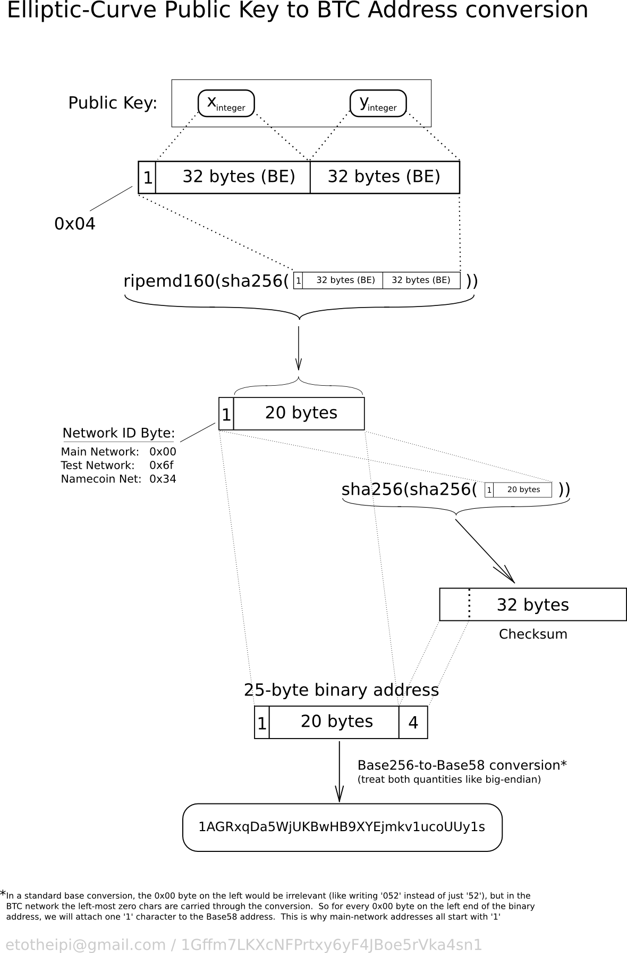

Slide 34
Privacy
Addresses not directly connected to real-world identity.
But observer can link together an address’s activity over time, make inferences.
https://www.chainalysis.com/
https://blockchaingroup.io/
Later: (maybe) more lectures on privacy in Bitcoin ...

Slide 35
Lecture 1.5:
Simple Cryptocurrencies

Slide 36

GoofyCoin

Slide 37
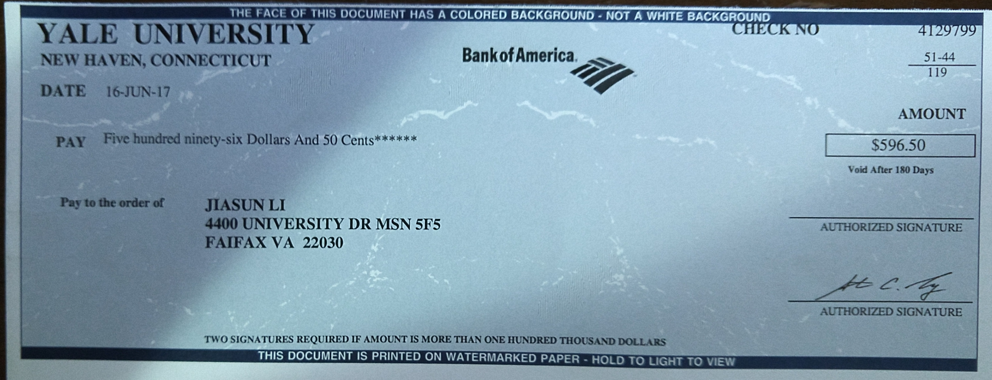

Slide 38
Goofy can create new coins
New coins belong to me.
signed by pk_{Goofy}
CreateCoin [uniqueCoinID]

Slide 39
A coin’s owner can spend it.
Alice owns it now.
signed by pk_{Goofy}
Pay to pk_{Alice} : H( )
signed by pk_{Goofy}
CreateCoin [uniqueCoinID]

Slide 40

The recipient can pass on the coin again.
signed by pk_{Alice}
Bob owns it now.
Pay to pk_{Bob} : H( )
signed by pk_{Goofy}
Pay to pk_{Alice} : H( )
signed by pk_{Goofy}
CreateCoin [uniqueCoinID]

Slide 41
Recall about a check again!

Slide 42
double-spending attack
signed by pk_{Alice}
signed by pk_{Alice}
Pay to pk_{Bob} : H( )
Pay to pk_{Chuck} : H( )
signed by pk_{Goofy}
Pay to pk_{Alice} : H( )
signed by pk_{Goofy}
CreateCoin [uniqueCoinID]

Slide 43
double-spending attack
the main design challenge in digital currency
Can you think about a good way to bypass this problem?
Quantum One-Shot Signatures (https://www.btq.com/blog/one-shot-signatures-new-paradigm-in-quantum-cryptography)
Sui: fast / slow path of transaction processing. Can the fast path be extended in some ways to avoid double-spending without introducing intermediaries?

Slide 44
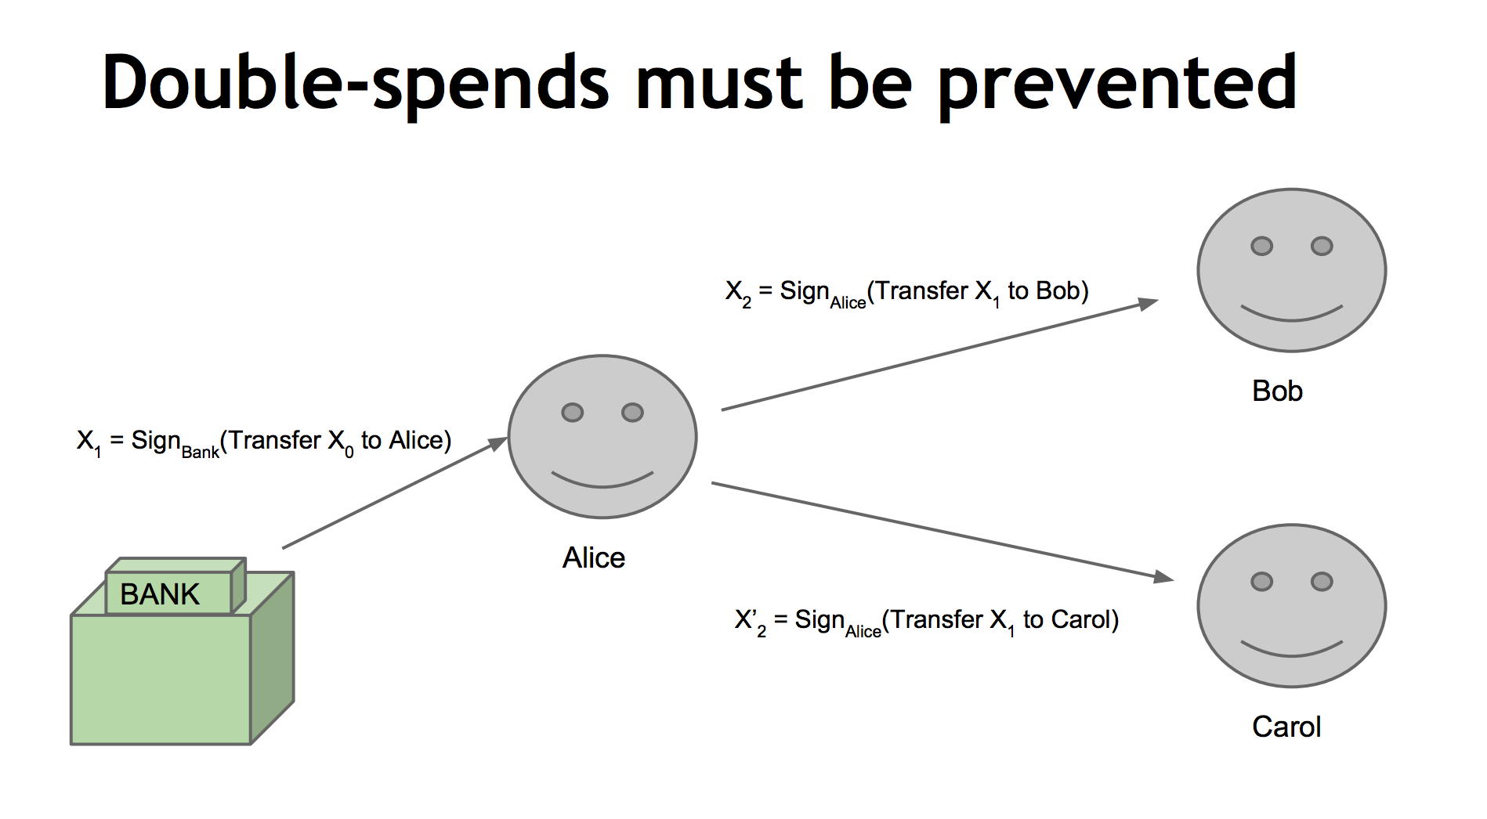

Slide 45
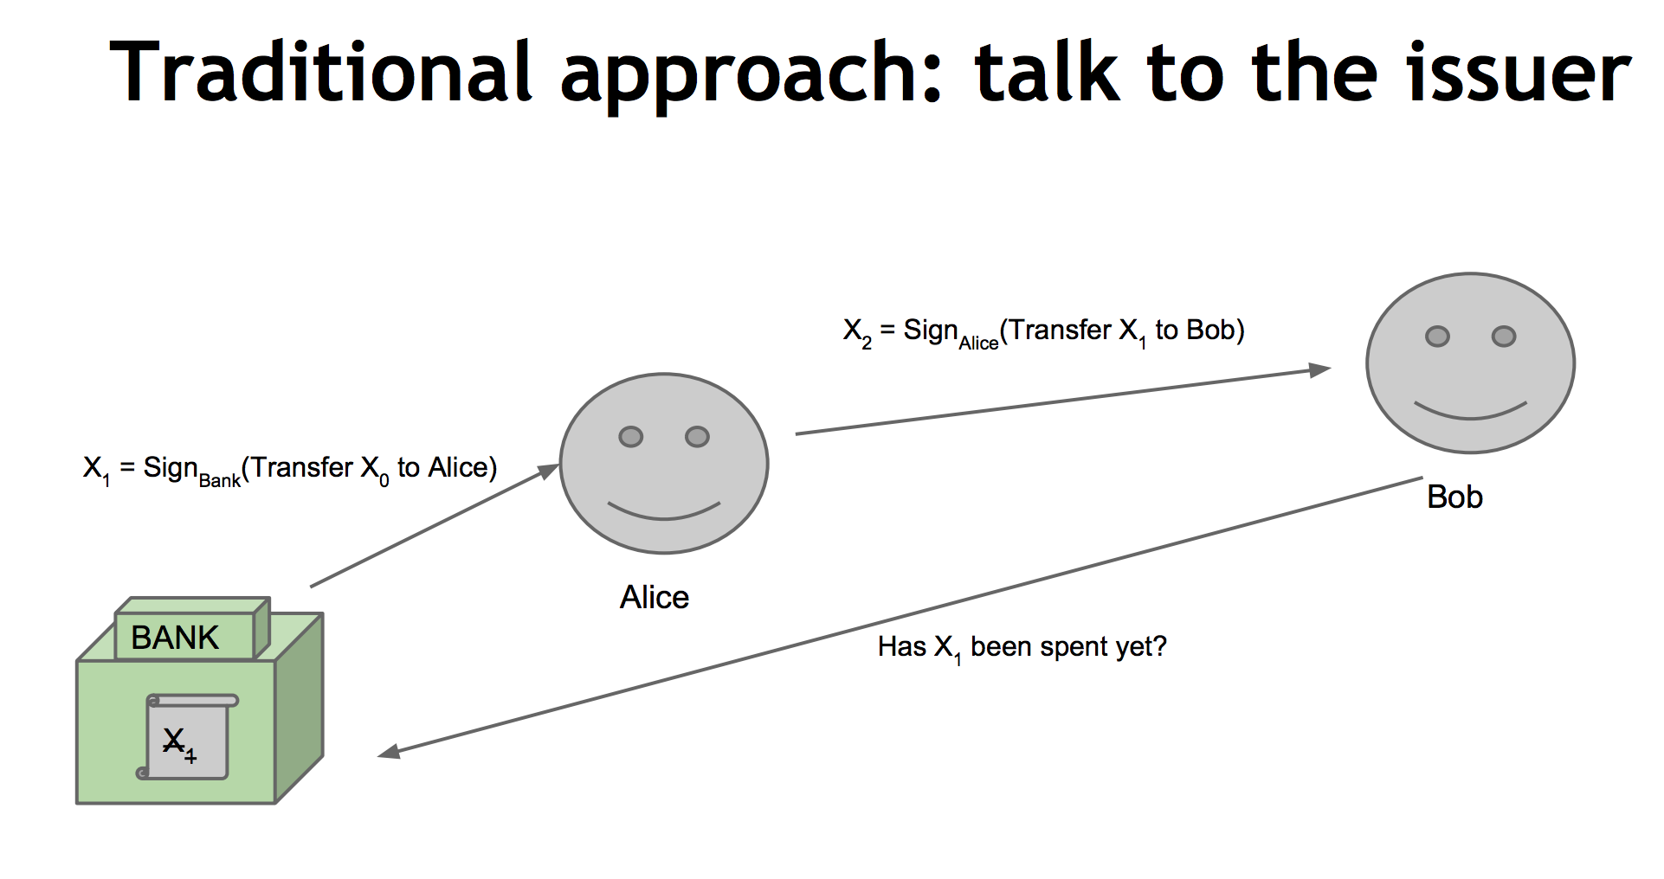

Slide 46

ScroogeCoin

Slide 48
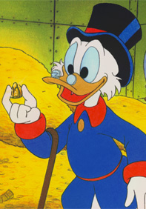
Scrooge publishes a history of all transactions
(a block chain, signed by Scrooge)
H( )
prev: H( )
prev: H( )
prev: H( )
transID: 71
transID: 72
transID: 73
trans
trans
trans
optimization: put multiple transactions in the same block

Slide 49
CreateCoins transaction creates new coins
Valid, because I said so.
transID: 73 type:CreateCoins
coins created
num | value | recipient
0 | 3.2 | 0x...
1 | 1.4 | 0x...
2 | 7.1 | 0x...
coinID 73(0)
coinID 73(1)
coinID 73(2)

Slide 50
PayCoins transaction consumes (and destroys) some coins,
and creates new coins of the same total value
transID: 73 type:PayCoins
consumed coinIDs:
68(1), 42(0), 72(3)
Valid if:
-- consumed coins valid,
-- not already consumed,
-- total value out = total value in, and
-- signed by owners of all consumed coins
coins created
num | value | recipient
0 | 3.2 | 0x...
1 | 1.4 | 0x...
2 | 7.1 | 0x...
signatures

Slide 51
Immutable coins
Coins can’t be transferred, subdivided, or combined.
But: you can get the same effect by using transactions
to subdivide: create new trans
consume your coin
pay out two new coins to yourself

Slide 52
Don’t worry, I’m honest.
Crucial question:
Can we descroogify the currency, and operate without any central, trusted party?

