Slide 1
Part 2
How Bitcoin Achieves Decentralization

Slide 2
Lecture 2.1:
Centralization vs. decentralization

Slide 3
Centralization vs. decentralization
Competing paradigms that underlie many digital technologies

Slide 4
Decentralization is not all-or-nothing
E-mail: decentralized protocol, but dominated by centralized webmail services
Cloud service:
logically centralized; with distributed elements
Equifax?

Slide 5
Aspects of decentralization in Bitcoin
Who maintains the ledger?
Who has authority over which transactions are valid?
Who creates new bitcoins?
Who determines how the rules of the system change?
How do bitcoins acquire exchange value?
Beyond the protocol:
exchanges, wallet software, service providers...

Slide 6
Aspects of decentralization in Bitcoin
Peer-to-peer network:
open to anyone, low barrier to entry
Mining:
open to anyone, but inevitable concentration of power
often seen as undesirable (Decentralized Mining in Centralized Pools)
Updates to software: https://github.com/bitcoin/bitcoin
core developers trusted by community, have great power
(De)Centralization in Blockchain Open-Source Development Community: https://scholarspace.manoa.hawaii.edu/items/d2cf4ede-34cf-4259-bceb-17a737ba354d

Slide 7
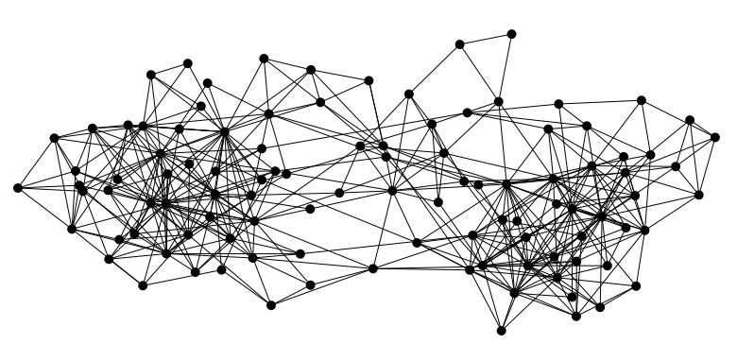

Bitcoin is a peer-to-peer system
When Alice wants to pay Bob: she broadcasts the transaction to all Bitcoin nodes
signed by Alice
Pay to pk_{Bob} : H( )
Note: Bob’s computer is not in the picture

Slide 8
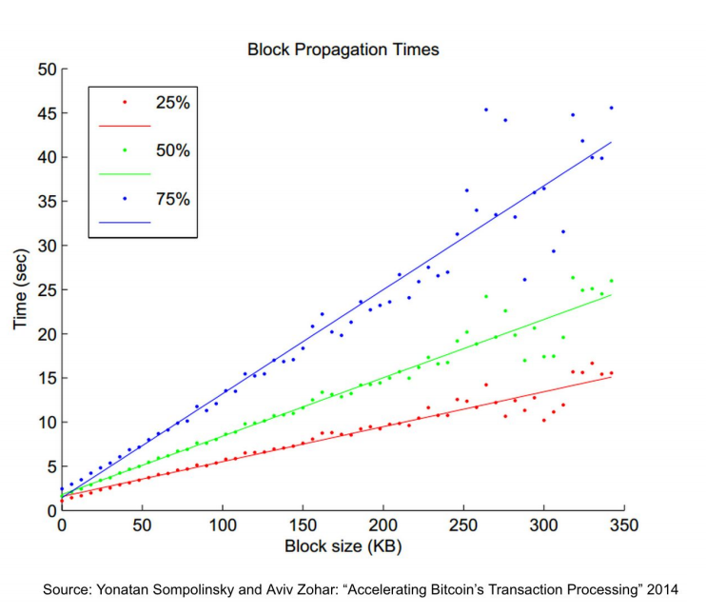
Bitcoin P2P network
https://ieeexplore.ieee.org/stamp/stamp.jsp?arnumber=8703385

Slide 9
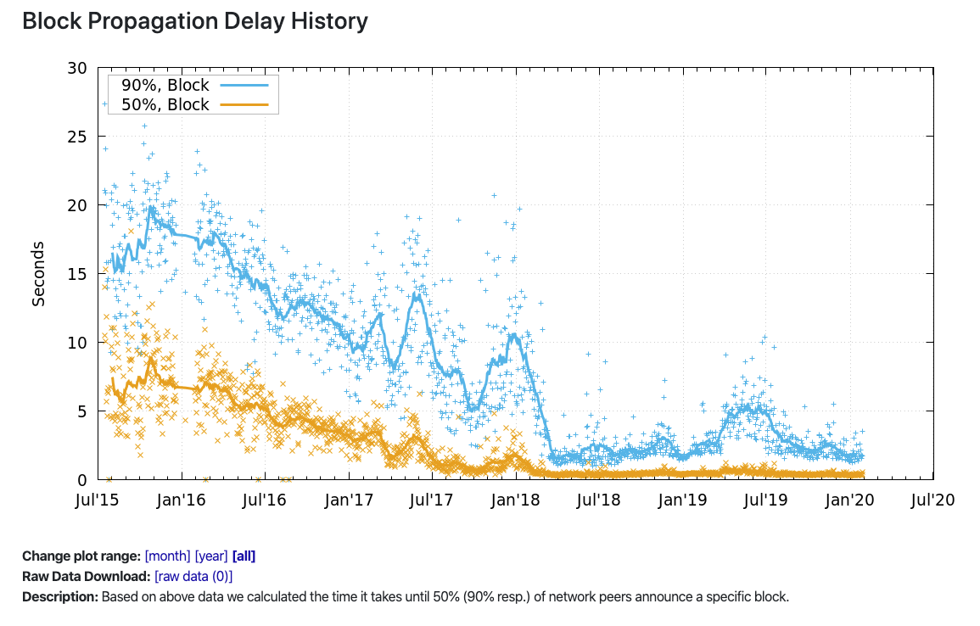
https://nakamoto.com/bitcoins-p2p-network/

Slide 10
Aspects of decentralization in Bitcoin
Peer-to-peer network:
open to anyone, low barrier to entry
Mining:
open to anyone, but inevitable concentration of power
often seen as undesirable (Decentralized Mining in Centralized Pools)
Updates to software: https://github.com/bitcoin/bitcoin
core developers trusted by community, have great power
(De)Centralization in Blockchain Open-Source Development Community: https://scholarspace.manoa.hawaii.edu/items/d2cf4ede-34cf-4259-bceb-17a737ba354d

Slide 11
Lecture 2.2:
Distributed consensus

Slide 12
Bitcoin’s key challenge
Key technical challenge of decentralized e-cash: distributed consensus
or: how to decentralize ScroogeCoin
(remove the need to trust Scrooge)

Slide 13
Why consensus protocols?
Traditional motivation: reliability in distributed systems
Distributed key-value store enables various applications:
DNS, public key directory, stock trades …
Good targets for Altcoins!

Slide 14
Defining distributed consensus
The protocol terminates and all correct nodes decide on the same value
This value must have been proposed by some correct node
Liveness
Safety/consistency
Non-trivialness

Slide 15
How consensus could work in Bitcoin
At any given time:
All nodes have a sequence of blocks of transactions they’ve reached consensus on
Each node has a set of outstanding transactions it’s heard about

Slide 16



How consensus could work in Bitcoin
Tx
Tx
…
Tx
Tx
Tx
Tx
Tx
Tx
Tx
…
…
…
Consensus
protocol
Tx
Tx
Tx
Tx
Tx
Tx
Tx
…
…
Tx
Tx
OK to select any valid block, even if proposed by only one node

Slide 17
Why consensus is hard
Nodes may crash
Nodes may be malicious
Network is imperfect
Not all pairs of nodes connected
Faults in network
Latency
No notion of global time
Notes:
Analogy of talking on the phone and having a lag

Slide 18
Impossibility results
Fischer-Lynch-Paterson (deterministic nodes): consensus impossible with a single faulty node
These results say more about the model than about the problem
The models were developed to study systems like distributed databases
e.g., Ben-Or randomized algorithm

Slide 19
Some well-known protocols
Example: Paxos/Raft
Never produces inconsistent result, but can (rarely) get stuck
Byzantine generals problem

Slide 20
Bitcoin consensus: theory & practice
Originally Bitcoin consensus works better in practice than in theory
Theory is catching up (e.g. The blockchain folk theorem)
BUT theory is important, can help predict unforeseen attacks (selfish-mining, etc.)

Slide 21
Some things Bitcoin does differently
Introduces incentives
Possible only because it’s a currency!
Embraces randomness
Does away with the notion of a specific end-point
Consensus happens over long time scales — about 1 hour

Slide 22
Lecture 2.3:
Consensus without identity: the block chain

Slide 23
Why identity?
Pragmatic: some protocols need node IDs
Security: assume less than 50% malicious

Slide 24
Why don’t Bitcoin nodes have identities?
Identity is hard in a P2P system — Sybil attack
Pseudonymity is a goal of Bitcoin

Slide 25
Weaker assumption: select random node
Analogy: lottery or raffle
When tracking & verifying identities is hard, we give people tokens, tickets, etc.
Now we can pick a random ID & select that node

Slide 26
Key idea: implicit consensus
In each round, random node is picked
This node proposes the next block in the chain
Other nodes implicitly accept/reject this block
by either extending it
or ignoring it and extending chain from earlier block
Every block contains hash of the block it extends

Slide 27
Consensus algorithm (simplified)
New transactions are broadcast to all nodes
Each node collects new transactions into a block
In each round a random node gets to broadcast its block
Other nodes accept the block only if all transactions in it are valid (unspent, valid signatures)
Nodes express their acceptance of the block by including its hash in the next block they create

Slide 28
What can a malicious node do?
Double-spending attack
signed by A
C_{A} → B
Pay to pk_{B} : H( )
signed by A
C_{A} → A’
Pay to pk_{A’} : H( )
Honest nodes will extend the longest valid branch
Notes:
Can’t create new transactions from someone else’s address, or modify them.
Suppressing tx’s is only a minor annoyance.

Slide 29
From Bob the merchant’s point of view
1 confirmation
3 confirmations
C_{A} → B
Double-spend probability decreases exponentially with # of confirmations
Most common heuristic: 6 confirmations
C_{A} → A’
double-spend attempt
Hear about C_{A} → B transaction
0 confirmations

Slide 30
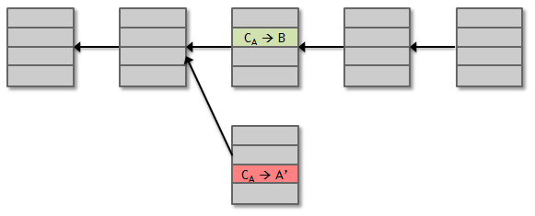
Recap
Protection against invalid transactions is cryptographic, but enforced by consensus
Protection against double-spending is purely by consensus
You’re never 100% sure a transaction is in consensus branch. Guarantee is probabilistic

Slide 31
Lecture 2.4:
Incentives and proof of work

Slide 32
Assumption of honesty is problematic
Can we give nodes incentives for behaving honestly?
Everything so far is just a distributed consensus protocol
But now we utilize the fact that the currency has value
Can we reward nodes that created these blocks?
Can we penalize the node that created this block?

Slide 33
Incentive 1: block reward
Creator of block gets to
include special coin-creation transaction in the block
Coinbase transaction
choose recipient address of this transaction
Value is fixed: currently 3.125 BTC, halves every 4 years
Block creator gets to “collect” the reward only if the block ends up on long-term consensus branch!

Slide 34
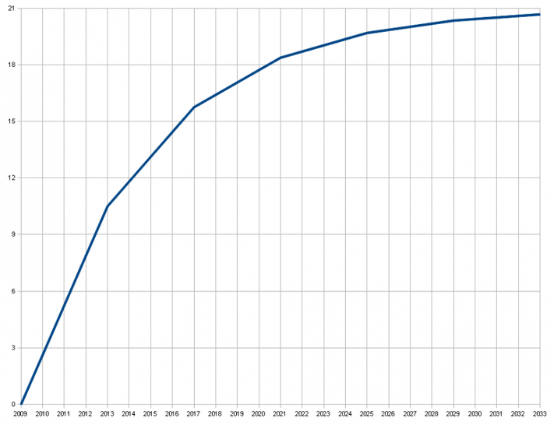
There’s a finite supply of bitcoins
Total supply: 21 million
Block reward is how new bitcoins are created
Runs out in 2140. No new bitcoins unless rules change
Total bitcoins in circulation
First inflection point: reward halved from 50BTC to 25BTC
Year

Slide 35
Incentive 2: transaction fees
Creator of transaction can choose to make
output value less than input value
Remainder is a transaction fee and goes to block creator
Purely voluntary, like a tip
https://faculty.chicagobooth.edu/jacob.leshno/Research/Bitcoin%20Market%20Design.pdf
https://www.microsoft.com/en-us/research/video/monopoly-without-monopolist-economic-analysis-bitcoin/

Slide 36
Remaining problems
How to pick a random node?
How to avoid a free-for-all due to rewards?
How to prevent Sybil attacks?

Slide 37
Mining Illustration
https://andersbrownworth.com/blockchain/blockchain

Slide 38
Proof of work
To approximate selecting a random node:
select nodes in proportion to a resource that no one can monopolize (we hope)
In proportion to computing power: proof-of-work
In proportion to ownership: proof-of-stake

Slide 39
Equivalent views of proof of work
Select nodes in proportion to computing power
2. Let nodes compete for right to create block
3. Make it moderately hard to create new identities

Slide 40
Hash puzzles
nonce
To create block, find nonce s.t.
H(nonce ‖ prev_hash ‖ tx ‖ … ‖ tx) is very small
prev_h
Tx
Tx
Output space of hash
Target
space
If hash function is secure:
only way to succeed is to try enough nonces until you get lucky
Notes:
If Alice has 100x more computing power than Bob it doesn’t mean she always wins the race. It means she has about a 99% chance of wining. In the long run Bob will create 1% of the blocks

Slide 41
PoW property 1: difficult to compute
As of Aug 2014: about 10²⁰ hashes/block
Only some nodes bother to compete — miners

Slide 42
PoW property 2: parameterizable cost
Nodes automatically re-calculate the target roughly every two weeks
(6*24*14 = 144*14 = 2016 blocks)
Goal: average time between blocks = 10 minutes
Prob (Alice wins next block) =
fraction of global hash power she controls
Notes:
what happens if time b/w blocks is too low or too high

Slide 43
Key security assumption
Attacks infeasible if majority of miners weighted by hash power follow the protocol

Slide 44
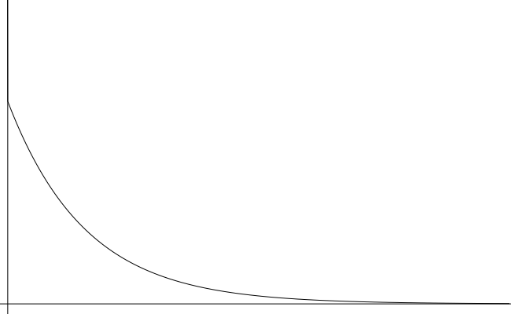
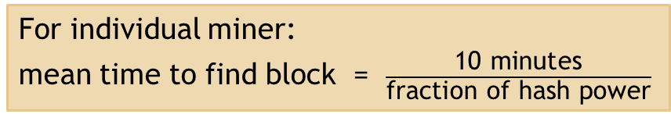
Solving hash puzzles is probabilistic
10
minutes
Probability density
Time to next block (entire network)

Slide 45
PoW property 3: trivial to verify
Nonce must be published as part of block
Other miners simply verify that
H(nonce ‖ prev_hash ‖ tx ‖ … ‖ tx) < target

Slide 46
Mining economics
Complications:
fixed vs. variable costs (my conversation with Canaan)
reward depends on global hash rate
If mining reward (block reward + Tx fees) | > | hardware + electricity cost | → | Profit

Slide 47
Lecture 2.5:
Putting it all together

Slide 48
Recap
Identities
Transactions
P2P network
Block chain & consensus
Hash puzzles & mining

Slide 49
Bitcoin has three types of consensus
Value
State
Rules

Slide 50
Bitcoin is bootstrapped
security of block chain
health of mining ecosystem
value of currency

Slide 51
What can a “51% attacker” do?
Steal coins from existing address?
Suppress some transactions?
From the block chain
From the P2P network
Change the block reward?
Destroy confidence in Bitcoin?
✗
✓
✗
✗
✓✓

Slide 52
Remaining questions
How do we get from consensus to currency?
What else can we do with consensus?

