Slide 1
Consensus Introduction to Byzantine Fault Tolerance Problems
Jiasun Li

Slide 2
Consensus algorithm (simplified)
New transactions are broadcast to all nodes
Each node collects new transactions into a block
In each round a random node gets to broadcast its block
Other nodes accept the block only if all transactions in it are valid (unspent, valid signatures)
Nodes express their acceptance of the block by including its hash in the next block they create

Slide 3
Consensus protocols
Byzantine generals Problem
Two generals problem
Agreement/broadcasting problem; State-machine replication
Nakamoto consensus
pBFT: practical Byzantine Fault tolerance protocol
HotStuff (Libra-BFT/Diem)
Tendermint, etc. (Cosmos, Substrate, Polkadot)

Slide 4
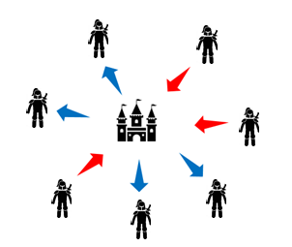
Byzantine generals Problem

Slide 5
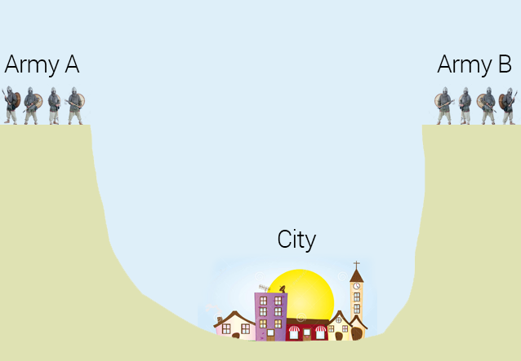
Two generals problem

Slide 6

Higher-order belief/knowledge

Slide 7

Higher-order belief/knowledge

Slide 8
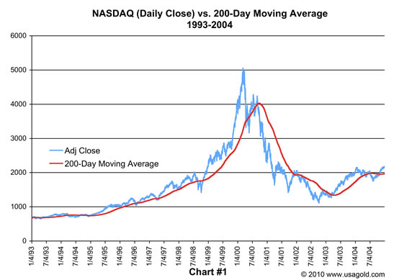
Higher-order belief/knowledge

Slide 9
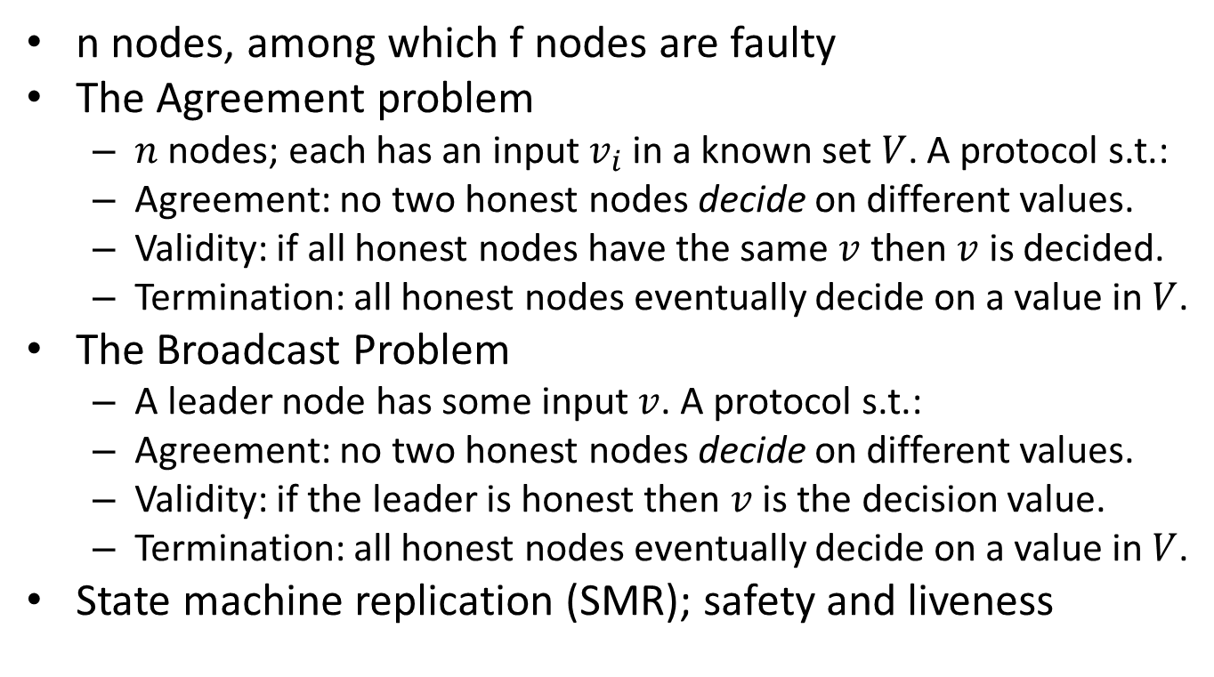
The problem
n nodes, among which f nodes are faulty
The Agreement problem
$n$nodes; each has an input $v_{i}$ in a known set $V$. A protocol s.t.:
Agreement: no two honest nodes decide on different values.
Validity: if all honest nodes have the same $v$ then $v$ is decided.
Termination: all honest nodes eventually decide on a value in $V$.
The Broadcast Problem
A leader node has some input $v$. A protocol s.t.:
Agreement: no two honest nodes decide on different values.
Validity: if the leader is honest then $v$ is the decision value.
Termination: all honest nodes eventually decide on a value in $V$.
State machine replication (SMR); safety and liveness

Slide 10
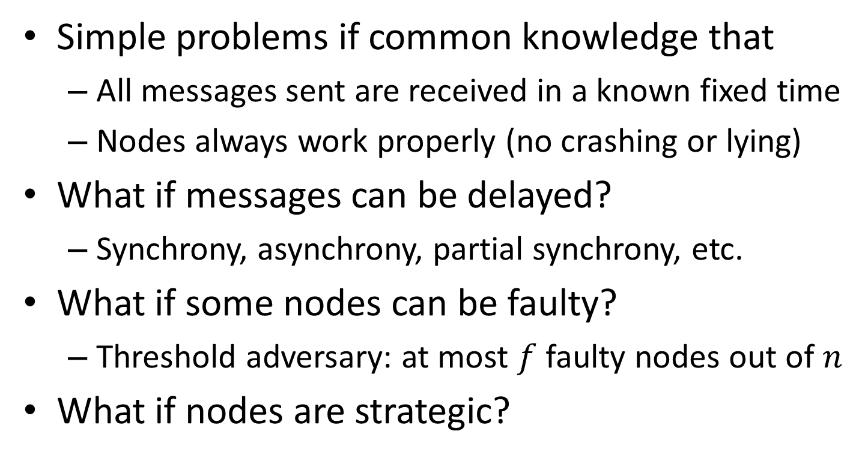
Examples
Simple problems if common knowledge that
All messages sent are received in a known fixed time
Nodes always work properly (no crashing or lying)
What if messages can be delayed?
Synchrony, asynchrony, partial synchrony, etc.
What if some nodes can be faulty?
Threshold adversary: at most $f$ faulty nodes out of $n$
What if nodes are strategic?

Slide 11
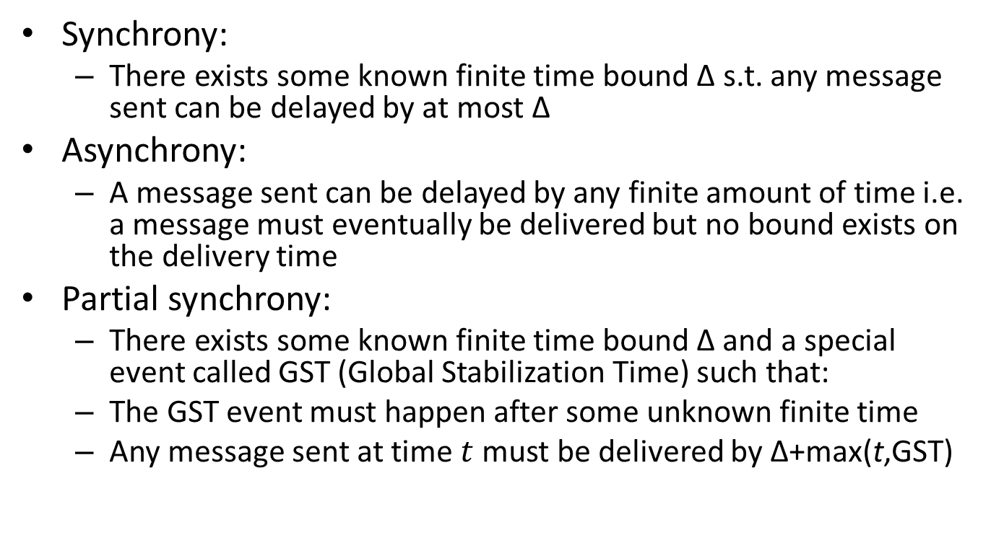
Communication model
Synchrony:
There exists some known finite time bound $\text{Δ}$ s.t. any message sent can be delayed by at most $\text{Δ}$
Asynchrony:
A message sent can be delayed by any finite amount of time i.e. a message must eventually be delivered but no bound exists on the delivery time
Partial synchrony:
There exists some known finite time bound Δ and a special event called GST (Global Stabilization Time) such that:
The GST event must happen after some unknown finite time
Any message sent at time $t$ must be delivered by $\text{Δ}\text{+}\text{max}\text{(}\text{t}\text{,}\text{GST}\text{)}$
Source: Decentralized Thoughts by Ittai Abraham adapting DLS88 (somehow differs from DLS88 from my reading…)

Slide 12
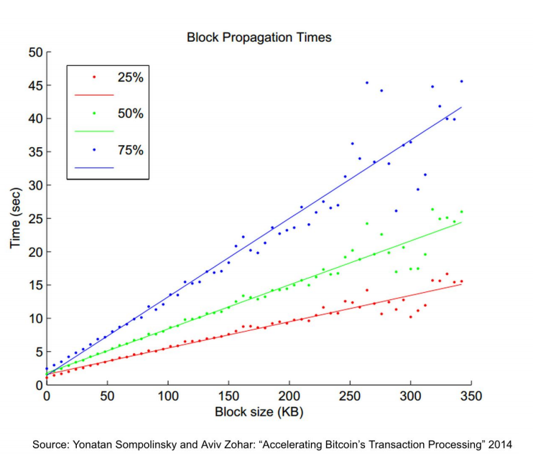

Slide 13
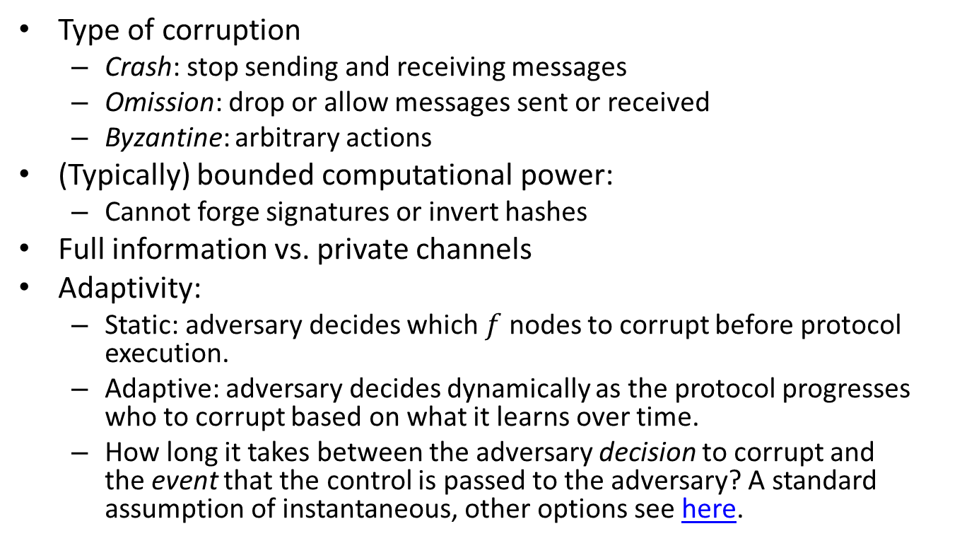
Fault Models
Type of corruption
Crash: stop sending and receiving messages
Omission: drop or allow messages sent or received
Byzantine: arbitrary actions
(Typically) bounded computational power:
Cannot forge signatures or invert hashes
Full information vs. private channels
Adaptivity:
Static: adversary decides which $f$ nodes to corrupt before protocol execution.
Adaptive: adversary decides dynamically as the protocol progresses who to corrupt based on what it learns over time.
How long it takes between the adversary decision to corrupt and the event that the control is passed to the adversary? A standard assumption of instantaneous, other options see here.

Slide 14
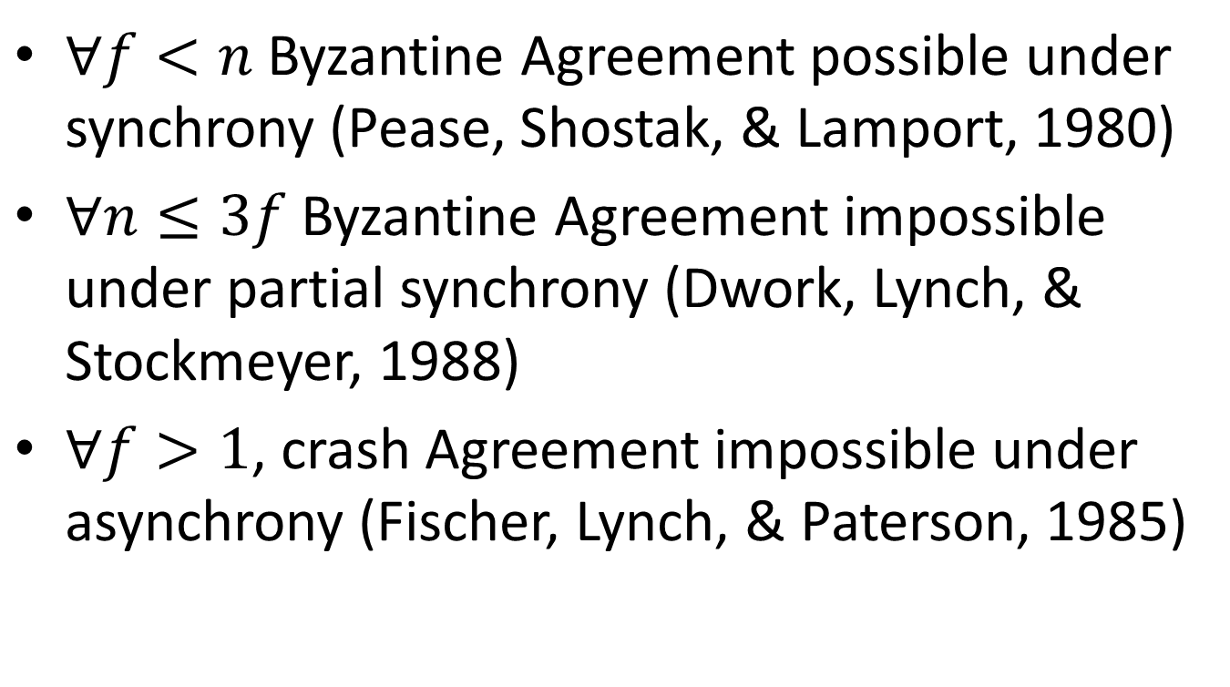
Some possibility/impossibility results
$∀f<n$ Byzantine Agreement possible under synchrony (Pease, Shostak, & Lamport, 1980)
$∀n≤3f$ Byzantine Agreement impossible under partial synchrony (Dwork, Lynch, & Stockmeyer, 1988)
$∀f>1$, crash Agreement impossible under asynchrony (Fischer, Lynch, & Paterson, 1985)

Slide 15
Synchrony
f<n: f+1 rounds of communication

Slide 16
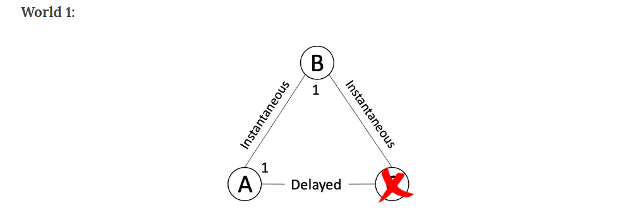
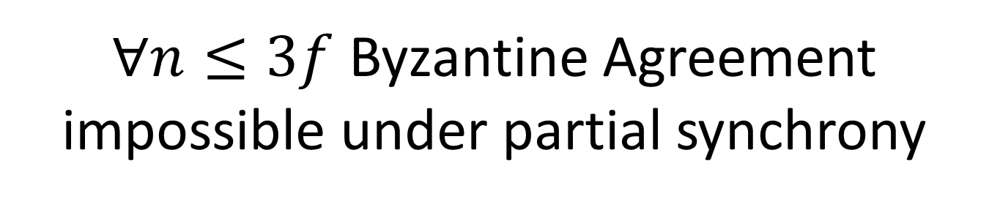
$∀n≤3f$ Byzantine Agreement impossible under partial synchrony

Slide 17
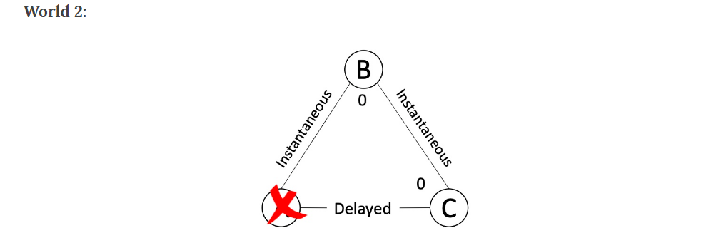
$∀n≤3f$ Byzantine Agreement impossible under partial synchrony

Slide 18
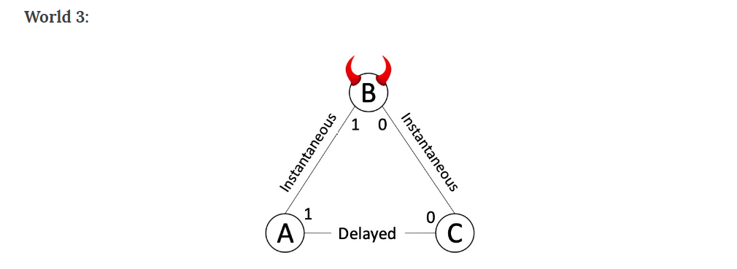
$∀n≤3f$ Byzantine Agreement impossible under partial synchrony

Slide 19
Recent BFT development in Blockchain
Tendermint (Buchman, 2016)
BFT in the Age of Blockchains
Casper (Buterin and Griffith 2017)
Casper the Friendly Finality Gadget
Hot-Stuff (AGM 2018)
Hot-Stuff the Linear One-Message BFT Devil

Slide 20
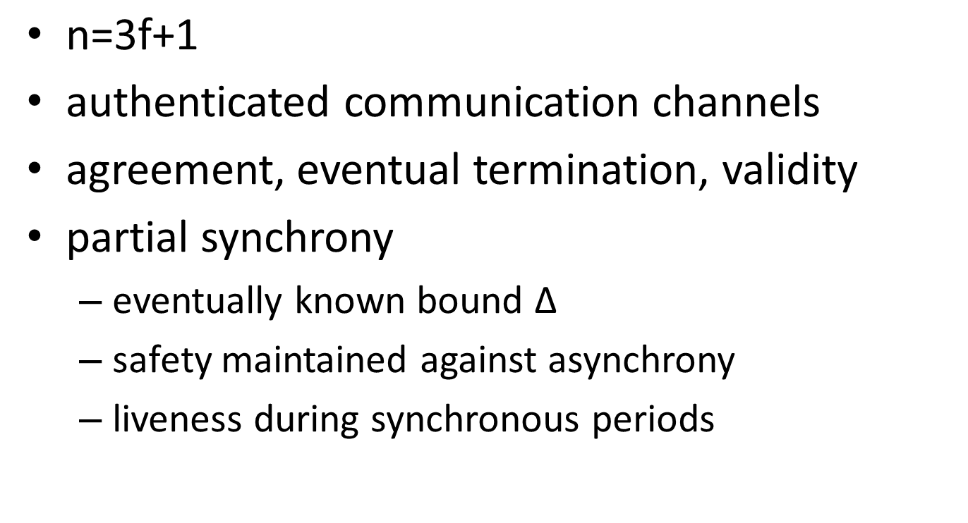
BFT Consensus
$\text{n}\text{=3}\text{f}\text{+1}$
authenticated communication channels
agreement, eventual termination, validity
partial synchrony
eventually known bound ∆
safety maintained against asynchrony
liveness during synchronous periods

Slide 21
Libra-BFT
Adaption of HotStuff
My understanding: marrying BFT and NC

Slide 22
Libra (Diem)
A “stablecoin” solution
Like MakerDAO, Tether, GUSD, USDC, etc.
(so far) a permissioned system with 21 nodes
Folded last year

