Slide 1

Smart Contract for Information Aggregation?
Jiasun Li
Assistant Professor of Finance
George Mason University

Slide 2
The question
Smart contract replicate market functions
Uniswap, Bancor, …
Contracts vs. markets
Classic topics in economics, too
Firm as a nexus of contracts vs. market (Coase 1937, Alchian & Demsetz 1972)
One important function of the market: information aggregation
Efficient market hypothesis (Fama 1970)
Rational expectation models (Grossman & Stiglitz 1980, Kyle 1989)
Information aggregation via contracts -- specifically smart contracts?

Slide 3
Information aggregation via market
A group of traders

Slide 4

Information aggregation via market
$$s_{2}$$
𝑠_2
$$s_{3}$$
𝑠_3
$$s_{1}$$
𝑠_1
A group of traders
Each has a private signal $s$

Slide 5

Information aggregation via market
$$x_{2}(s_{2},p)$$
𝑥_2 (𝑠_2,𝑝)
$$x_{3}(s_{3},p)$$
𝑥_3 (𝑠_3,𝑝)
$$x_{1}(s_{1},p)$$
𝑥_1 (𝑠_1,𝑝)
A group of traders
Each has a private signal $s$
Submit a set of limit orders
A demand schedule $x(s,p)$

Slide 6
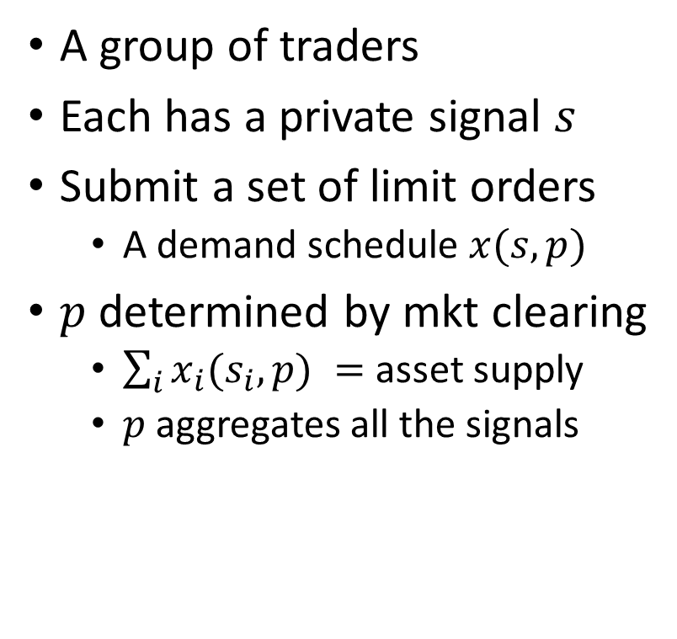

Information aggregation via market
$$x_{2}(s_{2},p)$$
𝑥_2 (𝑠_2,𝑝)
$$x_{3}(s_{3},p)$$
𝑥_3 (𝑠_3,𝑝)
$$x_{1}(s_{1},p)$$
𝑥_1 (𝑠_1,𝑝)
A group of traders
Each has a private signal $s$
Submit a set of limit orders
A demand schedule $x(s,p)$
$p$ determined by mkt clearing
$\sum_{i}{x_{i}(s_{i},p) }=$ asset supply
$p$ aggregates all the signals
$$p$$

Slide 7
Analogy: Information aggregation via contract
A group of investors

Slide 8

Analogy: Information aggregation via contract
$$s_{2}$$
𝑠_2
$$s_{3}$$
𝑠_3
$$s_{1}$$
𝑠_1
A group of investors
Each has a private signal $s$

Slide 9
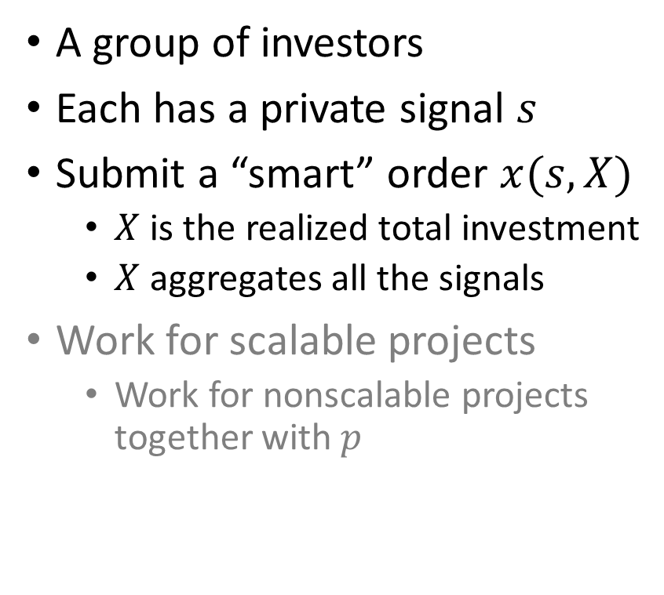
Analogy: Information aggregation via contract
$$x_{2}(s_{2},X)$$
𝑥_2 (𝑠_2,𝑋)
$$x_{3}(s_{3},X)$$
𝑥_3 (𝑠_3,𝑋)
$$x_{1}(s_{1},X)$$
𝑥_1 (𝑠_1,𝑋)
A group of investors
Each has a private signal $s$
Submit a “smart” order $x(s,X)$
$X$ is the realized total investment
$X$ aggregates all the signals
Work for scalable projects
Work for nonscalable projects together with $p$

Slide 10
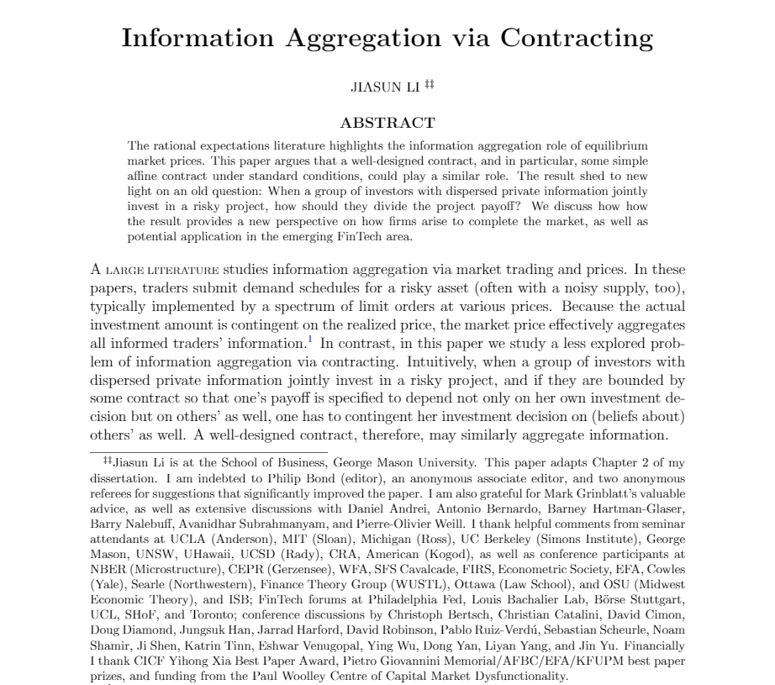

Slide 11
Going beyond investment
Re-interpret monetary investment as
providing other production inputs (e.g. effort, human capital)
Contracts vs. markets in terms of
organizing general business activities
for efficient uses of everyone’s information
Old wisdom with new insight
Old wisdom: Firm as a nexus of contracts
New insight (maybe): DAO as a nexus of smart contracts

